Slide 1
GOES-R LAP Profiles
Zhenglong Li, Jinlong Li, Pei Wang, Rich Dworak,
Scott Lindstrom
University of Wisconsin-Madison CIMSS
(Cooperative Institute for Meteorological Satellite Studies)
Updated April 2025
Past contributors: Jun Li, Yong-Keun Lee, Tim Schmit
Notes:
This is the Satellite Foundation Course for GOES-R training on the Legacy Atmospheric Profiles. These satellite retrievals use GOES-R ABI data in lieu of Sounder Data. I'm Scott Lindstrom and I'll be guiding you through the training.

Slide 2
Learning Objectives
Understand the information within GOES-R Legacy Atmospheric Profiles
Describe the products derived from Legacy Atmospheric Profiles
How might you use these products operationally?
Notes:
At the end of this training you should be able to describe the differences between Legacy Atmospheric Profiles and GOES Sounder profiles, understand how and why Legacy Atmospheric Profiles are created, and be familiar with some uses of the products

Slide 3
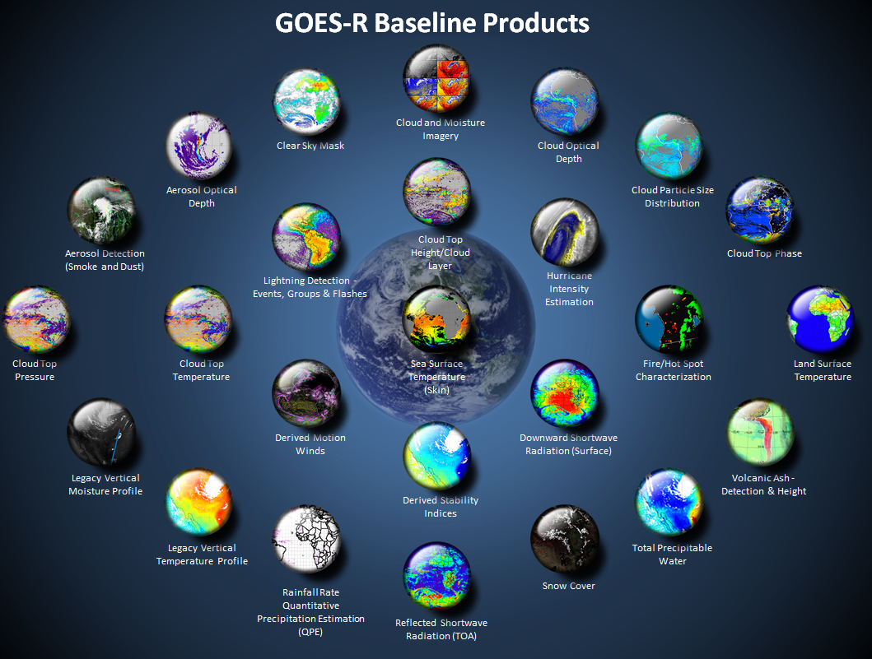
Stability Indices
Total Precipitable
Water
Vertical Temperature
and Moisture Profiles
http://www.goes-r.gov
Notes:
LAP products are boxed in yellow. They originate from atmospheric profiles of temperature and moisture. They include stability indices such as CAPE and Lifted Index, and Total Precipitable Water

Slide 4
Legacy Profiles are created because there is no Sounder on GOES-R
Considerable overlap between Sounder Channels and GOES-R Infrared Spectrum
GOES-14 Sounder is still Spectrally Superior to GOES-R
GOES-R is spatially superior to GOES-14 Sounder
Pixel resolution: 2 km on GOES-R, 10 km on Present GOES Sounder
GOES-R scans full disk, GOES Sounder scans small region in Northern Hemisphere
GOES-R is temporally superior to GOES Sounder (FD every 10 minutes v. Small Region of NH every hour)
Retrieved LAP FD Data are created every 10 minutes, CONUS every 5 minutes, MESO every minute (better temporal coverage than described here: http://www.goes-r.gov/resources/docs/GOES-R_GS_FPS.pdf )
Notes:
GOES-R ABI channels have considerable spectral overlap with GOES-14/-15 Sounder data, so ABI information can be used in lieu of the sounder which is necessary because there is no sounder on GOES-R. ABI also has better spatial resolution than the GOES Sounder - 2 km on ABI vs. 10 km on the GOES Sounder. ABI scans the Full Disk much more quickly than the GOES Sounder, which scans only part of CONUS every hour. LAP products are created every 15 minutes in the FD domain, every 5 minutes in the CONUS domain and every 1 minute in the mesoscale domains.

Slide 5
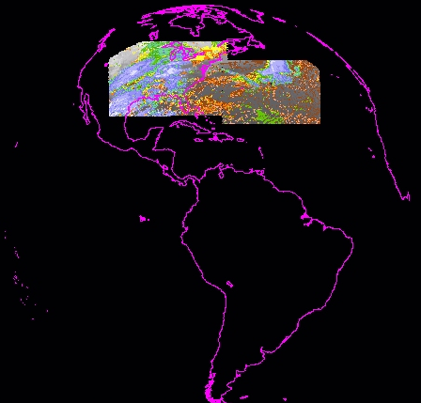
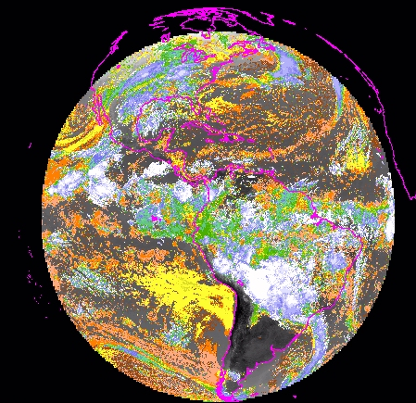
Much improved spatial coverage (at more times) with ABI over the current Sounder
Legacy GOES Sounder coverage in one hour
ABI in 10 minutes
CIMSS
Notes:
ABI provides more data than the GOES Sounder both spatially and temporally. This image compares the near-global coverage for ABI LAP products (up to 67 degrees local zenith angle) to current GOES Sounder. LAP products give far better spatial coverage more frequently than the GOES Sounder.

Slide 6
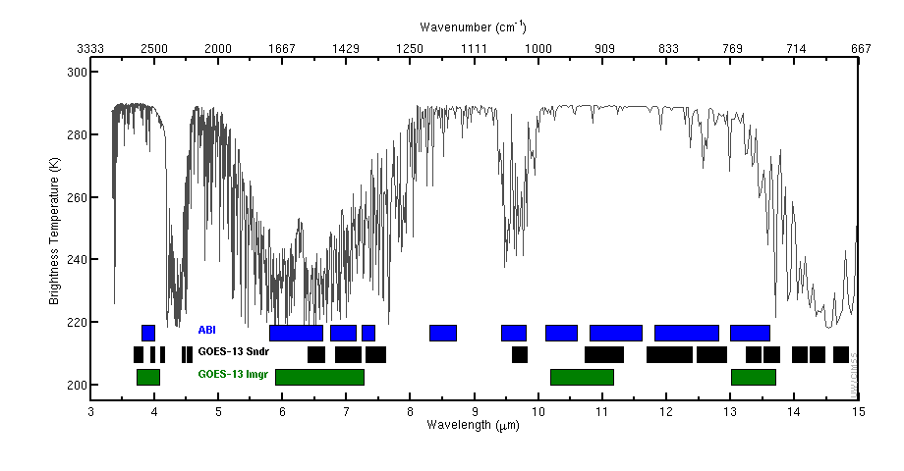
This figure shows channels for ABI, GOES-13 Sounder and GOES-13 Imager
3.9
6.2 7.0 7.4
8.4
9.7
10.3
11.2
12.3
13.3
4.4
3.7 4.1 4.6
6.5
7.5
9.7
11.0 12.0 12.7 13.4 14.1 14.7
4.0 4.5
7.0
13.7 14.3
3.9
6.5
10.7
13.3
Notes:
This slide depicts the channels present on the GOES-R ABI, on the present GOES Sounder, and on the present GOES Imager. The present GOES Sounder does a better job of sensing temperature because of the abundance of CO2 channels around 4-4.5 microns, and around 14.4 microns. ABI and GOES Sounder do have similar moisture-sensing channels, as shown here, so moisture retrievals from ABI and the GOES Sounder are similar. ABI channels are spectrally broad (compared to the more narrow GOES Sounder spectrum)…thus, ABI retrievals will smooth over features that have small vertical scales. The GOES Sounder with its more spectrally narrow windows is better able to resolve such features. There are two channels on ABI that aren't on the GOES Sounder: 8.4, which is in a region where SO2 absorption can be important and 10.3, the clean window channel.

Slide 7
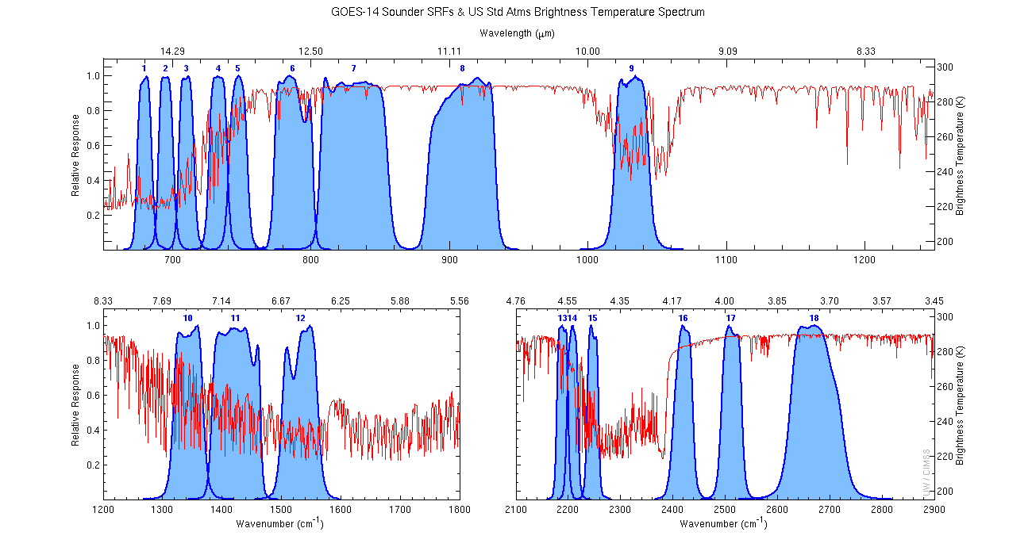
GOES-14 Sounder Spectrum
14.7
14.1
13.4
14.4
13.7
12.7
12.0
11.0
9.7
7.4
7.0
6.5
4.6
4.5
4.4
4.1
4.0
3.7
Notes:
This shows the spectral response function for the GOES-15 Sounder channel on top of the brightness temperature spectrum drawn in red. Note the abundance of channels around 14.4 microns and around 4.4 microns.

Slide 8
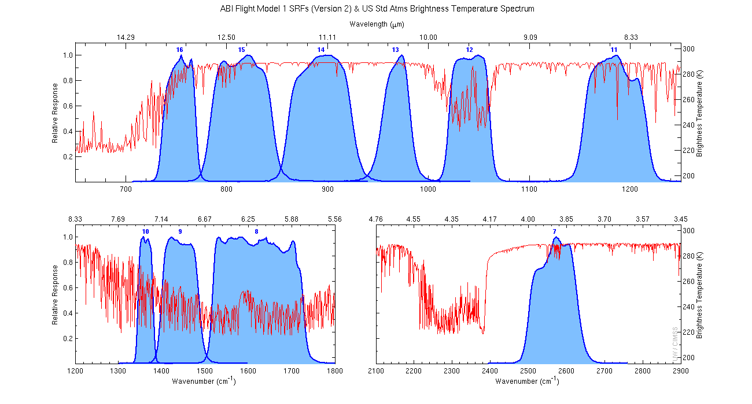
GOES-R Advanced Baseline Imager Spectrum
13.3
12.3
11.2
10.3
9.7
8.4
7.4
7.0
6.2
3.9
Notes:
ABI does not have those CO2 channels. It does have fairly broad channels in the water vapor absorption region, however, so that moisture can be sensed with about the same abililities as the GOES Sounder. This is important to consider in the unlikely (*and horrible*) possibility that GOES-14 is called into service after a failure of GOES-R satellites. Water Vapor coverage is similar between the two instruments

Slide 9
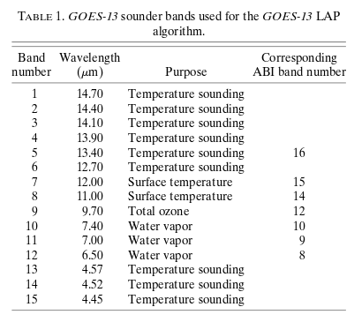
What do those two previous slides show you?
ABI has fewer temperature channels than the GOES Sounder of the past
Water vapor
channels are
equivalent
Notes:
This summarizes the previous slides. ABI and GOES Sounder have similar water vapor channel. But ABI has fewer temperature sounding channels.

Slide 10
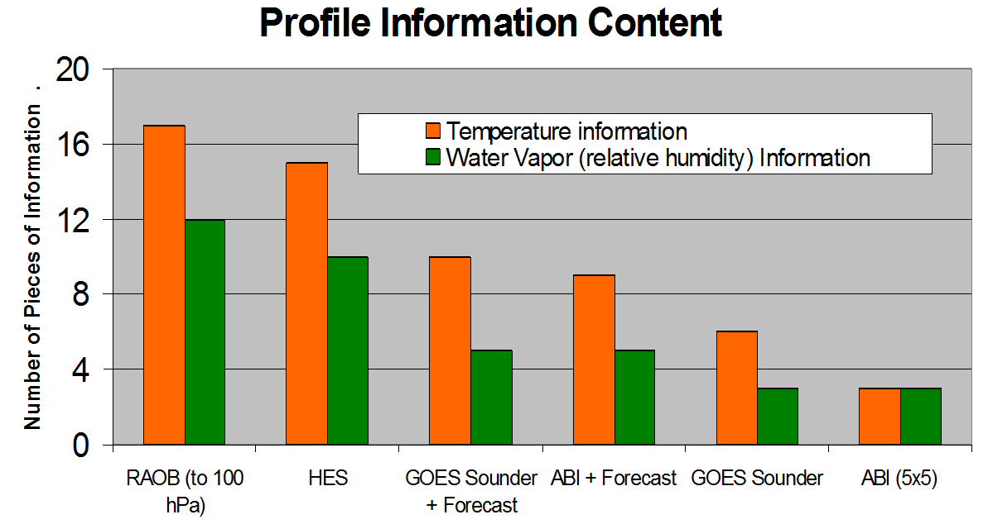
Legacy Profiles have more pieces of information in the vertical because model forecasts are also used in their computation.
In other words: ABI is not a sounder – it has limited temperature information in the vertical. ABI retrievals need to use the NWP forecast as a background field to increase the number of vertical layers measured
Notes:
To increase information, ABI data are used in concert with model simulations. How many layers of information do you have when you use only ABI? Not many. But by using Forecast information and GOES-R ABI data, you can get information comparable to that from forecast + GOES Sounder: about 5 layers in moisture. Temperature information from ABI is not as good as from the Sounder.

Slide 11
LAP Specs
Created with a 5x5 footprint (10-km at sub-satellite point)
Created for every Full Disk, CONUS and Mesoscale domain image
GFS short-range forecast is used as background information
Data produced up to Local Zenith Angle of 67º (Just Poleward of the Arctic Circle)
Vertical Resolution: 3-5 km
Accuracy (How close to correct?)
RH : ~20%; LI 2 K ; CAPE 1000 J/kg ; TPW 1 mm
Precision (How close to repeatable?)
RH : ~20%; LI 6.5 K ; CAPE 2500 J/kg ; TPW 3 mm
The Baseline Product is Clear Sky Only. An Experimental ‘All-Sky’ Product has been developed
Notes:
Legacy Atmospheric Profiles are created with an ABI footprint of 5x5 pixels so there are 25 ABI pixels in each LAP footprint. LAP products have spatial resolutions similar to present the GOES Sounder. Values are created for every Full Disk scan, for every CONUS scan, and for every MESO scans. The background fields used in creating Legacy Atmospheric Profiles are from the GFS forecast. The accuracy of the products is noted at the bottom.
As with GOES Sounder DPI products, LAP Products are Clear-Sky only - but an All-Sky product that is valid in clear and cloudy regions has been developed.

Slide 12
Regression and Retrieval
Regression uses static coefficients that give the best statistical relationship between observed temperature/ moisture/ozone/emissivity/surface temperature given GFS background and ABI radiance observations. This creates a first guess field for a Radiative Transfer Model (RTM)
Retrieval minimizes the difference between RTM driven radiances from First Guess (Regression) and ABI radiance observations.
For more details see ATBD link at end of training
Notes:
The first step to produce Profiles: A Regression that uses coefficients that were trained to give the best statistical relationship between observed temperature, moisture, surface temperature & emissivity and ozone. First guess: GFS data. Then the retrieval uses a radiative transfer model; differences between the regression values and RTM values are minimized during the retrieval step. Further technical details are available in the Advanced Theoretical Basis Document linked at the end of the this training.

Slide 13
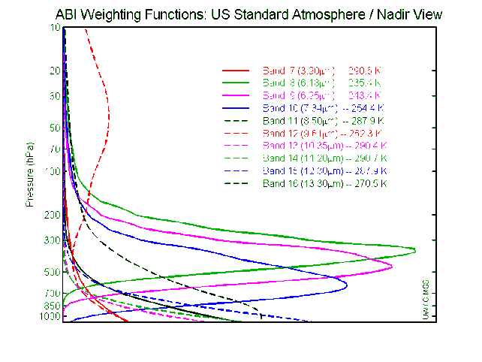
LAP Limitations
LAP and derived products are available over “clear” Fields of Regard (FORs), meaning 5 (out of 25) or more clear Fields of View (FOV)
ABI IR band emissivities are from a monthly dataset.
Surface roughness and skin temperature are assumed homogeneous within the Field of Regard
The iterative physical retrieval is computationally expensive; an increase in FOR width could be necessary for large region processing
Forecast temperature is hard to improve with ABI because ABI channels do not sense temperature at many different levels
GOES-R ABI weighting functions, at left, show a lot of surface contribution, but not a lot of mid-tropospheric contributions – water vapor channels 8,9,10 and Ozone band 12 have contributions away from the surface
Notes:
Clear-Sky LAP Products are only produced when at least 20 of the 25 fields of regard (in the 5x5 pixel set) have clear fields of view.
Other specs on LAP generation are listed on this slide.
Weighting functions for the GOES-R ABI show few peaks above the surface, LAP profiles therefore struggle to improve on the GFS representation of temperature. There is mid-tropospheric moisture information in ABI in the form of three water vapor channels. Thus there is improvement in the moisture field, as we'll see shortly.

Slide 14
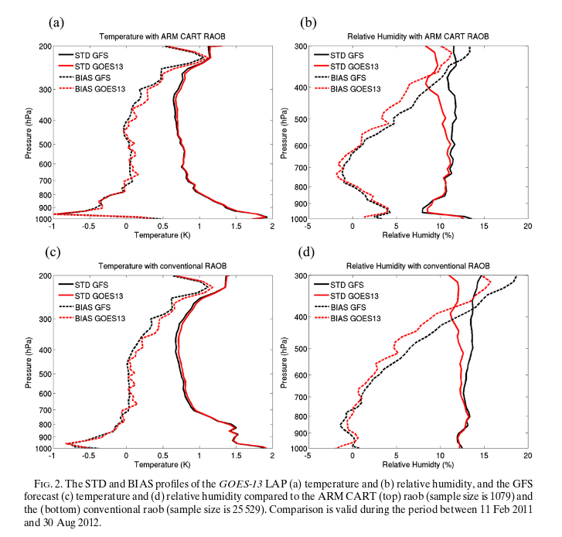
Clear Sky Results
Notes:
This figure shows an error analysis for clear sky results, comparing radiosondes (bottom) and ARM CART RAOBS (top) and GFS and LAP Vertical Profiles. Temperature is on the left, moisture is on the right.

Slide 15
Clear Sky Results
Satellite Retrievals do not improve temperature
because temperature is already very accurate
Satellite Retrievals do improve moisture between
700-300 mb – where observations occur
Notes:
What do these clear sky comparisons show? Improvement is best for moisture in mid-upper troposphere. That's were satellite observations give the most added information. Reduction in the bias values is pretty small for temperatures.

Slide 16
Clear Sky Results
Satellite Retrievals do not improve temperature
because temperature is already very accurate
Satellite Retrievals do improve moisture between
700-300 mb – where observations occur
(Think about Water Vapor Weighting Function!)
Notes:
Where the observations are giving information is described by the Weighting Function

Slide 17
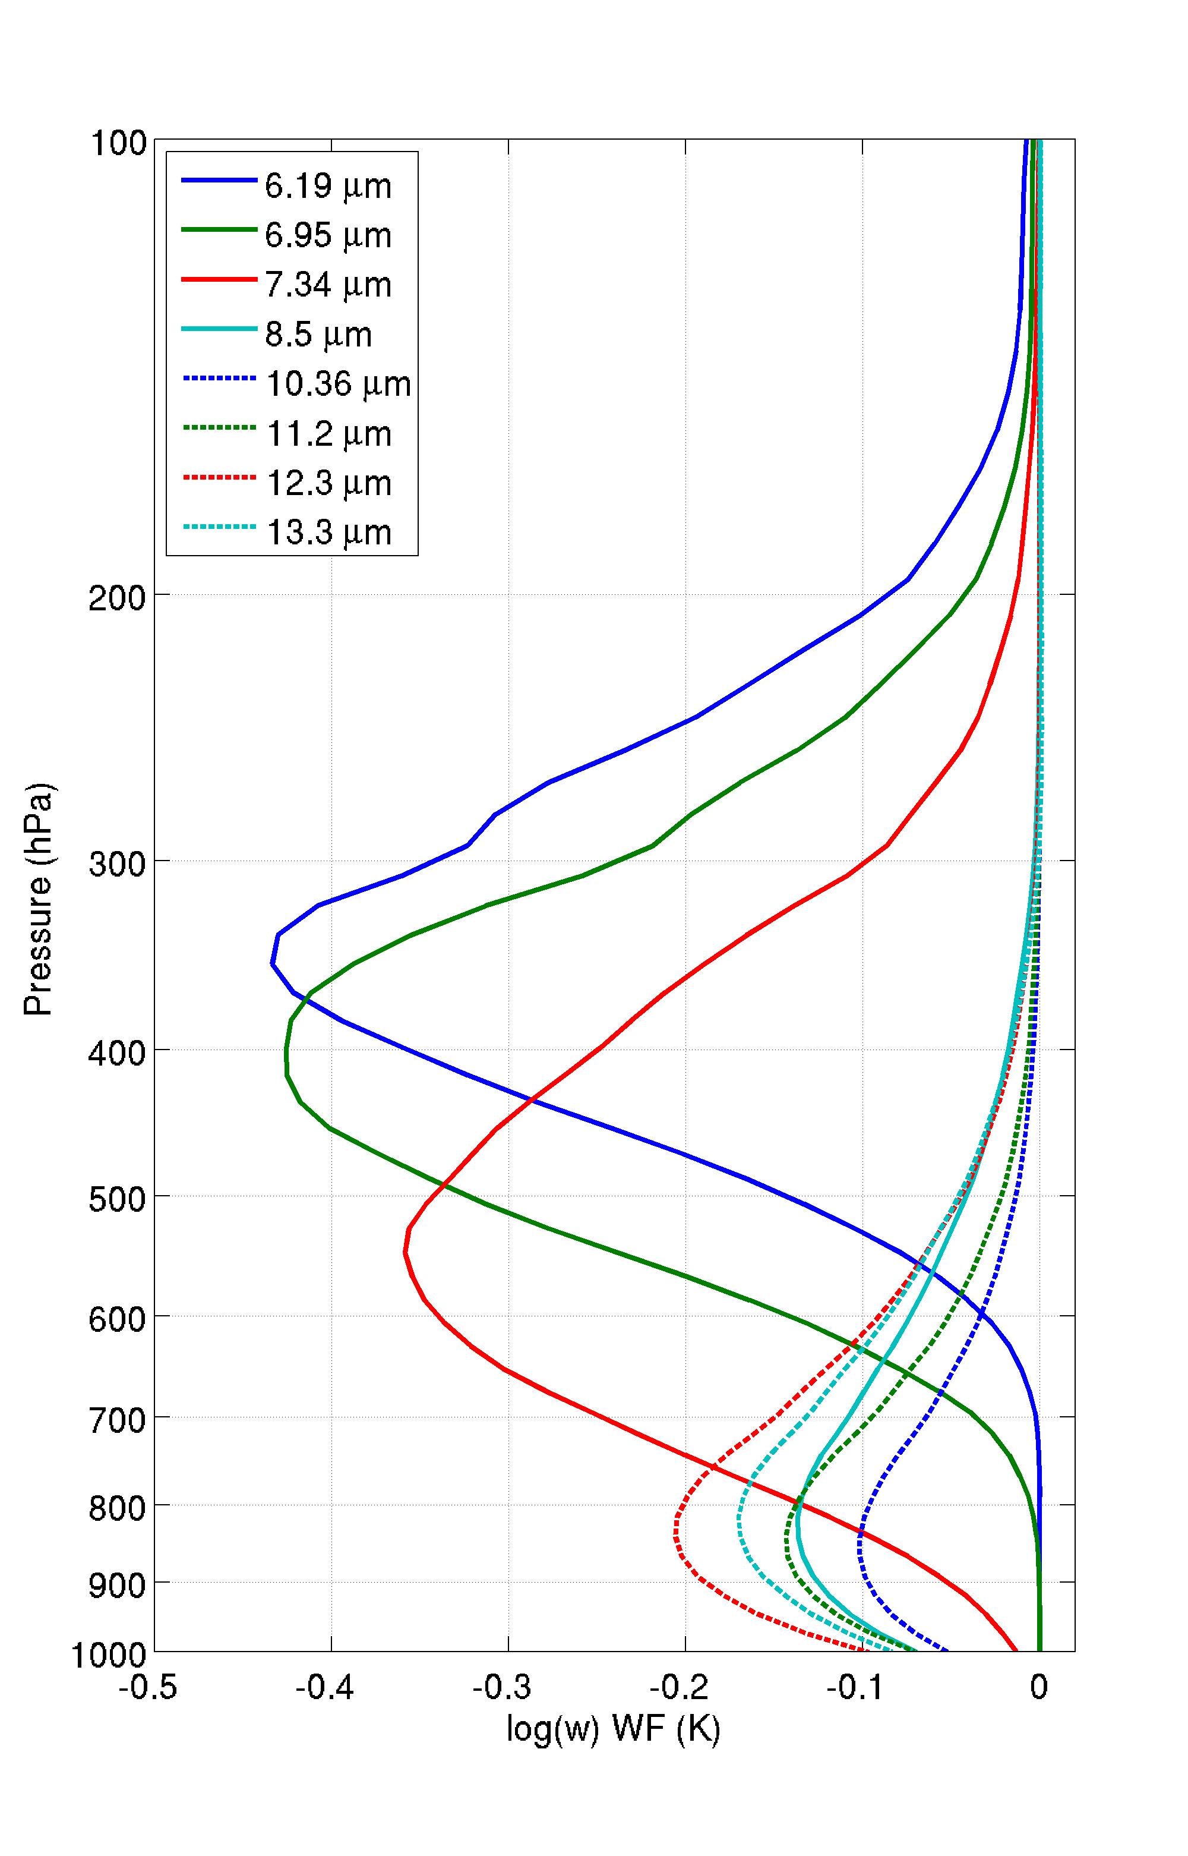
Weighting Function Plots
For a US Standard Atmosphere
Moisture and Temperature information in mid-troposphere from Water vapor Channels
Temperature information in lower troposphere other IR bands
Notes:
This shows weighting function for the US Standard Atmosphere. There are websites that show real-time weighting functions based on current radiosondes that you can find online. Weighting functions describe from where in the atmosphere information is being detected by the satellite. Most of the information from the ABI (or AHI) Water Vapor Channels is coming from the region between 300 and 700 mb - the level is higher in a moist atmosphere and lower in the dry atmosphere. That's why the bias correction you saw on the last page is largest in the mid and upper troposphere. Weighting functions for most of the other ABI and AHI channels peak near the surface: they're window channels. There's not a lot of mid-tropospheric temperature information available from ABI channels because CO2 channels - around 4.4 micrometers and at greater than 13.3 micrometers - are not present (as they were present on the GOES Sounder).

Slide 18
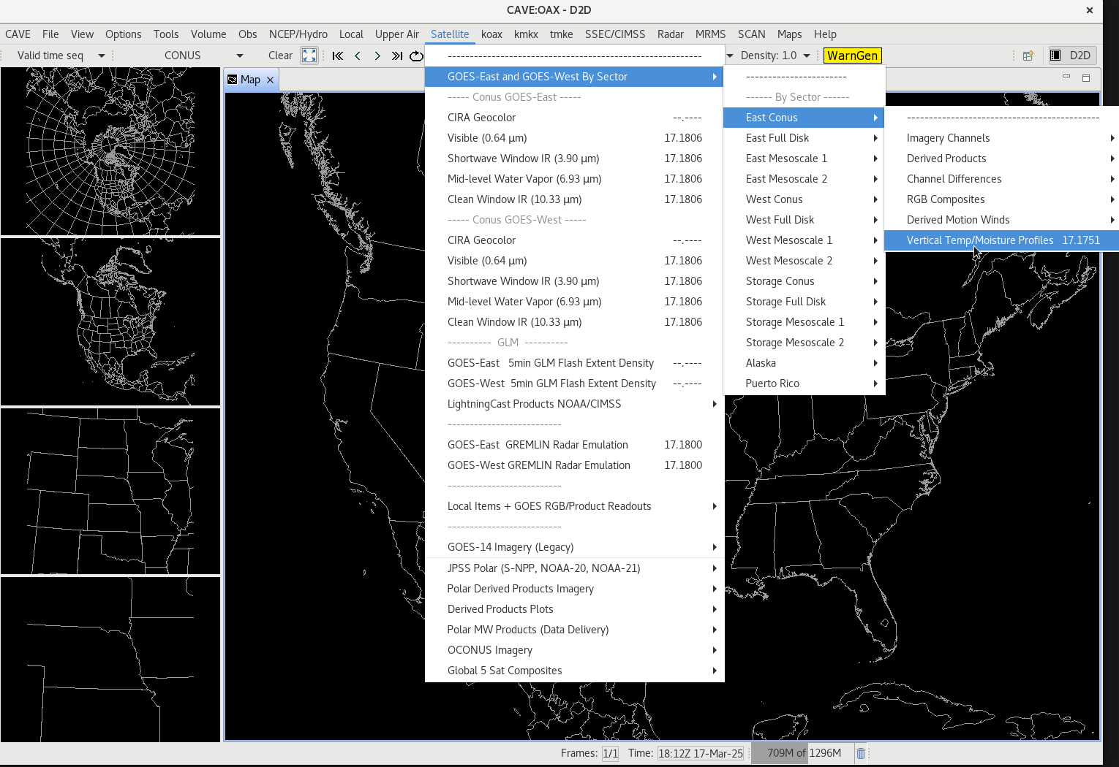
Individual Profiles are in AWIPS
Satellite GOES-East/GOES-West CONUS or Full Disk Vertical Temp/Moisture Profiles

Slide 19
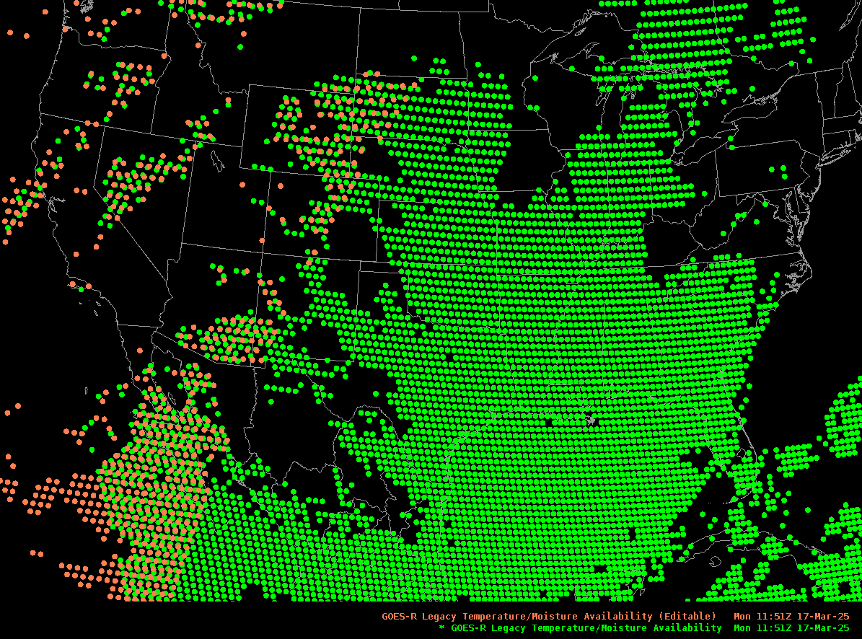
GOES-16 / GOES-18 Sounding Points
See that point in Idaho? You have a GOES-East and GOES-West profile there

Slide 20
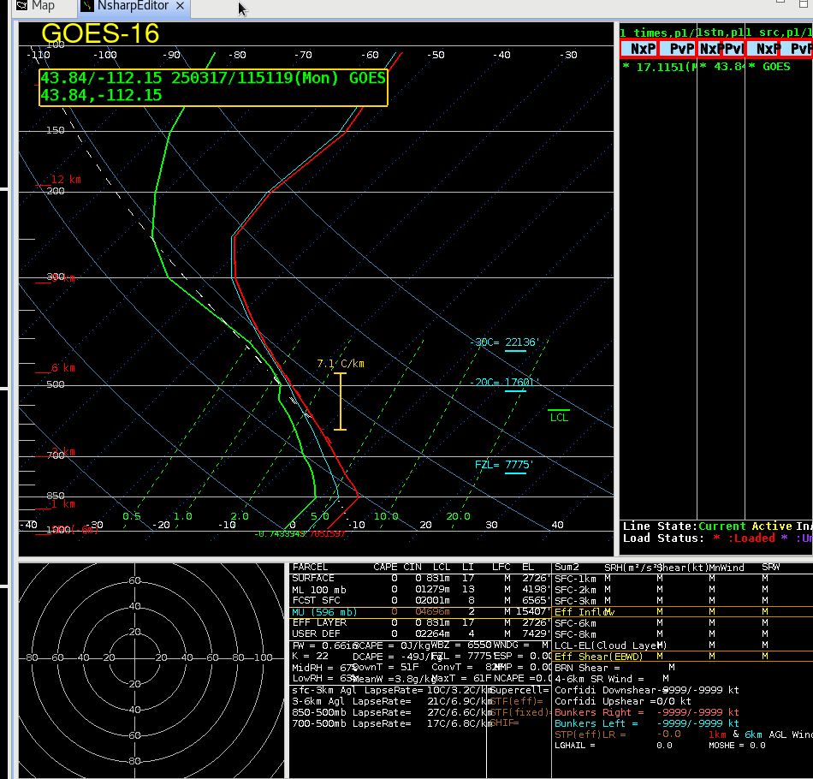
Compare the Profiles One computed from GOES-16, one from GOES-18
The profiles are smooth
Best information: How are things changing with time? Where are the edges of gradients?

Slide 21
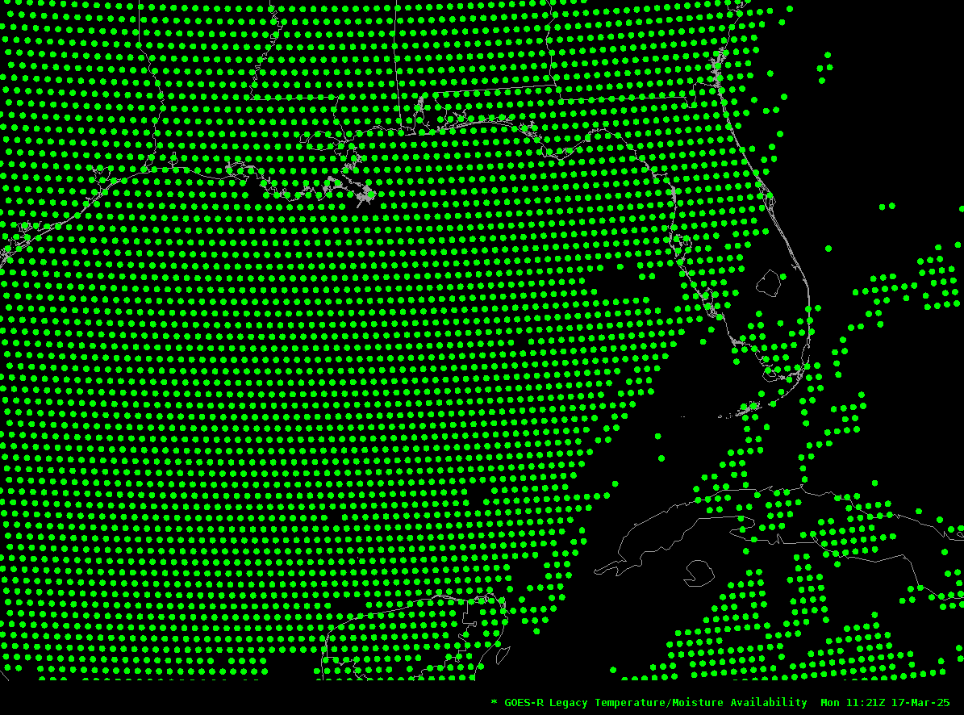
LAP Profiles over the SE USA

Slide 22
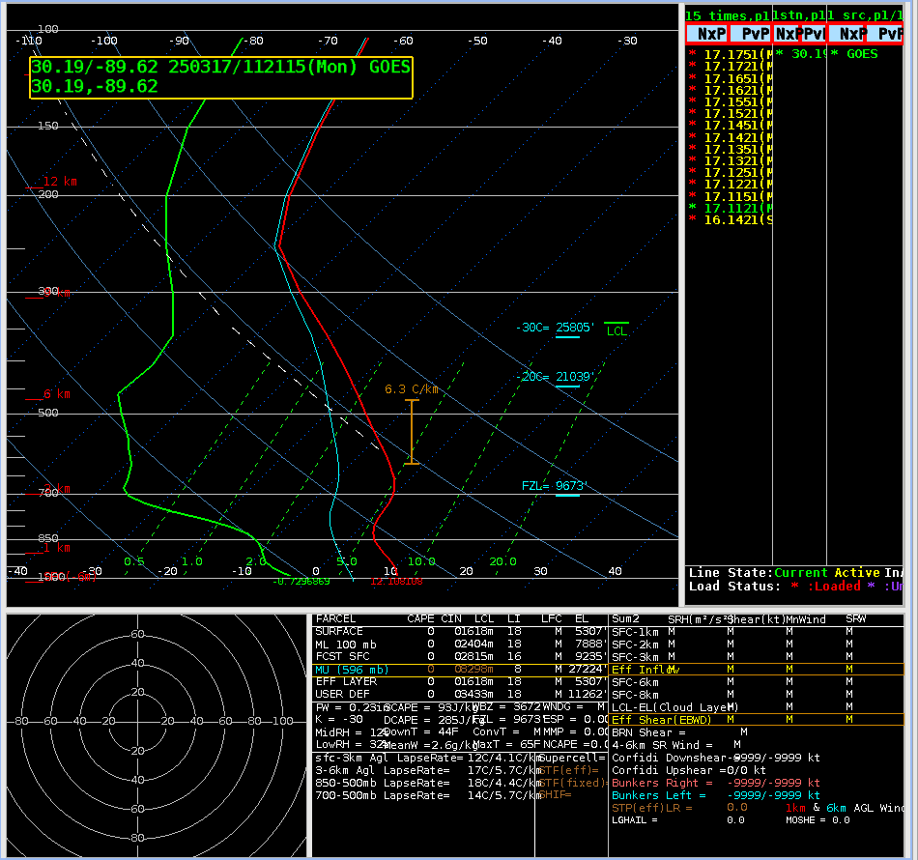
How is the profile changing every 30 minutes?
Watching
Moisture Return
Cooling before snow?
Possibility of Hail?
Warming ahead of rain?
.
.
.
.
Note that even though profiles are created every 5 minutes, the data are shipped to AWIPS every 30 minutes

Slide 23
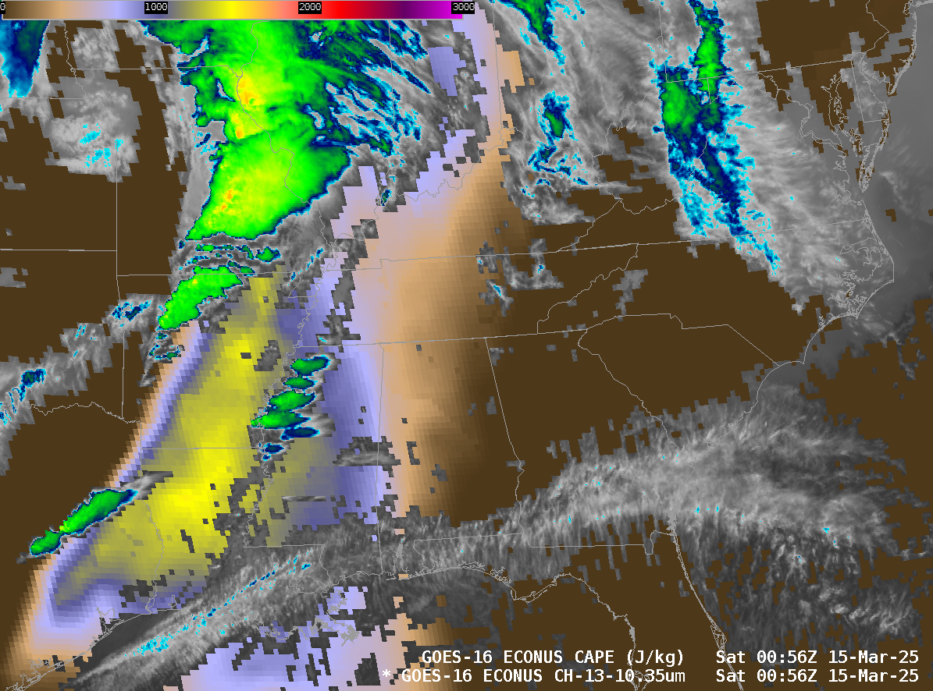
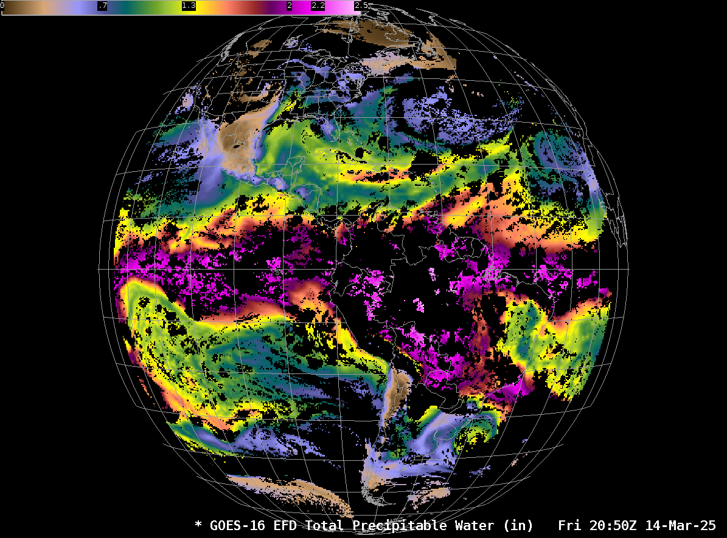
Clear-Sky CAPE with Band 13
Clear-Sky TPW
Baseline Products are clear Sky only – so plot them with other satellite data. In the example on the left, CAPE (values from 0 to 3000) is plotted with Band 13 imagery. You have data with every scan
In AWIPS, Clear Sky products show missing data where clouds are present
Notes:
Baseline Products are clear-sky only and should look familiar to forecasters who have used GOES Sounder DPI products. Examples of CAPE and Total Precipitable Water are shown here. The dark blue region is where the clear retrievals gave good data; yellow and cyan regions will not have data in the baseline products. A big display difference in AWIPS, however, for GOES-R Clear-Sky products is that Clear-Sky products will show no data where clouds are present, unlike the images on this page that blend cloud temperature information with the Clear-Sky product.

Slide 24
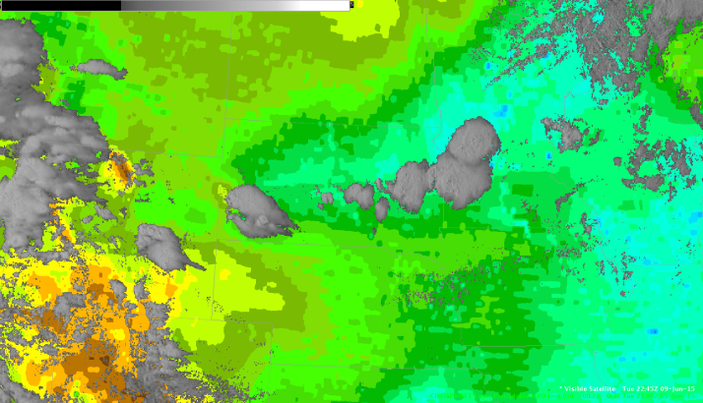
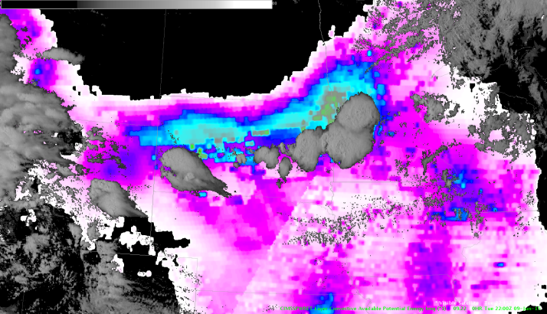
What’s best about LAP Soundings
Gradients
Time Tendencies
Quotes from HWT Evaluations:
“While looking at the CAPE and Precipitable Water trends, we noticed the storm development in SD matches almost exactly with the leading edge of the gradient”
“The overall gradient and orientation seems pretty good”
(HWT Products were created using GOES Sounder)
Notes:
All-Sky LAP products have been demonstrated at the Hazardous Weather Testbed starting in 2014, and forecasters there found great utility in gradients and time tendencies because Convection frequently formed along gradients in the fields. That is the case as shown here, for example, for CAPE and Total Precipitable Water.

Slide 25
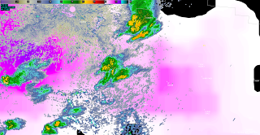
LAP CAPE and convection
Convection moving towards larger LAP CAPE values
2035 UTC
(All Sky Product created using GOES Sounder Data)
Notes:
Here’s an example, with modest convection in a region that is a diagnosed minimum of CAPE, moving towards higher values of CAPE. What would you expect as the convection moves from a local minimum in the CAPE towards a larger value.

Slide 26
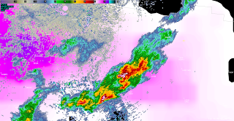
LAP CAPE and convection
Convection intensifies!
2119 UTC
Notes:
One hour later, the Convection had intensified

Slide 27
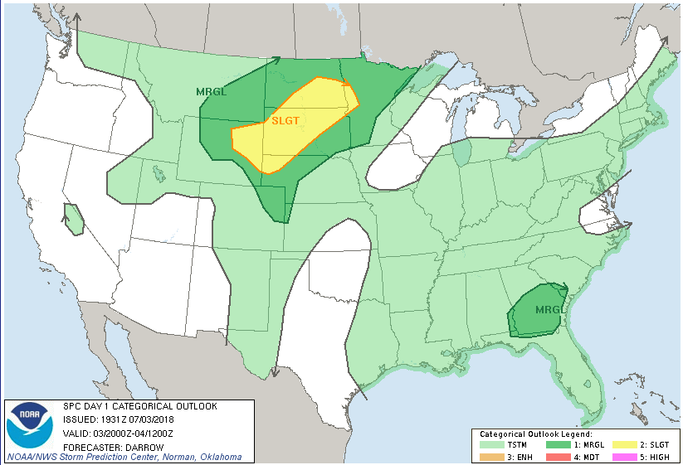
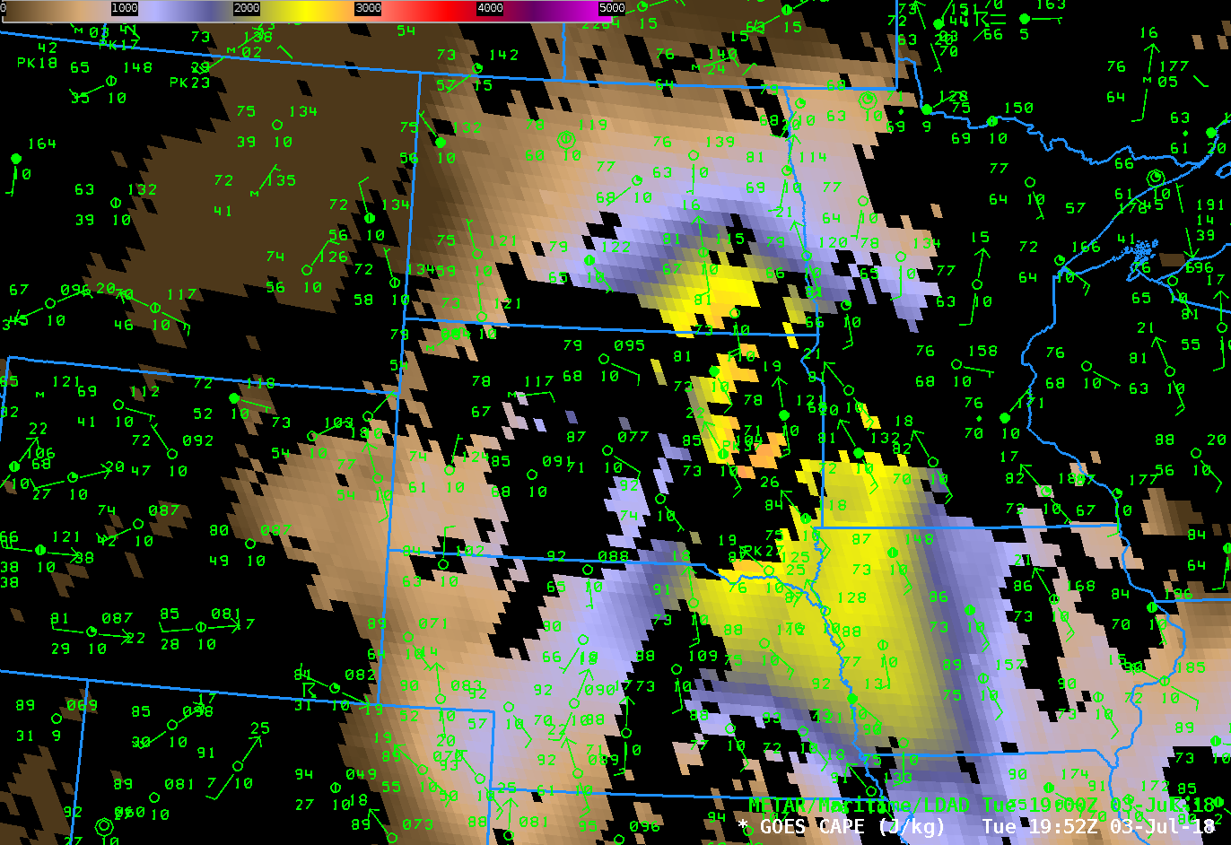
DPI CAPE at 1952 UTC on 3 July 2018
Black regions: Missing data because of clouds
Note how the surface dewpoint and CAPE gradients align.
Inset: SPC Outlook from 2000 UTC on 3 July 2018
Notes:
This shows DPI CAPE from AWIPS. This is the Clear Sky product that is baseline (Not the All Sky product available at HWT). Nevertheless, there is information, in particular over the Dakotas. Note how the CAPE values and surface Dewpoints align. A nose of higher CAPE overlaps with the Slight Risk.

Slide 28
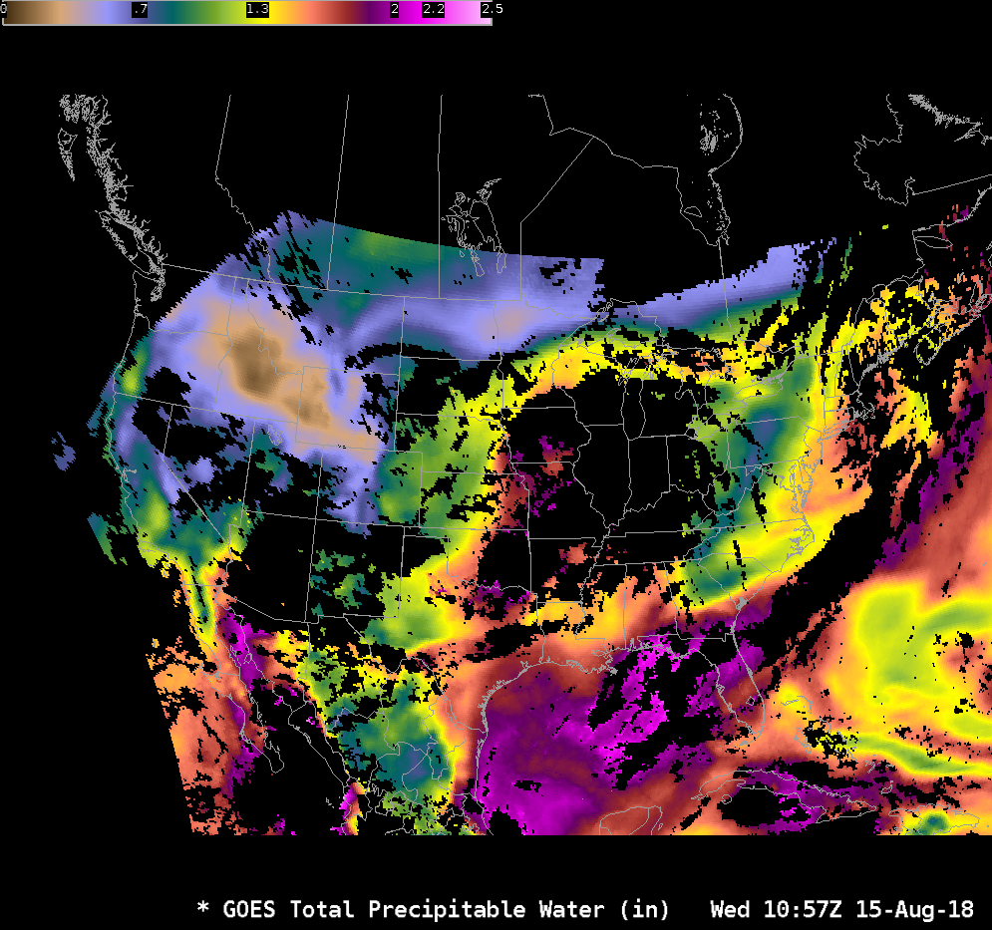
Total Precipitable Water
You can compare this to ALPW in AWIPS starting in mid-2025
Notes:
LAP Total Precipitable water shows tongues of moisture that can be useful in assessing the threat of heavy rain. Full Disk imagery can show Atmospheric Rivers, for example. This is a clear-sky only product however!

Slide 29
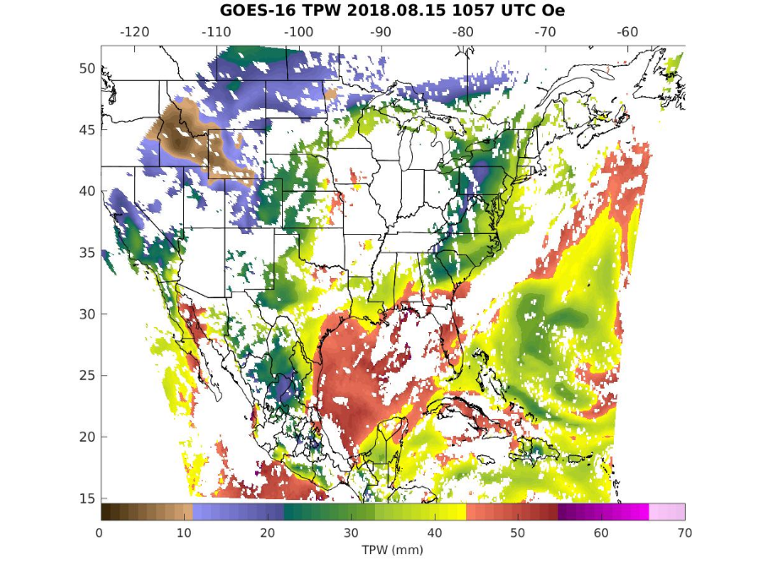
Total Precipitable Water
Data are available online at http://soundingval.ssec.wisc.edu
Clear-Sky View
Notes:
You can also find these data online, at the website shown. Clear-sky baseline products are available there.

Slide 30
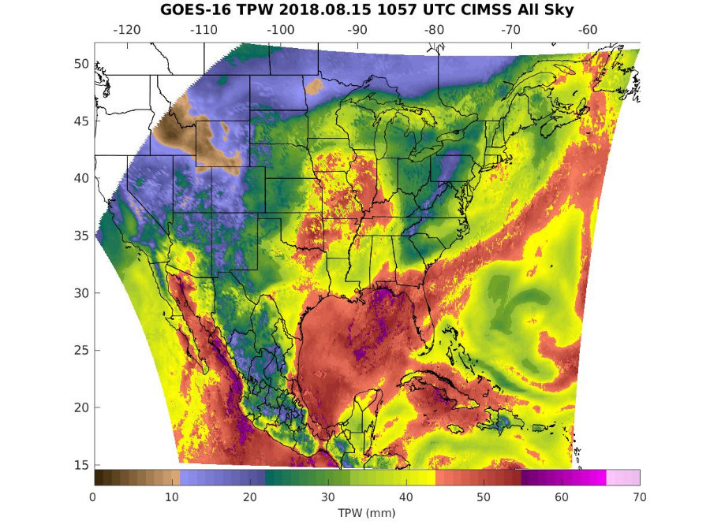
All Sky views are available at http://soundingval.ssec.wisc.edu
Modified First Guess Field (from GFS) is used where Retrieval fails
Notes:
But so are allsky products. The background field from the GFS is used where the clear or cloudy retrieval fails. Otherwise you are getting data that are influenced by the GOES-R ABI observations.

Slide 31
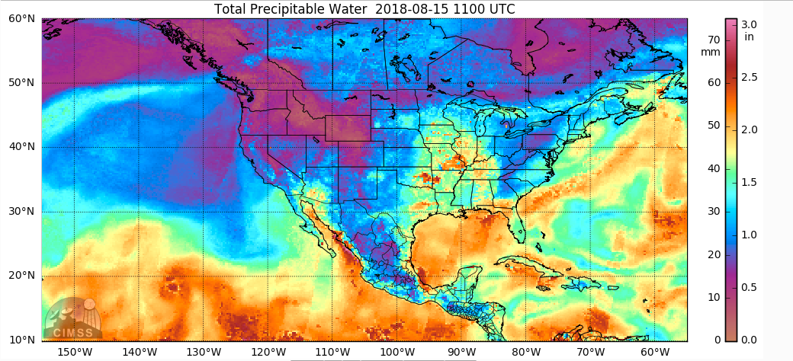
Total Precipitable Water
Compare GOES plot to Microwave Plot
MIMIC TPW
Notes:
You can compare the LAP Total precipitable water to other global TPW estimates such as from MIMIC. They show comparable values.

Slide 32
Supplemental Information
Schmit, T. J., J. Li, J. J. Gurka, M. D. Goldberg, K. J. Schrab, J. Li, and W. F. Feltz, 2008: The GOES-R Advanced Baseline Imager and the continuation of current sounder products. J. Appl. Meteor. Climatol., 47, 2696–2711.
Lee, Yong-Keun, Jun Li, Zhenglong Li, and T.J. Schmit (2017), Atmospheric temporal variations in the pre-landfall environment of Typhoon Nanka(2015) observed by the Himawari-8 AHI, Asia-Pacific Journal of Atmospheric Sciences. https://doi.org/10.1007/s13143-017-0046-z
Schmit, T. J., Li, J., Lee, S. J., Li, Z., Dworak, R., Lee, Y.‐K., et al., 2019: Legacy atmospheric proﬁles and derived products from GOES‐16:Validation and applications. Earth and Space Science, 6, 1730–1748.
GOES-R Algorithm Theoretical Basis Document for LAP: http://www.star.nesdis.noaa.gov/goesr/docs/ATBD/LAP.pdf
http://www.goes-r.gov
Thanks to Mat Gunshor from CIMSS for Figures!
Notes:
Supplemental Information is listed here. Read all about it!

Slide 33
Summary
Legacy Atmospheric Profiles are created for every scan: Full Disk every 10 minutes, CONUS every 5 minutes, Meso every 1 minute.
Temperature and Moisture data are retrieved from the ABI radiances. First Guess from GFS especially important for temperature retrieval because GOES-R ABI channels have limited temperature information
Profiles as well as Total Precipitable Water and Atmospheric Stability Parameters (eg., CAPE, LI, Total Totals, K Index, Showalter Index) are available. Gradients and time tendencies are more useful than absolute values.
Baseline Products are Clear-Sky products All-Sky Products in development use GFS data as the first guess, and GFS values emerge as the solution if both Clear and Cloudy Retrievals Fail.
The AWIPS display of Clear Sky products will show no data where clouds are present.

