Slide 1
Multi-Channel Interpretation Approaches
(ABI, Band Differences and RGBs)
Scott Lindstrom
University of Wisconsin-Madison CIMSS
(Cooperative Institute for Meteorological Satellite Studies)
Notes:
This is the Satellite Foundational Course for GOES-R on Multi Channel Interpretation Approaches for use with ABI. It includes information on band differences - why they work, and what information they show, which band differences are in AWIPS - and on RGBs, (Red-Green-Blue composites) including the baseline RGB products in AWIPS.

Slide 2
Learning Objectives
Bands on ABI, and what they are useful for
How can you use multiple bands to reveal atmospheric phenomena
  Band Differences
  Band Comparisons
AWIPS channel combinations
RGBs:
  What are they?
  How are they created?
  What are some simple examples?
Notes:
The topics of this training are related. There are different ways of looking at channel differences from the GOES-S Advanced Baseline Imager, or ABI: you can look at difference fields (brightness temperature differences for IR, or reflectance difference for visible/near IR), you can toggle between fields, and you can look at RGBs or Red-Green-Blue images . These are created by assigning an individual band or a band difference to the three color components (red, green and blue) used to create an image. All of the ways of looking at channel differences highlight the sensitivities of the individual channels.

Slide 3
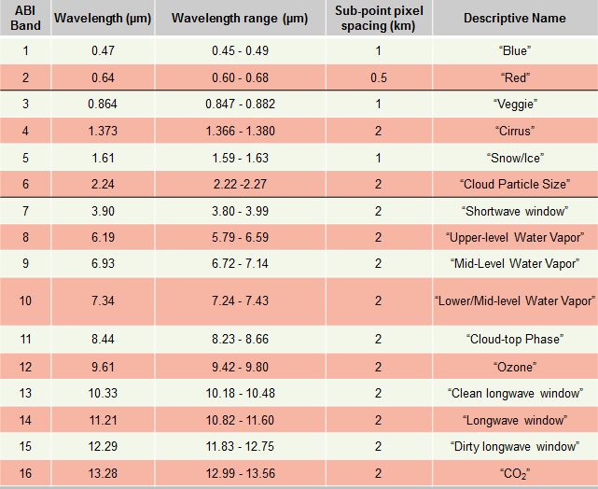
ABI: Bands 1-16 (Visible /Near-IR/ IR)
Notes:
Based on Schmit et al, 2017. This chart lists out the bands that are available on the GOES-R Advanced Baseline Imager, or ABI. The chart shows 16 bands, the central wavelength, the wavelength range, the resolution and the band nickname. The nickname gives you and idea, sometimes, of what the band can be use for; there are lots of other possibilities that extend beyond the nickname. Band placement is typically related to absorption by a particular gas, be it water vapor, sulfur dioxide, ozone or carbon dioxide, or bands placed in a region where this is little absorption by atmospheric gases. There are Satellite Foundation Course trainings on the individual bands - check them out!

Slide 4
Multi-Channel Approaches
Band Differences reveal something about the structure of the atmosphere.
  ABI Band 13 (10.34 μm) is the ‘cleanest’ (least affected by water vapor) window
  ABI Band 15 (12.3 μm) is in a region of even more water vapor absorption
    The Difference in brightness temperature between two channels tells you about the water vapor distribution
  ABI Band 7 (3.9 μm) is in a region where water droplets do not emit as blackbodies; it’s also far more sensitive to heat sources.
  ABI Band 13/14/15 (10.34 μm, 11.2 μm, 12.3 μm) is in a region where water droplets do emit as blackbodies
  ABI Band 11 (8.4 μm) is a region where ice absorbs differently than in window channels.
    The inferred brightness temperature difference tells you something about cloud composition.
  ABI Band 13 (10.3 μm ) is in a region where dust absorbs differently than in other window channels
  ABI Band 3 (0.86 μm) and Band 5 (1.61 μm) have different reflectances over different surfaces compared to Band 1 (0.47 μm) and Band 2 (0.64 μm)
Notes:
When you are looking at band differences, or RGBs, or even just comparing one band with another, it’s important that you understand the physics of the bands in question: Why is that particular band included on GOES-R? There are training modules on individual bands to which you can refer. When band differences are considered, what differences between the bands exist, and why? Some of those are listed on this slide, and will be considered more in depth in this training.

Slide 5
Several Well-known Brightness Temperature Difference Fields
10.3 μm – 12.3 μm Brightness Temperature Difference
  Split Window Difference (SWD)
  Keys on differences in water vapor absorption, highlights water vapor distribution
  Can also key on Absorption Differences in dust, to detect airborn dust.
  Sometimes the definition is flipped (i.e., 12.3 μm – 10.3 μm)
10.3 μm – 3.9 μm Brightness Temperature Difference
  Leverages Emissivity Differences in water clouds, used to detect water-based clouds at night
8.4 μm – 11.2 μm Brightness Temperature Difference
  Highlights absorption differences in ice clouds (best for thick ice)
  Also important for SO₂ detection.
Notes:
Some brightness temperature difference fields are very well known. Those are listed there. That they are well known in part underscores why the channels are included on ABI.

Slide 6
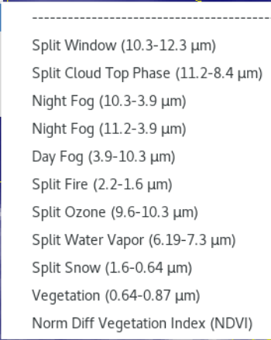
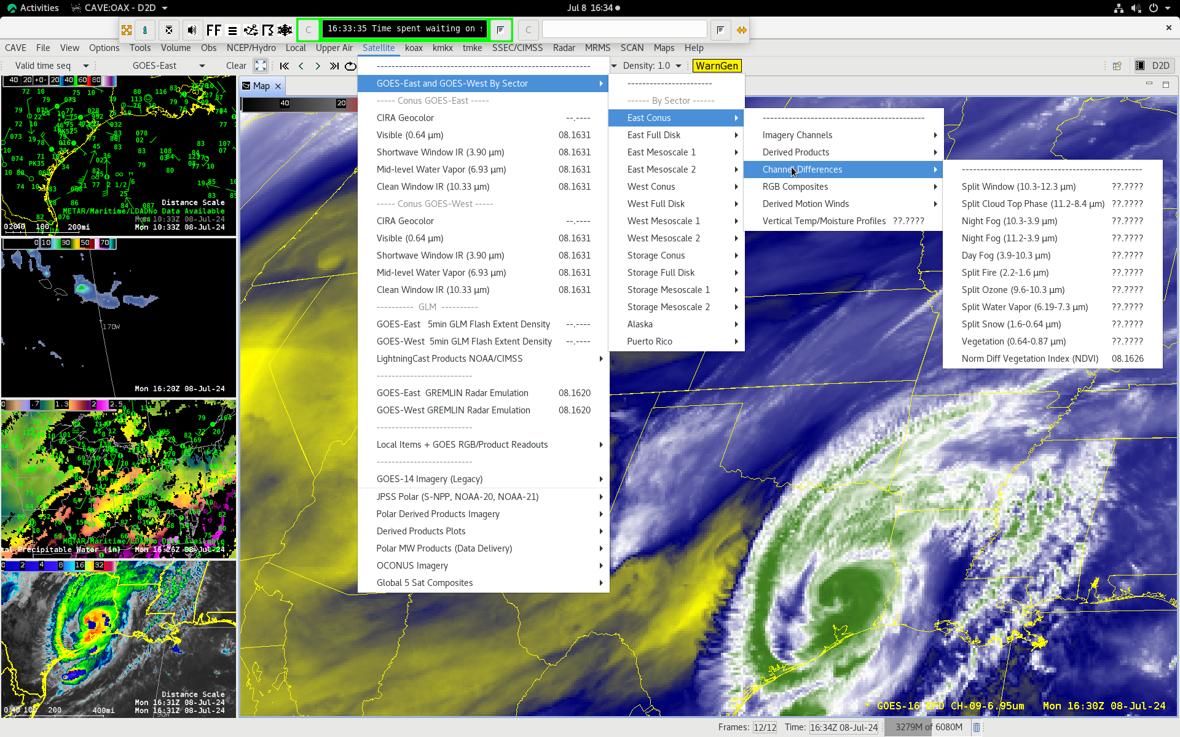
There are Channel Differences in AWIPS
(Screenshot as of Fall 2024)
Notes:
These are all simple difference fields – except for NVDI that is defined on the next slide

Slide 7
Channel Differences
Split Window (10.3 μm – 12.3 μm)
Split Cloud-Top Phase (11.2 μm – 8.4 μm)
Night Fog (10.3 μm – 3.9 μm)
Night Fog (11.2 μm – 3.9 μm)
Day Fog (3.9 μm – 10.3 μm)
Split Fire (2.2 μm – 1.6 μm)
Split Ozone (9.6 μm – 10.3 μm)
Split Water Vapor (6.19 μm – 7.3 μm)
Split Snow (1.6 μm – 0.64 μm)
Vegetation (0.64 μm – 0.86 μm)
NDVI
Absorption Differences
Emissivity Differences
Reflectance Differences
Tranmissivity Differences
Normalized Difference Vegetation Index:
(0.86 μm – 0.64 μm)/(0.86 μm + 0.64 μm)
If there is a Channel Difference in an RGB, it is likely in this list
Notes:
This slide lists how differences between the two channels occur, whether by differences in absorption (usually absorption by water vapor), emissivity differences, differences in reflectance – which differences occur only during the day, and transmissivity differences.

Slide 8
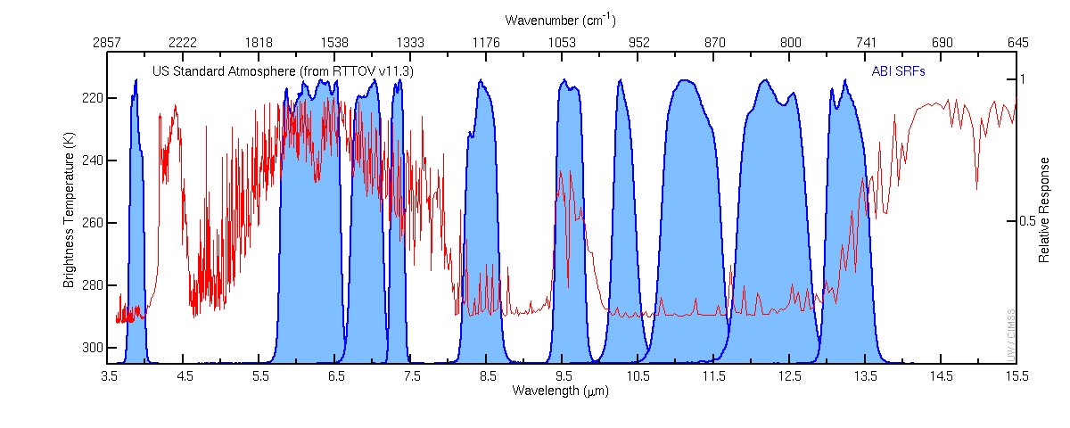
GOES-R Advanced Baseline Imager (ABI) Infrared Spectrum
Brightness Temperature (K)
Relative Response
7
8
9
10
11
12
13
14
15
16
3.9μm
6.2μm
7.3μm
8.4μm
9.6μm
11.2μm
13.3μm
6.9μm
10.3μm
12.3μm
Two channels with different water vapor absorption as depicted by the red line. Split Window Difference (SWD) is computed from the 10.3 μm on ABI “Clean Window” 12.3 μm “Dirty Window”
Notes:
This chart that you may have seen before shows the infrared channels on ABI. The blue regions show where individual bands are detecting energy. Some are narrow (Band 10) and some are relatively wide (Band 8). The red line can be interpreted two ways: Either the relative amount of absorption -- by any gas -- in the atmosphere, or the brightness temperature sensed by the satellite in clear skies. Cooler brightness temperatures result when absorption by a gas occurs in the atmosphere. Strong absorption by water vapor is apparent in bands 8 9 and 10; ozone absorption is apparent in band 12; CO2 absorption occurs in band 16. These bands will all give cooler brightness temperatures in clear skies. When the red line is near 0, at the bottom of the chart, little absorption is occurring; this is the case for the 10.3 micron band 13. Many of the 'heritage' difference products use 10.7 microns on GOES -13/-14/-15 - how does that particular channel compare to the closest channels on ABI, channels 13 (10.3) and 14 (11.2). The 10.3 micron channel on ABI is 'cleaner' - that is, there is less water vapor absorption - and narrower than the 10.7 micron channel on GOES-13/-14/-15. The 11.2 micron channel is also narrower than the 10.7 micron channel - but has similar amounts of water vapor absorption. So if you want to highlight water vapor differences between channels with a split window difference that includes 12.3 microns, maybe 10.3 is the channel to use, but 11.2 will give similar results

Slide 9
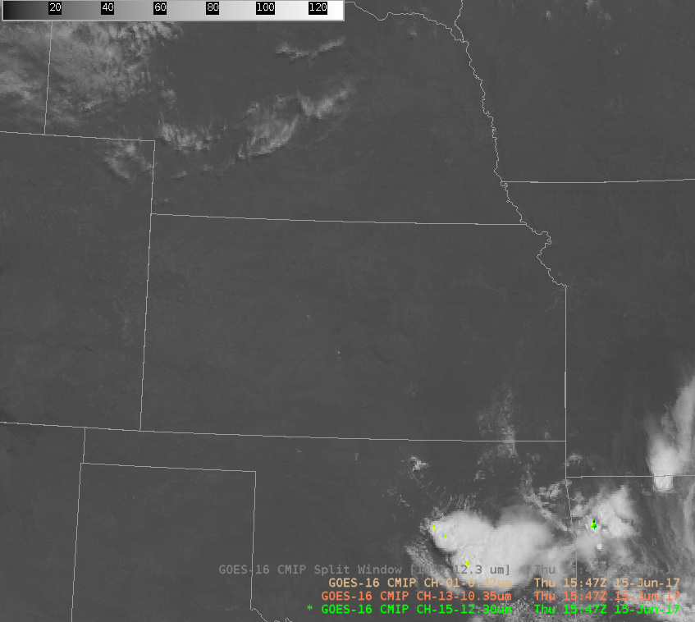
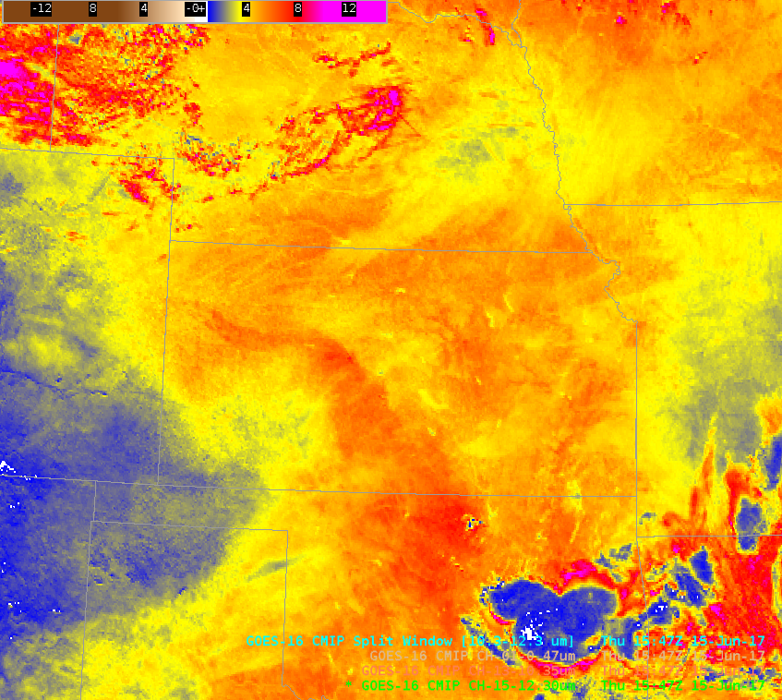
0.47 μm
10.3 μm – 12.3 μm
The 10.3 – 12.3 μm SWD shows a distinct moisture gradient over Kansas on 15 June 2017 at 1547 UTC. Inset: Clear Skies shown at the same time.
As of 2024, there is a second SWD enhancement in AWIPS that is greyscale
BAMS Article at this link
Notes:
Be careful when interpreting the Split Window Difference field especially with regard to temporal changes. It is very sensitive to changes in the skin temperature.

Slide 10
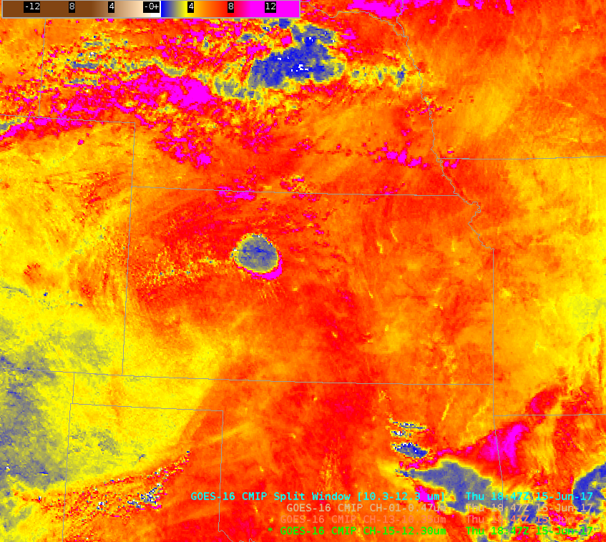
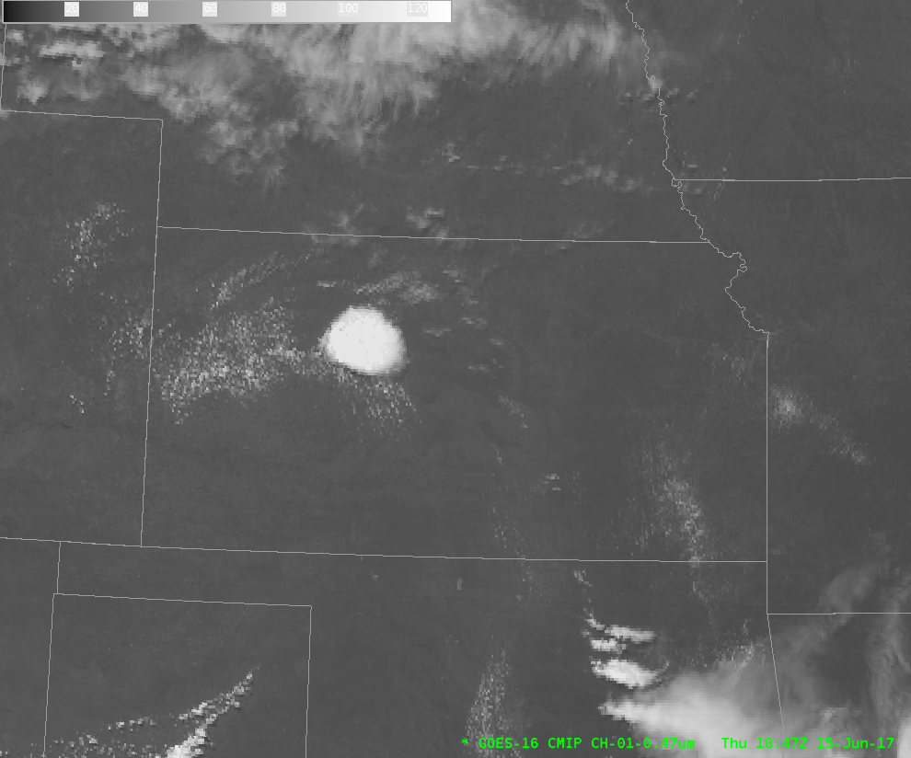
10.3 μm – 12.3 μm
0.47 μm
Three hours later (1847 UTC), strong convection has initiated along the SWD 10.3 – 12.3 μm axis over Kansas on 15 June 2017. Inset: SWD at 1847 UTC.
Notes:
This case is classic because the convection develops in a region where the SWD shows a tongue of moisture – something you can not infer easily from the visible imagery.

Slide 11
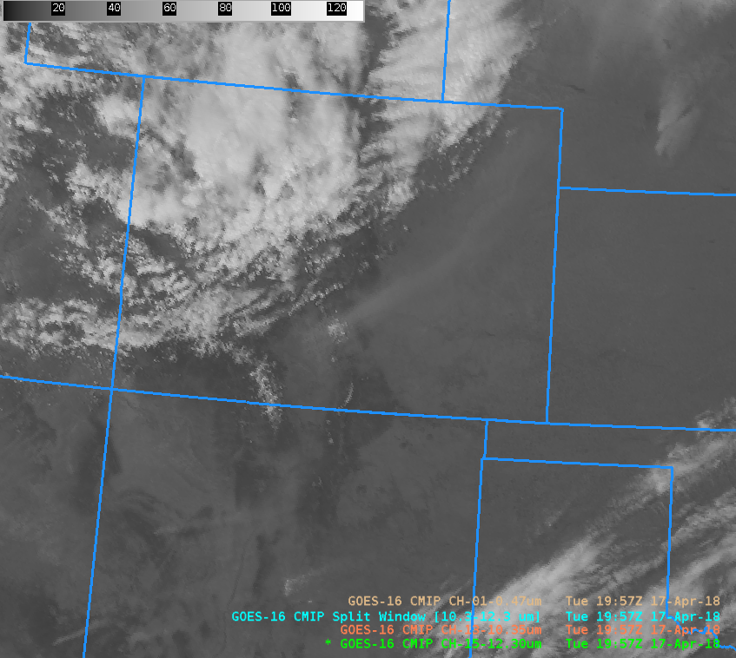
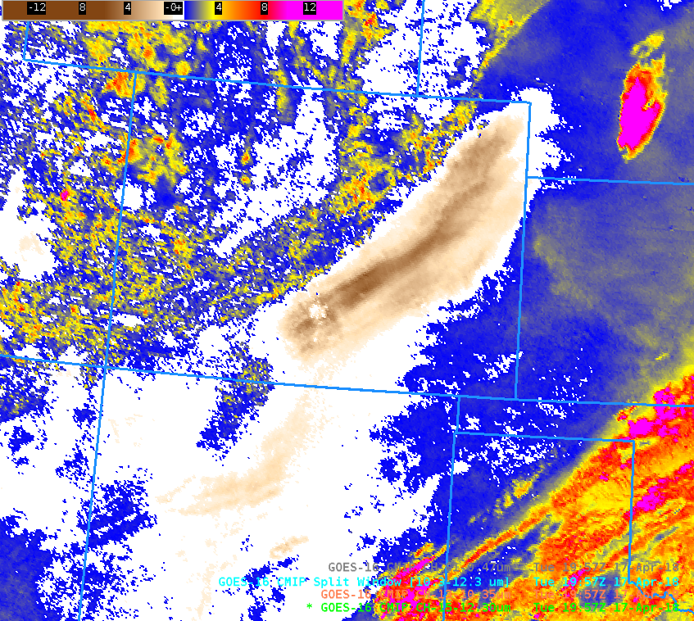
SWD detects dust
Upwelling energy from the Earth passes through a dusty layer. Dust is a more effective absorber of this energy at 10.3 μm than at 12.3 μm – thus the 10.3 μm temperature value is colder than the 12.3 μm in regions of airborne dust.
11.2 μm – 8.4 μm gives a similar result (ABI Bands 14 and 11)
The Dust RGB uses both of these channel differences
Dust plume in 0.64 μm
Dust plume in 10.3 – 12.3 μm
Notes:
The SWD also detects dust. When energy radiates upwards from the surface through a dust layer, the amount of absorption (and subsequent re-emission) varies with wavelength. In particular, dust is a good absorber of 10.3 micron radiation, but a not-so-good absorber of 12-micron radiation. 10.3 micron energy leaves the warm surface and is absorbed by dust higher in the atmosphere, and then re-emitted from that higher level where the temperature is cooler. 12 micron energy leaves the warm surface passes through the dust without being absorbed as much, so there is less re-emission from the colder higher levels. Thus the 11 micron brightness temperature will be cooler than the brightness temperature at 12 microns. It's common for Dust RGBs to include the SWD as one of the colors. Now, it is true that water vapor in the atmosphere will more readily absorb the 12 micron energy (the reason why the SWD can detect moisture distributions), but this is a dust storm; it's occurring in a region without a lot of water vapor present.

Slide 12
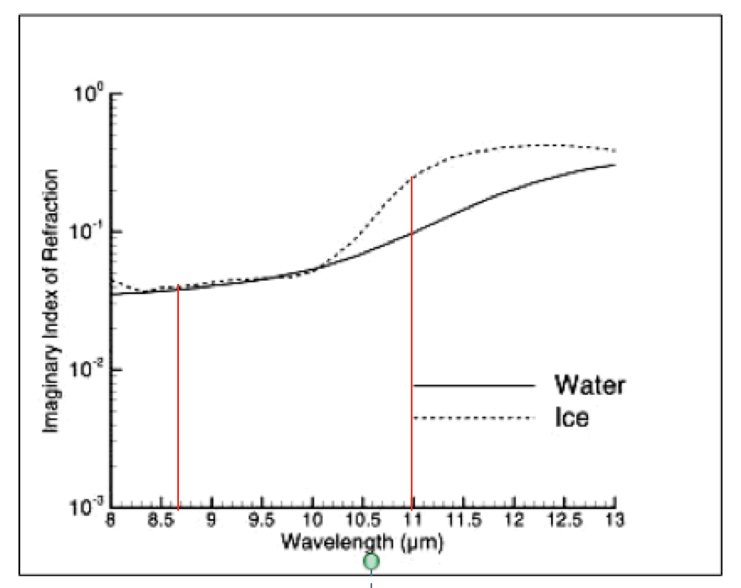
Compare Channels if absorptive qualities differ
Ice absorbs more strongly at 11 μm than it does at 8.4 μm
There’s a difference with water too, but not as great
Result: Ice clouds show colder temperatures at 11 μm compared to 8.4 μm – upwelling energy at 11 μm is absorbed. More energy at 8.4 μm passes through the ice unaffected. This is most pronounced for thin cirrus.
Relative amounts of absorption
Wavelength (μm)
Notes:
The dust absorptive differences for the 11/12 micron channels are mirrored in the ice absorptive differences in 11.2 and 8.4 microns. Again, why does greater absorption lead to cooler brightness temperatures? Much of the 11-micron energy upwelling through (in this case) the ice cloud will be absorbed, and then re-emitted from the colder temperature. Proportionally not as much energy at 8.4 microns is absorbed. If there isn’t absorption, or there is less absorption, the emitting surface is farther down, closer to the surface, in the warmer atmosphere.

Slide 13
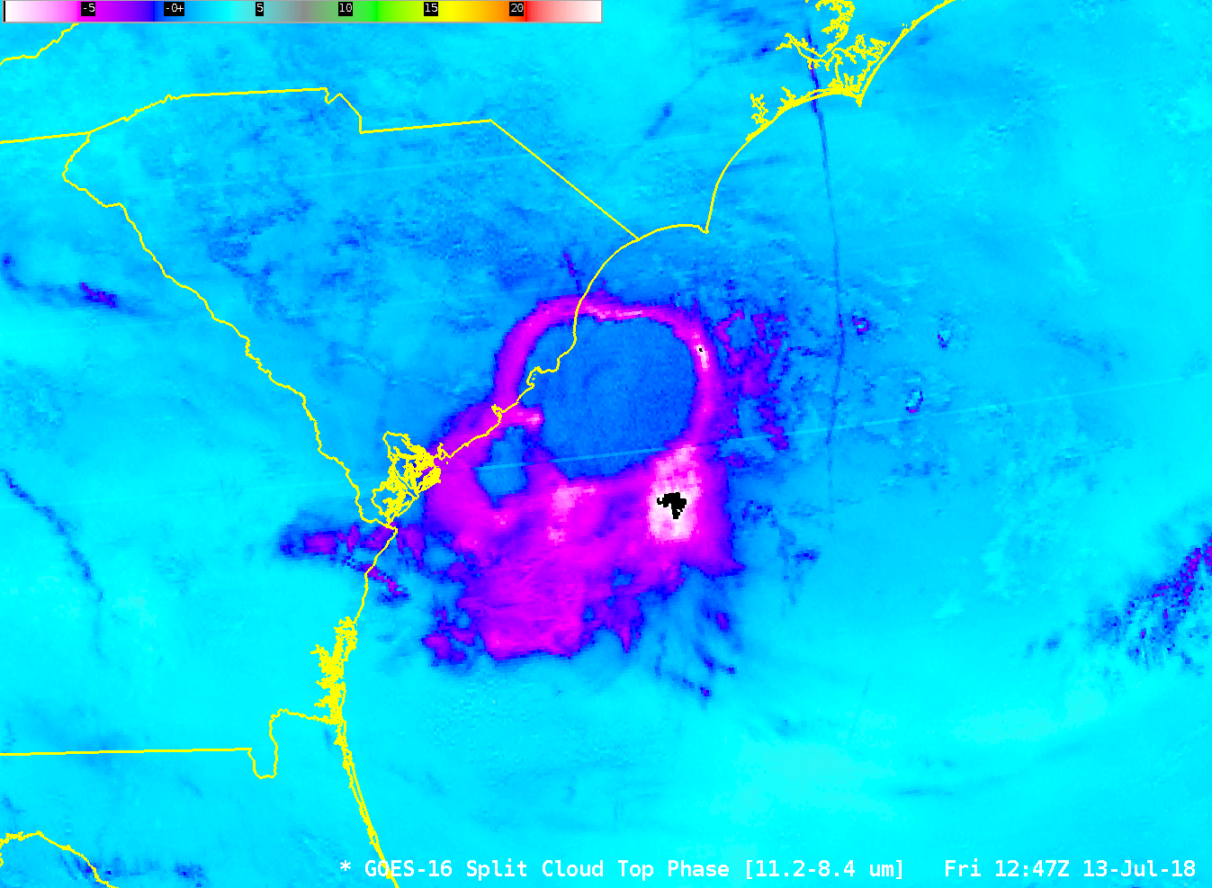
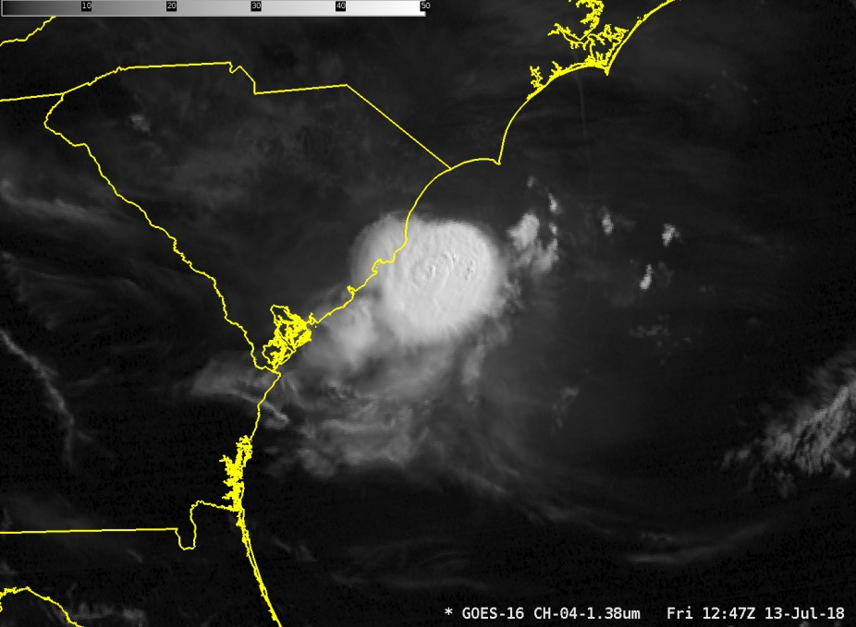
Split Cloud Top Phase
Notes:
In this example of convection off the South Carolina coast, thin cirrus (as inferred also, perhaps, by the inset 1.38 micrometer imagery) shows as magenta and white whereas thicker cirrus is blue. This is because more low-level 8.4-micrometer energy is upwelling through the thin cirrus. 11.2 micrometer energy is more likely to be absorbed

Slide 14
Sub-Pixel Effects
Longer wavelength detectors are more sensitive to colder temperatures and will show colder values in thin cirrus
Shorter wavelength detectors are more sensitive to warmer temperatures and will show warmer values in thin cirrus
  This is in part why Fire Detection uses the shortwave infrared band
This is generally called The Sub-Pixel Effect and it must be considered when interpreting difference fields
Notes:
There are also sub-pixel effects that must be considered in any brightness temperature difference field. There isn't really a sub-pixel effectin clear fields of view, or in completely cloudy fields of view - but there is a big impact on partially clear fields of view.
When a cloud does not completely fill a pixel, parts of the pixel will be filled with colder regions, parts filled with warmer regions. Shorter Wavelength detectors are more sensitive to these warm regions, and longer wavelength detectors are more sensitive to colder regions, and this subpixel effect leads to differences in computed brightness temperatures in the ABI bands that are independent of gas absorption.

Slide 15
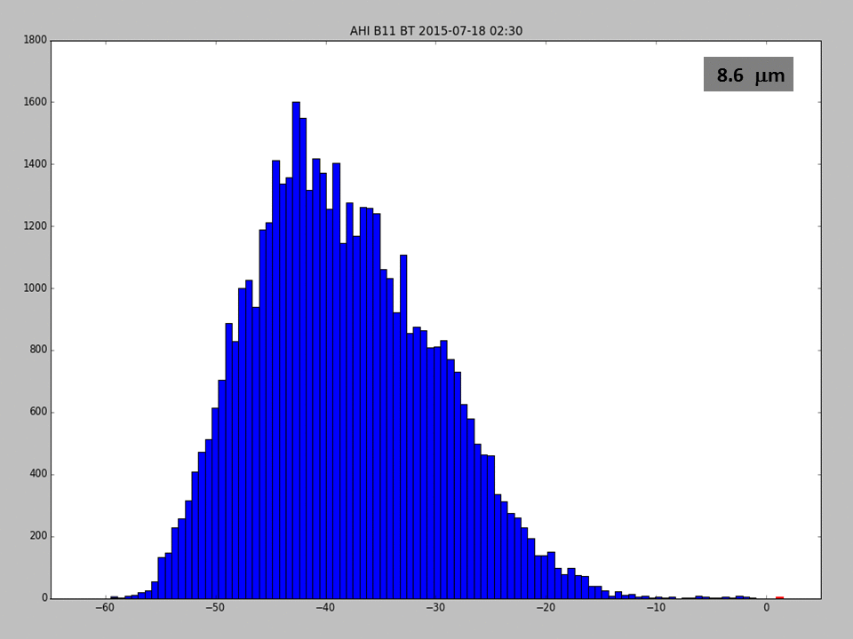
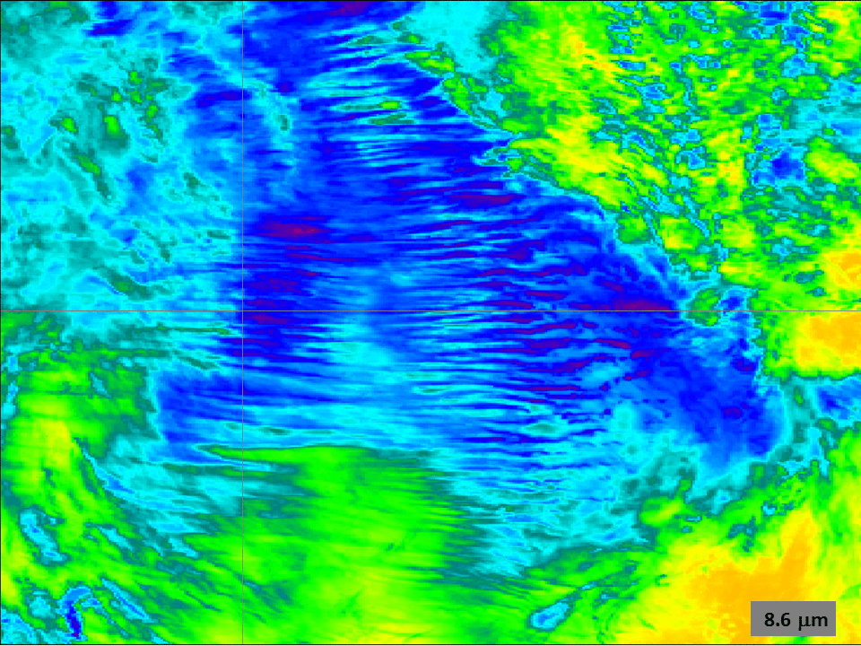
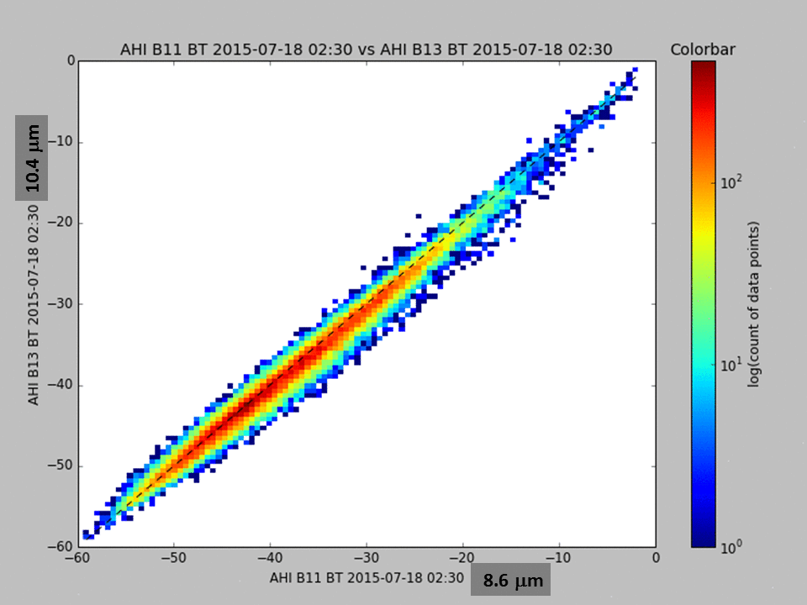
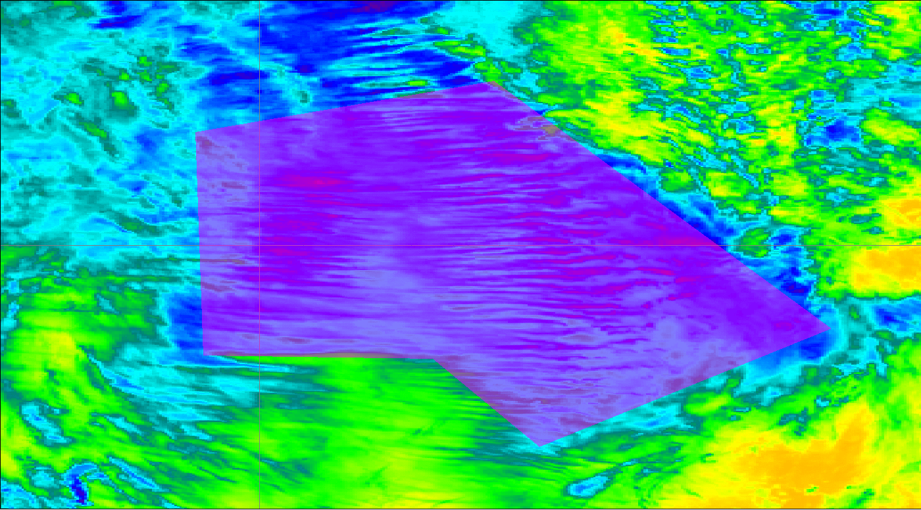
Comparison of Window Channels within one region of cirrus
Bar Plot showing temperature distribution within the purple region
Four Different Window Channels
Scatterplot comparing brightness temperatures between two different channels in purple region
The purple region
Notes:
Several plots on this page document sub-pixel effects. Four window channels are in the upper left - and you can see that detected temperatures cool for this thin cirrus as the wavelength of the observation increases. Longer wavelength detectors are more sensitive (than shorter wavelength detectors) to the colder parts of a pixel.
The figure in the bottom left shows a shaded region from which points are extracted for the figures on the right. The bar graph shows the number of pixels showing the given temperatures (colder to the left, warmer to the right) - note how shorter wavelengths show more points that are relatively warmer, and longer wavelengths show more points that are colder, as expected given the sub-pixel effect. The bottom right figure shows a density diagram of band 11 (8.6 microns) on Himawair vs. Bands 13, 14, 15. The dashed line shows x=y, and you can see that temperatures observed shorter wavelengths are generally warmer than longer.

Slide 16
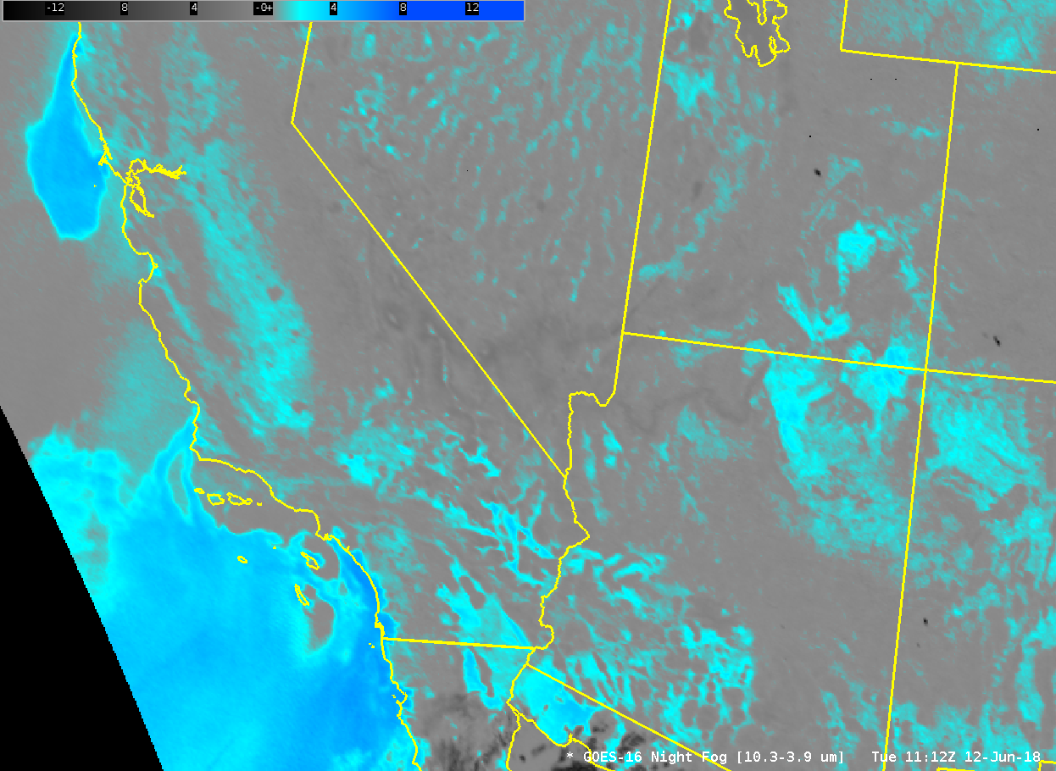
Brightness Temperature Difference Fields for Fog/Stratus Detection at Night
Water based clouds (stratus)
Emit Longwave IR radiation as a blackbody
Do not emit Shortwave IR (3.9 μm) radiation as a blackbody
Brightness Temperature Computation assumes blackbody emissions
Computed 3.9 μm temperature is relatively cold
Brightness Temperature Difference larger over water-based clouds
During the day, reflected solar radiation at 3.9 μm overwhelms this affect
Emissivity differences over dry land can also cause a signal. Check the obs and model data too to make sure.
If a band includes 3.9 μm or near-infrared data, beware solar contamination and sunglint.
Notes:
Another well-known difference field is used to identify regions of low stratus and fog. Clouds made up of water droplets are not black-body emitters of all wavelength radiation. Satellite detectors of radiation simply collect a number of photons. The conversion of those radiance counts to brightness temperature assumes blackbody emission, however, so if a surface hasn't emitted as a blackbody (meaning less photons than a theoretical maximum have been emitted), then the inferred temperature will be cooler. This occurs for 3.9 micrometer radiation, but not for radiation around 11 micrometer. For water based clouds, the 3.9 micrometer brightness temperature is cooler than the 10.3 micrometer brightness temperature or the 10.7 micrometer brightness temperature on GOES 13/14 & 15.

Slide 17
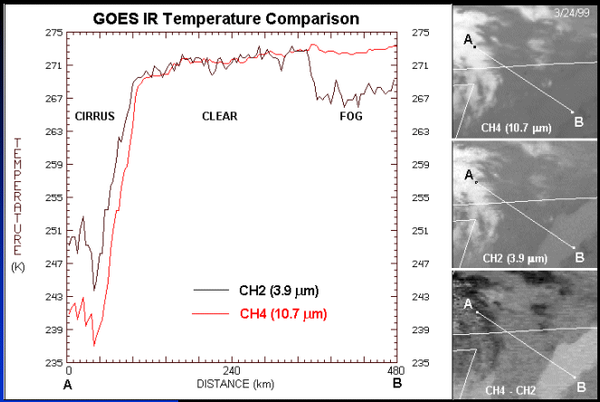
Legacy
Band differences can be related to surface- (or cloud-) based
emissivity differences or to sub-pixel effects
Regardless of cause, the differences can be exploited
Notes:
In this cross-section from a fog bank to a cirrus deck, you see differences in the brightness temperatures that are related to emissivity differences in the low stratus (so that the 3.9 micrometer temperature is cooler than 10.7) and you see transmissivity differences in cirrus and subpixel effects so that 3.9 micrometer brightness temperatures are warmer than 10.7 micrometer brightness temperatures. In clear regions, at night, the 10.7 and 3.9 temperatures are similar.

Slide 18
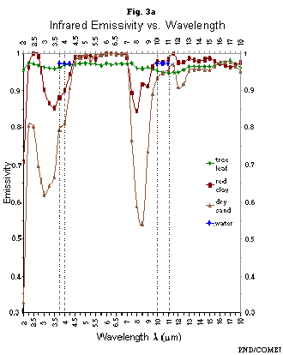
Emissivity differences are not limited to water-based clouds
There are big differences in emissivity at 3.9 μm for different surfaces.
There are not big differences in emissivity at 10.7 μm for different surfaces.
Reminder: Reflectivity differences occur as well….there’s a lot of 3.9 μm solar reflectivity and not as much 10.7 solar reflectivity (during the day)
Notes:
It's not only clouds that can affect 3.9 micrometer temperatures. This graph shows emissivity over water (pretty close to 1), dry sand, red clay, and tree leaf. Dry sand and red clay who emissivities much less than 1. Black body temperatures over this, then, will be cooler than black body temperature computed at other wavelengths where emissivities are close to 1 (like 11 micrometers). Keep this in mind when you're looking at brightness temperature differences that key off emissivity differences.

Slide 19
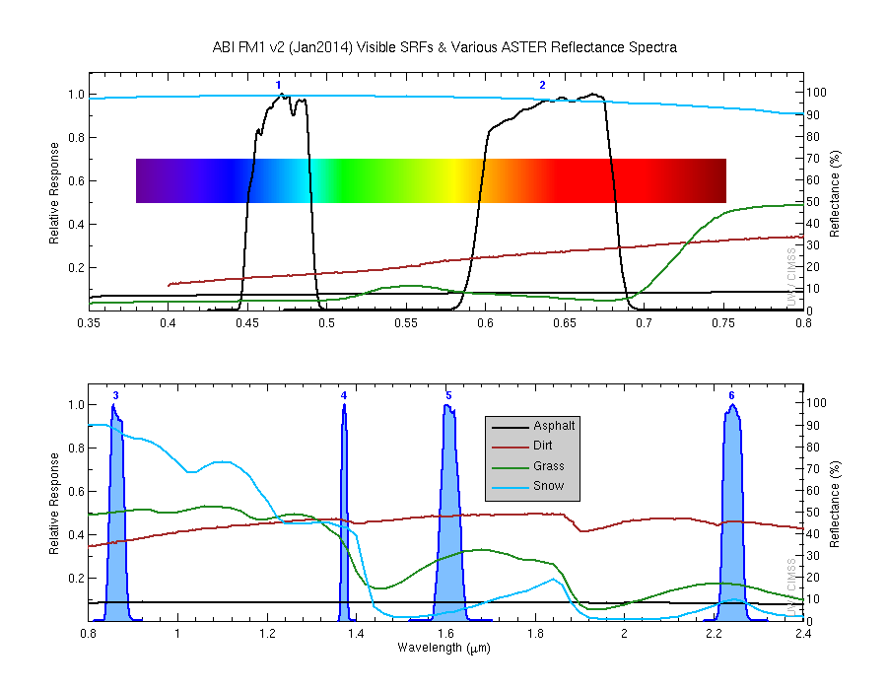
Notes:
Reflectance differences are what's important for visible and near-infrared channels, as shown on this chart showing the 2 visible and 4 near-IR channels on ABI. Note, for example, how much more reflective grass is in the .86 micrometer band 3 (“the veggie band”) than in the .64 micrometer visible. Note how much more reflective snow/ice are in the visible than in the 1.6 micrometer channel. These differences can be played off one another to highlight features in either difference fields, or in RGBs, or in simple comparisons (that is visual inspection) of two bands.

Slide 20
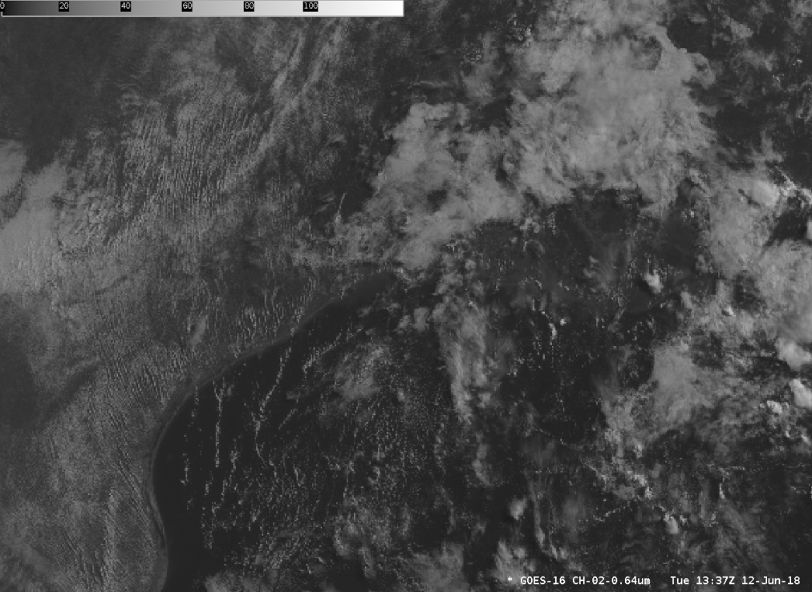
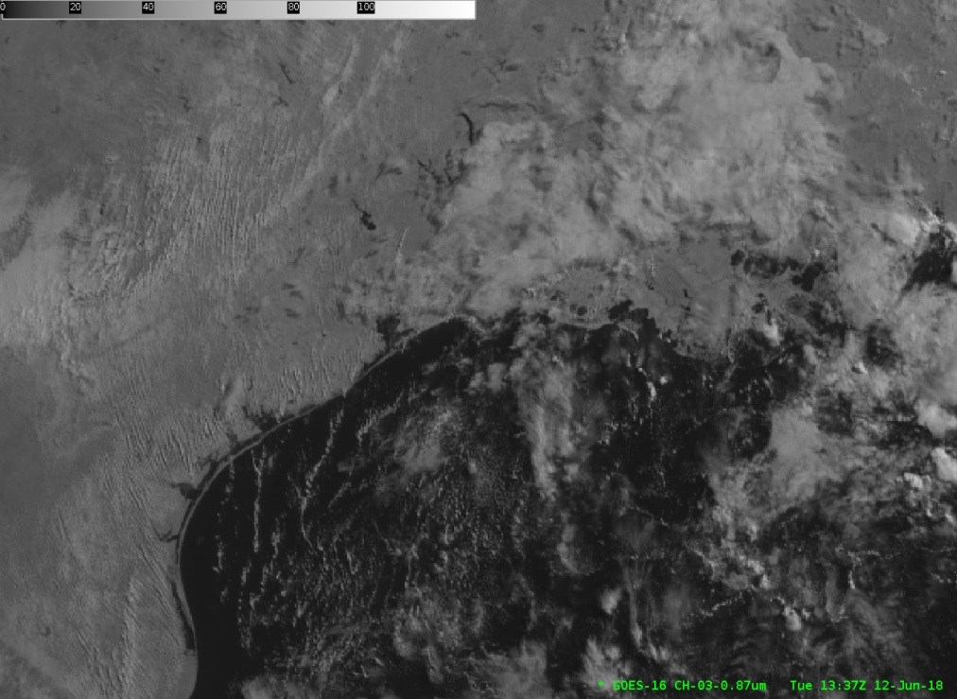
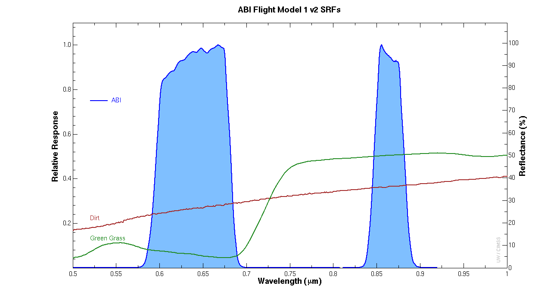
ABI Band 2 (0.64 μm) Versus Band 3 (0.86 μm)
ABI Band 2 (0.64 μm)
ABI Band 3 (0.86 μm)
Vegetation is more reflective at 0.86 μm than at 0.64 μm
Water and clouds have similar reflectance at 0.86 & 0.64 μm
Land/Water contrast greatest at 0.86 μm
Land/Cloud contrast greatest at 0.64 μm
Notes:
In Band 3 - the veggie band on ABI, 0.86 micrometer - green vegetation is far more reflective than in the visible channel. Thus, this band excels in distinguishing between land and water. Bodies of water surrounded by land will really pop out, so it's great for examining changes due to excessive rainfall (that is, flooding). Because green land is so reflective, clouds are sometimes hard to distinguish over land in the 0.86 micrometer - there's more contrast in the visible.

Slide 21
Snow is Highly Reflective!
Snow/Ice looks different
in visible vs. 1.6/2.2
Snow is Not Reflective!
Notes:
Snow/Ice clouds are highly reflective in the 0.64 micrometer visible band on ABI. Snow absorbs energy at 1.6 micrometers. Thus, snow/ice and clouds made up of water droplets that look similar in the visible 0.64 micrometer imagery will look much different in 1.6 micrometer imagery.

Slide 22
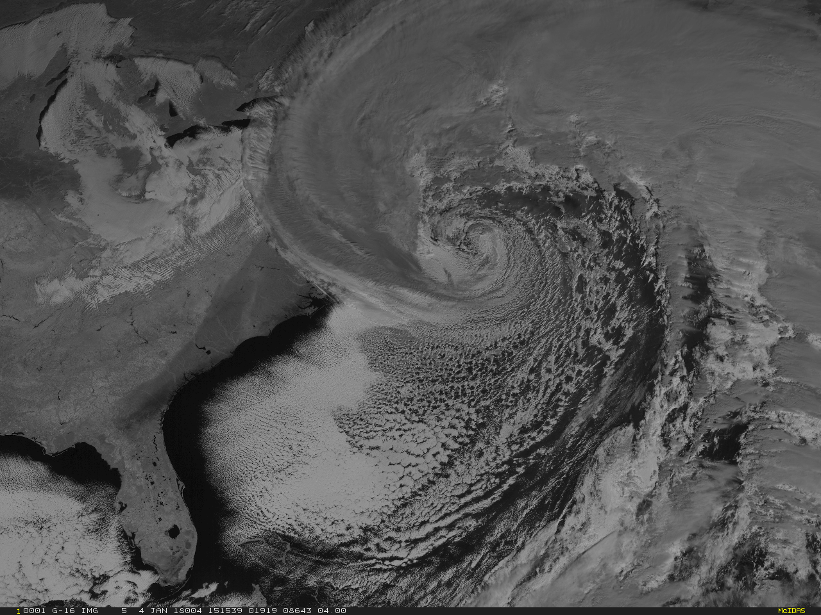
ABI Band 5 (1.6 μm)
Water clouds
snow
ice
Ice clouds
Imagery above from this blog post
Notes:
This figure of a wave cyclone in the western Altantic shows a cirrus shield that is much less bright than the lower water clouds. That's because ice is absorbing a lot of energy and reflecting not as much compared to water based clouds. There’s also a band of snow on the ground over the mid-Atlantic states that shows up as dark. Ice to the south shows up as even darker.

Slide 23
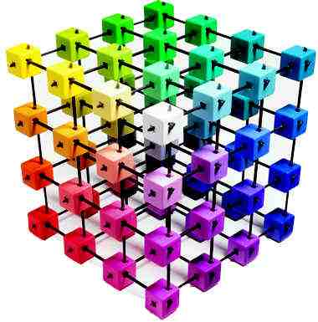
Critical Knowledge for interpreting RGBs
What color combinations create which color?
  Red + Green = Yellow
  Red + Blue = Magenta
  Green + Blue = Cyan
Notes:
Let's now consider RGBs. To interpret RGBs, you must understand how colors are constructed in modern computer imagery. In the color cube, the primary colors (Red, Green, Blue) are at 3 corners of the cube, White (All Colors) and Black (no colors) are at 2 corners, and the other 3 corners are color combinations: Yellow (Red+Green with no blue), Cyan (Green+Blue with no red) and Magenta (Red+Blue with no green). All colors can be found in the color cube based on the 3-color combination. For example, orange is a lot of red plus some green and no blue. Knowing how different colors are created will help your interpretation of RGB imagery.

Slide 24
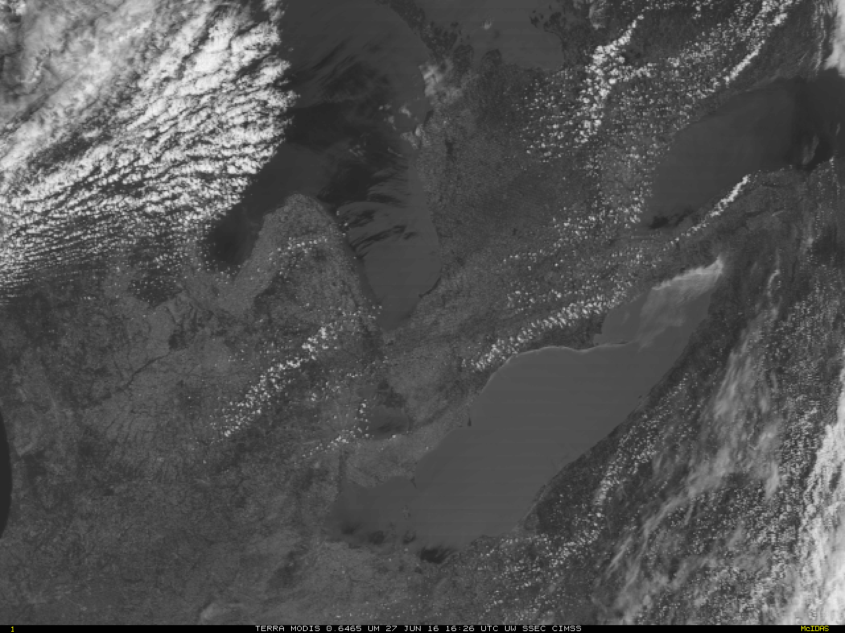
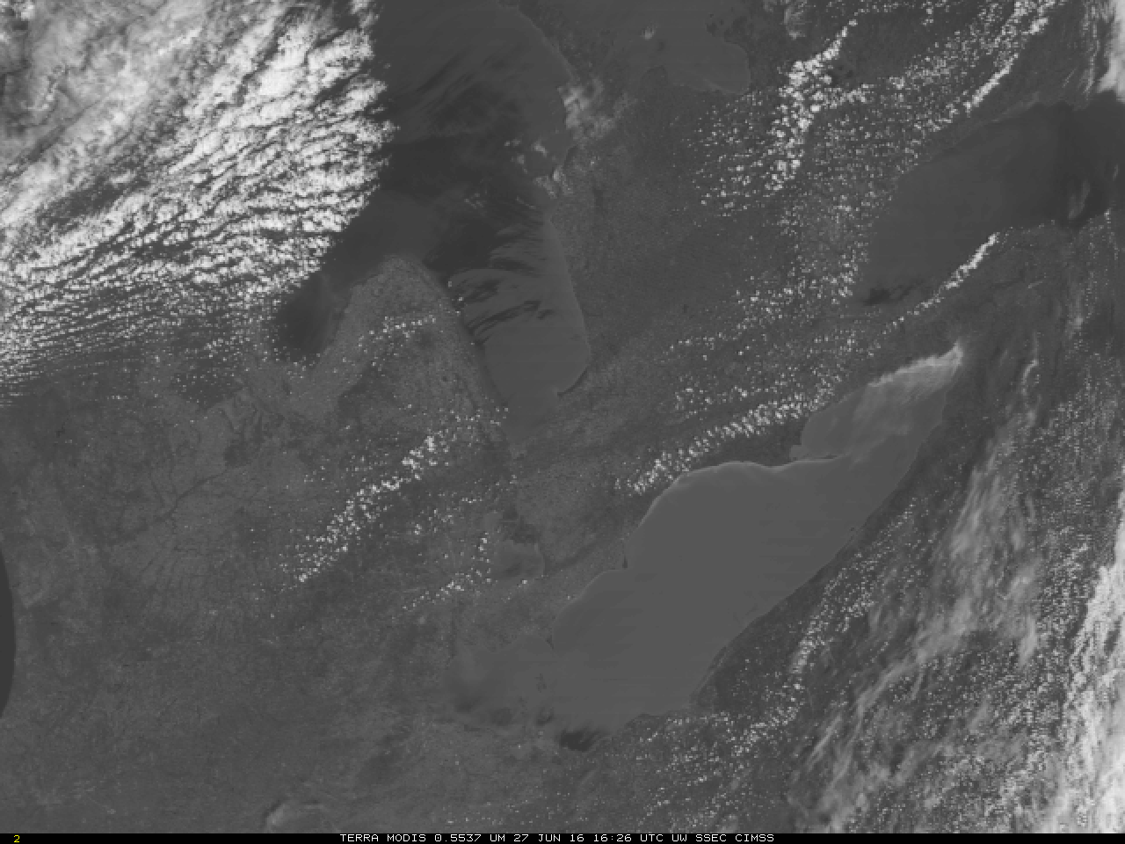
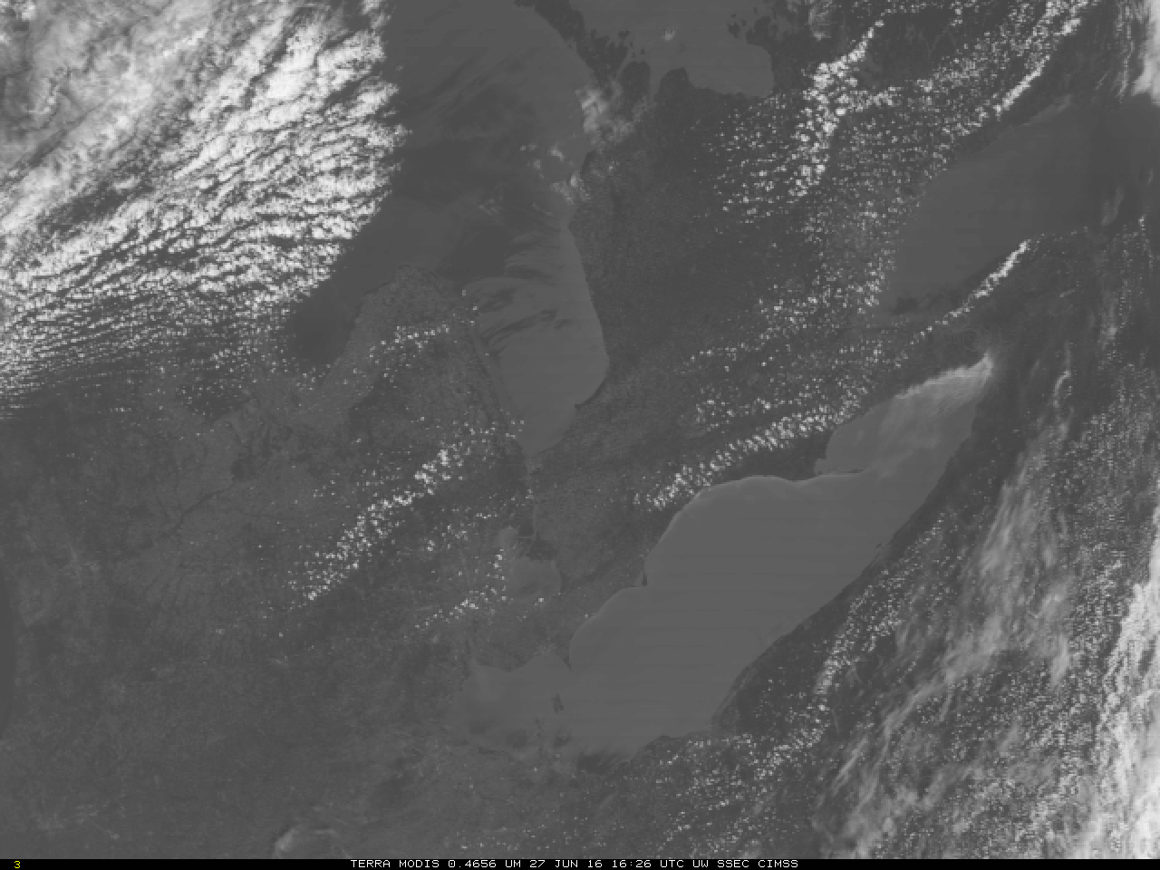
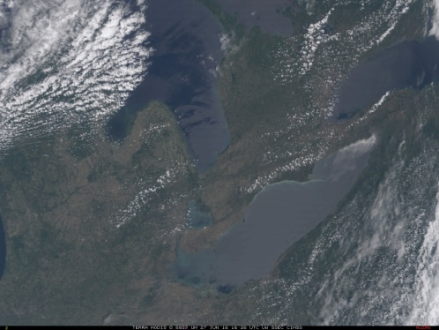
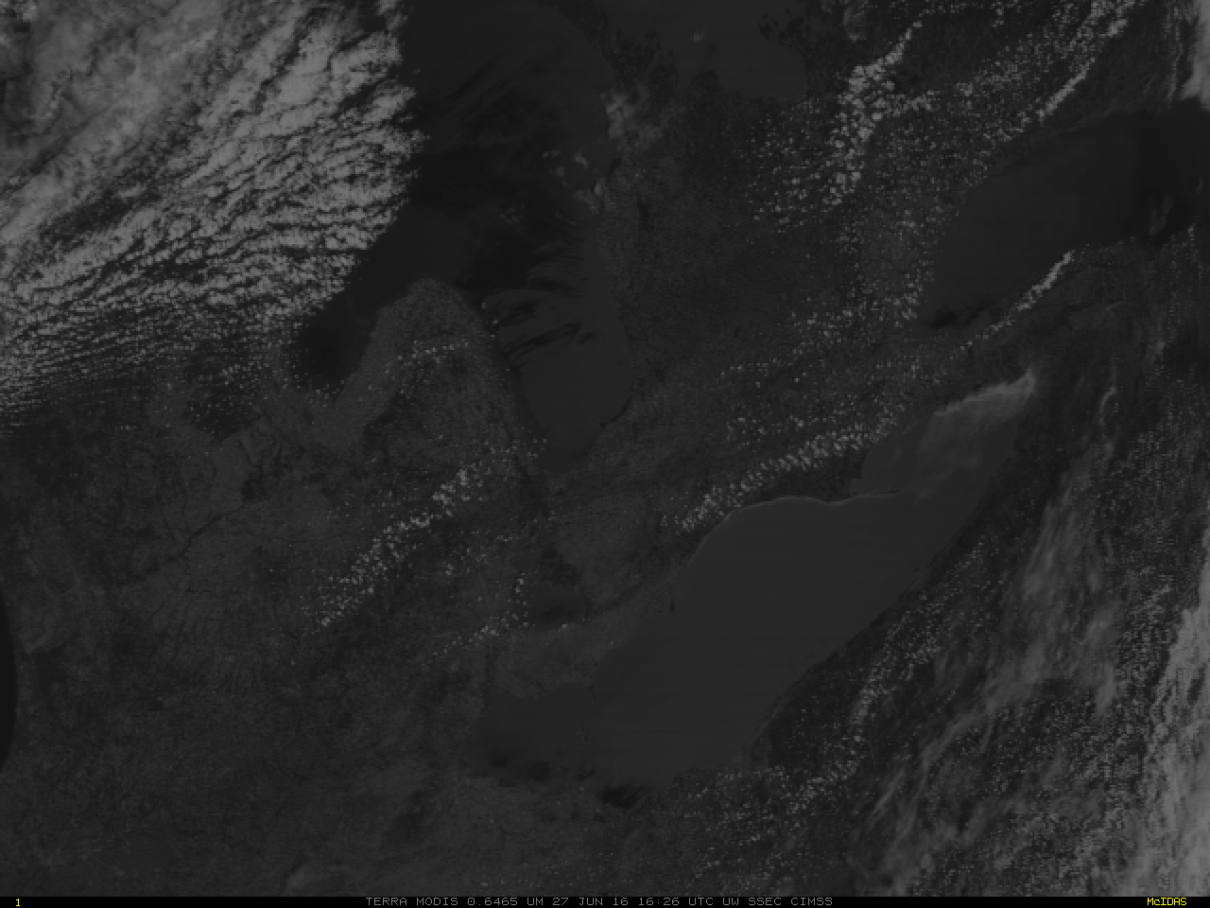
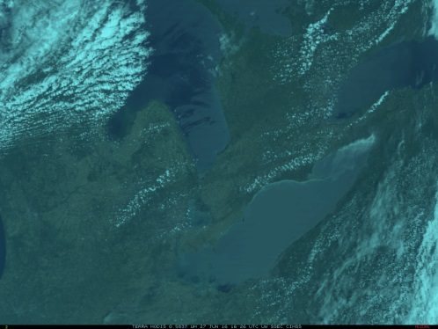
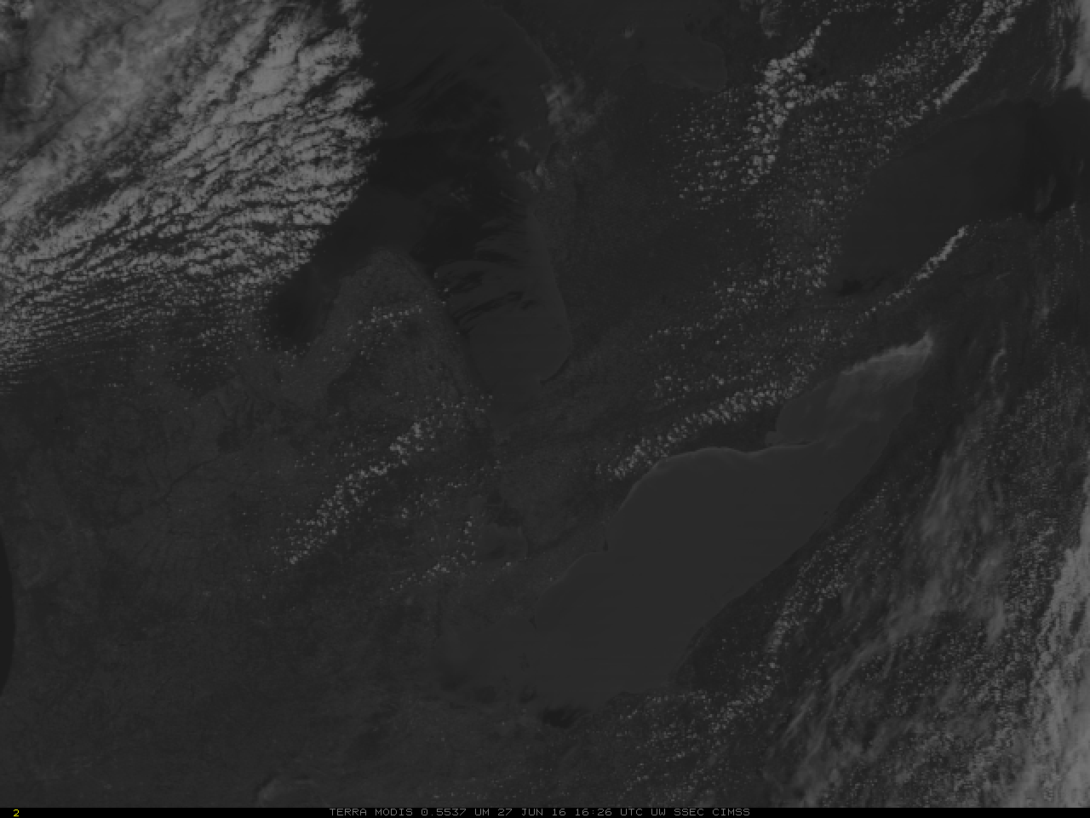
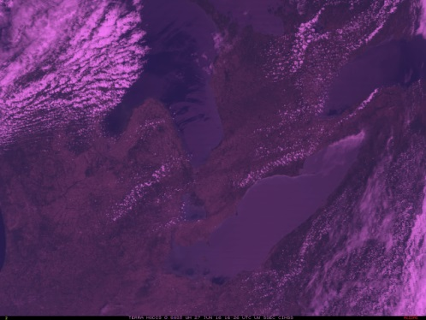
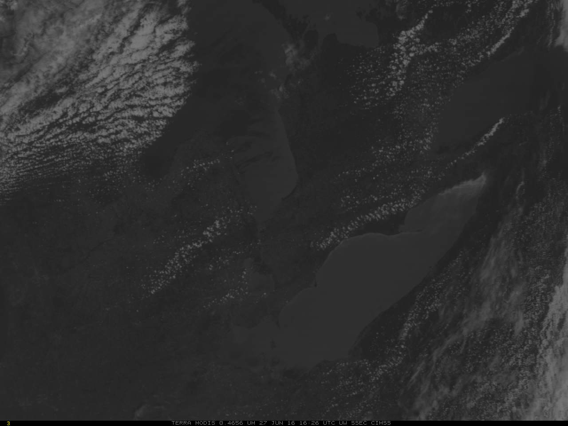
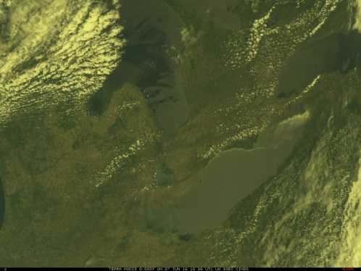
0.65 μm
0.55 μm
0.47 μm
Line 1: Regular RGB Composite
Line 2: Half the amount of Red, cyan tint to RGB
Line 3: Half the amount of Green, magenta tint to RGB
Line 4: Half the amount of Blue, yellow tint to RGB
Notes:
This slide shows how changing one of the three inputs will affect the RGB image. The columns show the red, green and blue component and a derived RGB. The top line shows the red, green and blue bands from Terra MODIS, and the True-Color RGB. The control, if you will. In the 2nd line, the red component is only half as bright - the green and blue are full intensity - in the 3rd line the green component is half as bright - the red an blue are full intensity and in the 4th line the blue component is half as bright - the red and green remain at full intensity. The RGBs from the 4 combinations are the rightmost column. With less red, the RGB acquires a cyan-ish hue: blue + green is cyan. With less green, the RGB acquires a purple hue because red and blue make magenta, and with less blue the RGB acquires a yellowish hue because red+green makes yellow. In this example, my opinion is that the RGB with halved green is the most un-natural looking, perhaps indicating the importance of green wavelengths over a vegetated surface.

Slide 25
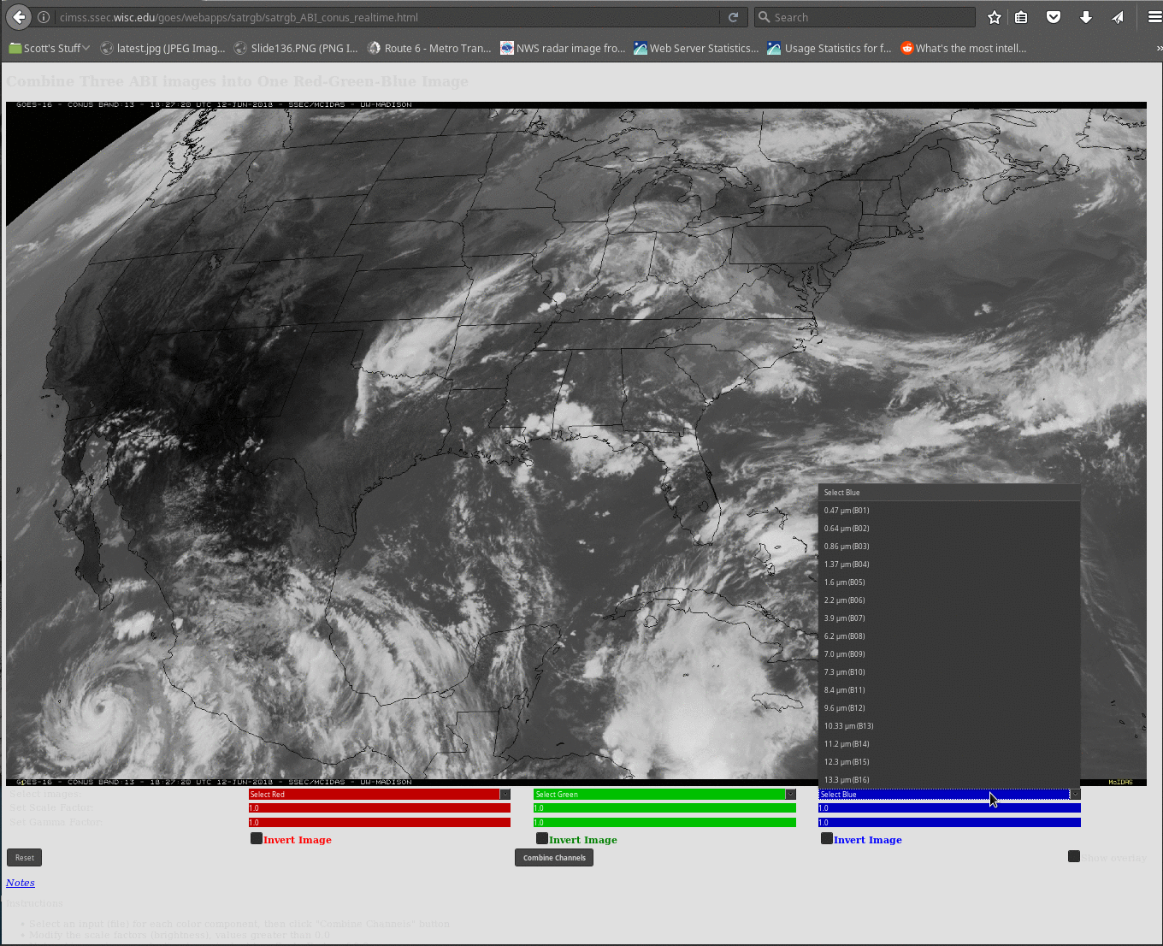
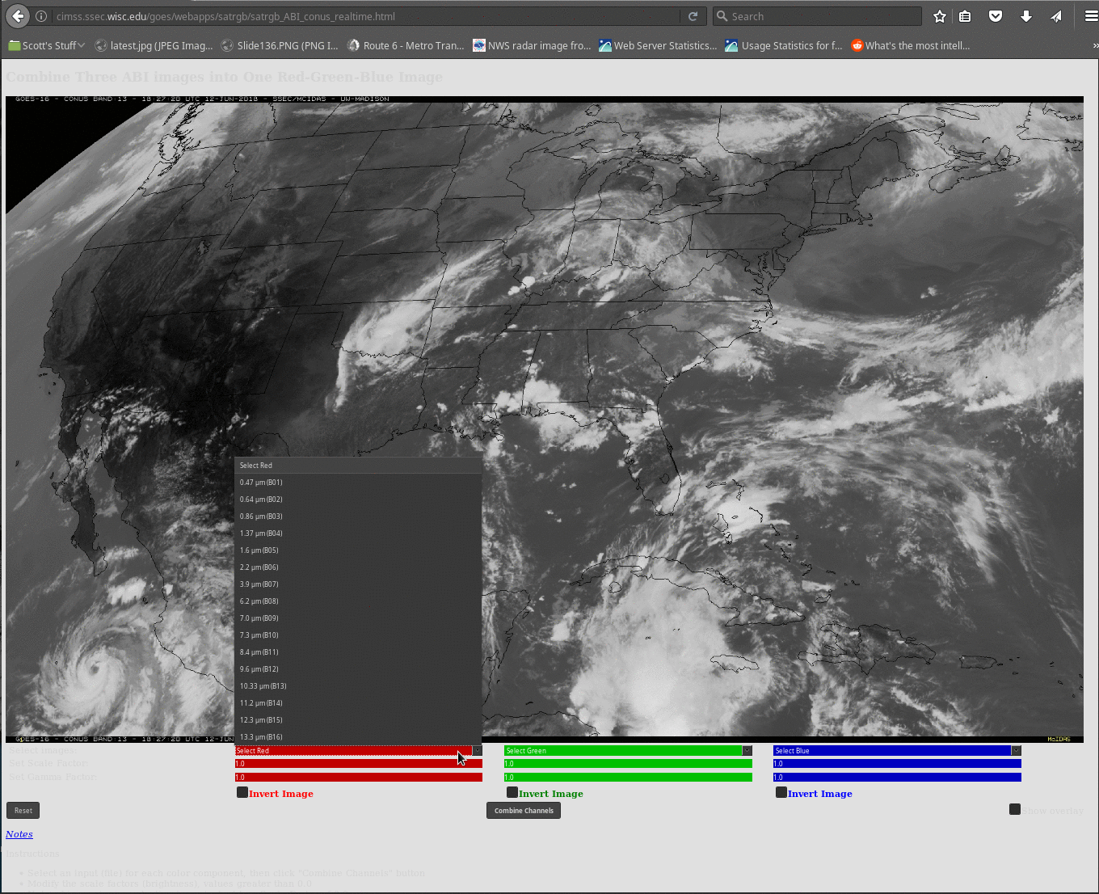
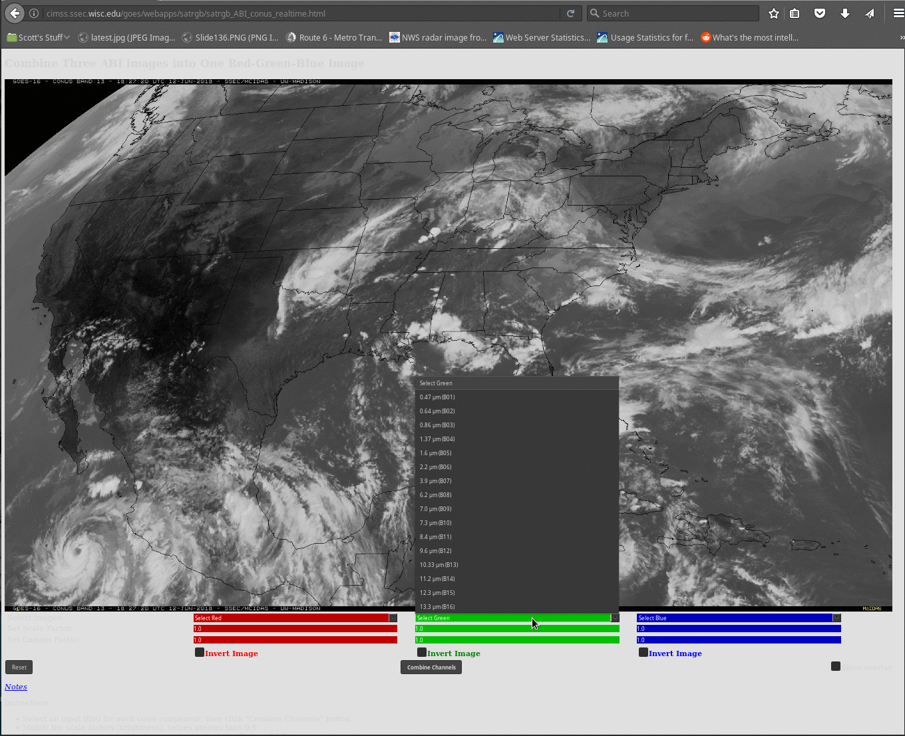
RGB Computation can be done on-line with real-time data! http://cimss.ssec.wisc.edu/goes/webapps/satrgb/satrgb_ABI_conus_realtime.html
Choose Channels for Red, Green and Blue
Notes:
You can create single-banded combinations of RGBs using an online tool at the url on this screen. (Click on it!). This webapp uses current ABI data, allows you to choose single bands for the red, green an blue components, and creates the RGB combination. In this way you can explore the different possibilities combining single ABI channels.

Slide 26
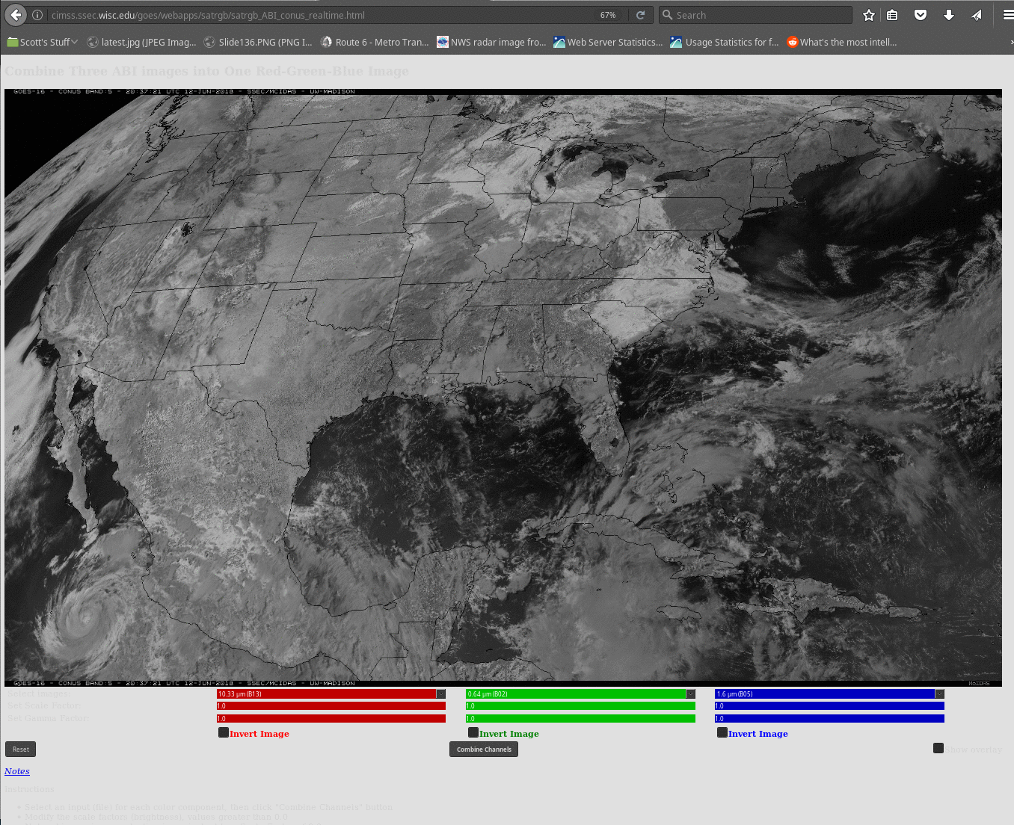
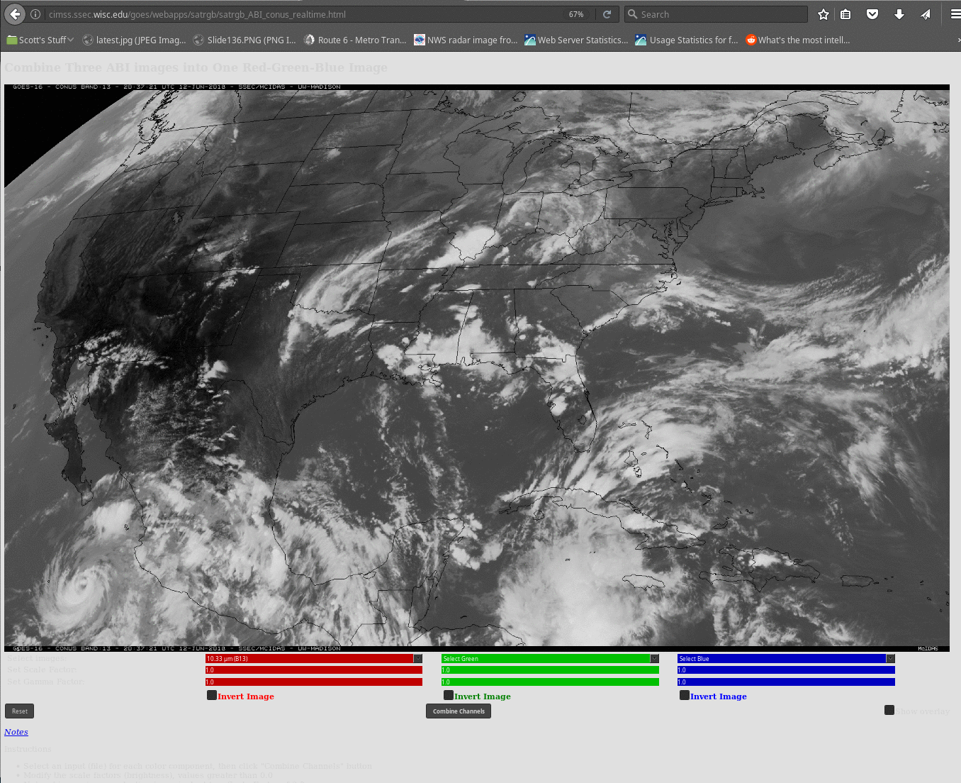
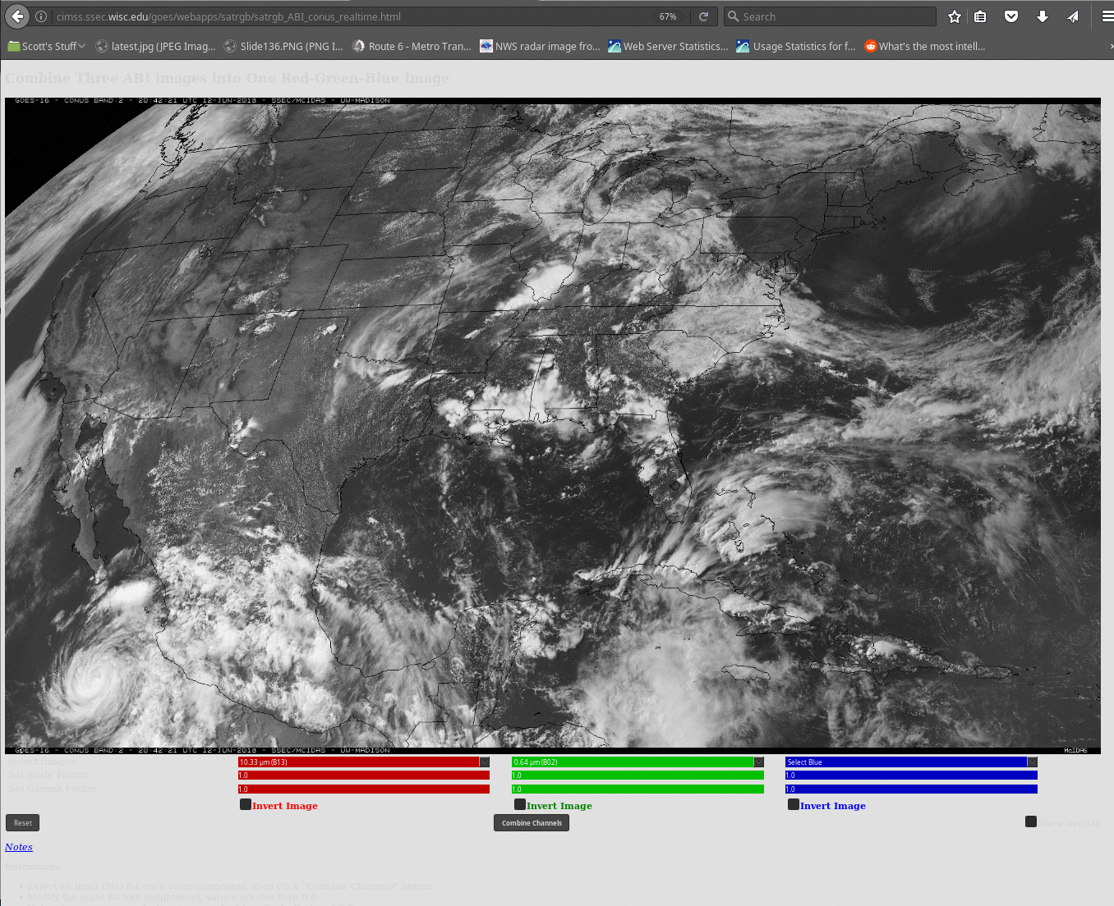
1.61 μm
10.3 μm
Red: 10.3 μm
Green: 0.64 μm
Blue: 1.61 μm
RGB Combination: Any guesses?
This is ‘Day Cloud Phase Distinction’ in AWIPS
0.64 μm
Notes:
Here's a Daytime image that combines 10.3 micrometers in the red, visible 0.64 micrometers in the green, and snow/ice 1.6 micrometers in the blue. Do you have a guess what you'll see? What color will the hurricane in the pacific be, for example?

Slide 27
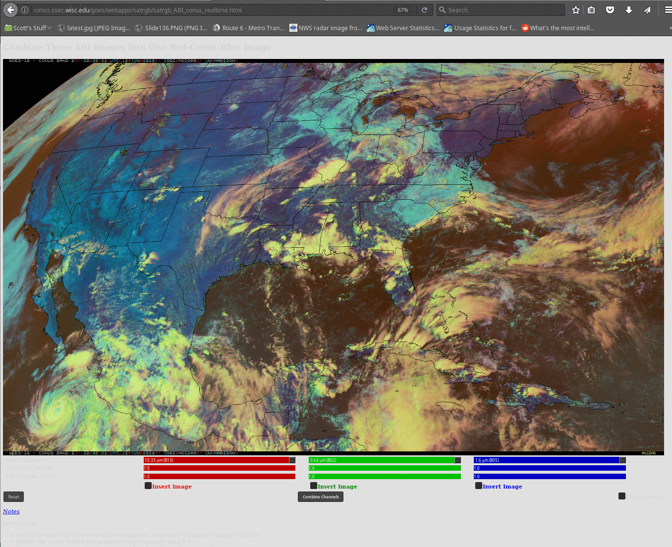
Blue regions: Blue is dark, and Red is warm
Yellow: Red is cold, Green is bright (High Ice Clouds)
Cyan: Red is warm, Green, Blue both bright (Water clouds)
Notes:
were your guesses correct? Water clouds will be cyan, without a lot of red (10.3 micrometers) because they are warm. High ice clouds -- like over the hurricane are yellow because they don't contain a lot of 'blue' from the snow/ice channel.

Slide 28
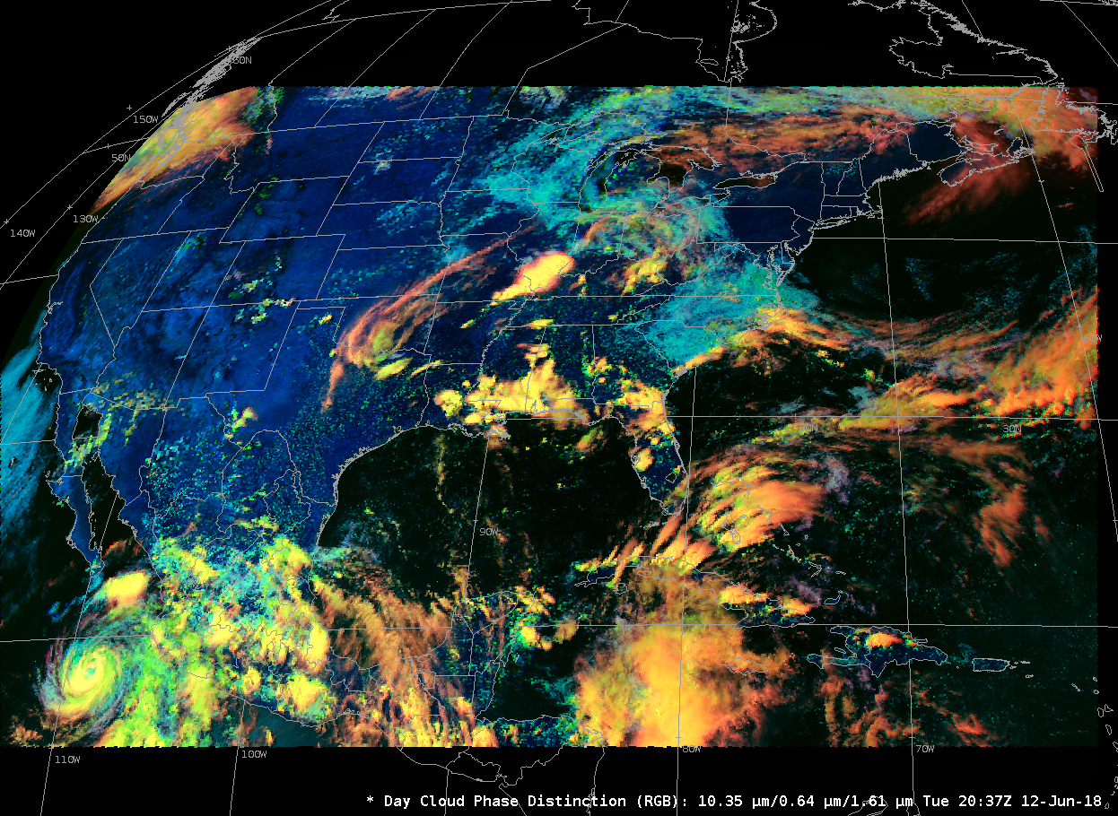
The same RGB in AWIPS
You can use DCPD RGB to monitor convective development – clouds transition from cyan to green to yellow as the grow vertically. Bands used in this RGB as integral to LightningCast probability fields too
Example 1
Example 2
Example 3
Notes:
Here's the same RGB as produced in AWIPS

Slide 29
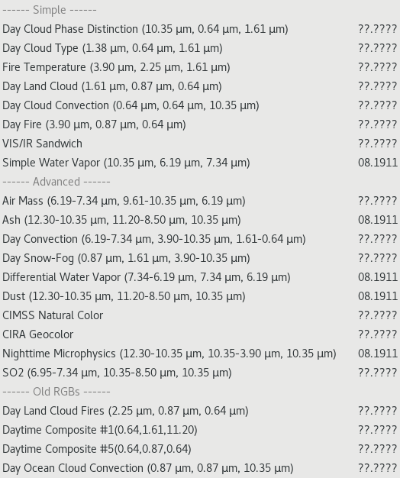
RGBs that are in AWIPS (Nov 2024)
(COMET Module on RGBs)
(RGB Information from Eumetsat)
Notes:
RGBs that are present in AWIPS have been changing at times in the past 18 months (as of mid-summer 2018), but they are now relatively stable. They are listed here. You can also find additional information on RGBs at the link to a COMET module on RGBs, and at the link to EUMETSAT.

Slide 30
RGB Products in this module
Fire Temperature
  3.9 μm ; 2.24 μm; 1.61 μm
Air Mass
  6.19 – 7.34 μm ; 9.6 – 10.3 μm ; 6.19 μm
Nighttime Microphysics
  12.3 – 10.3 μm ; 10.3 – 3.9 μm ; 10.3 μm
Day Snow Fog
  0.87 μm ; 1.61 μm ; 3.9 – 10.3 μm
Day Land Cloud
  1.61 μm ; 0.87 μm ; 0.64 μm
CIMSS Natural Color
  0.64 μm ; 0.86 μm ; 0.47 μm
Notes:
There are seven RGB images that you'll see next. Given the bands, maybe you can guess what you'll see, and why you are seeing that color - but for some of the RGBs, that's far more difficult because (1) a band difference is used and (2) only certain ranges of that band difference are included in the RGB.
Note that if reflective channels are used, the product is generally not useful at night.

Slide 31
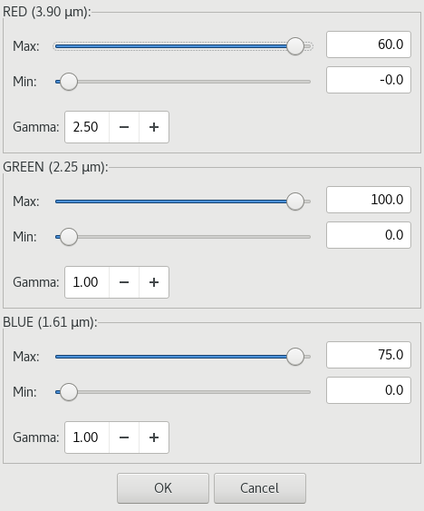
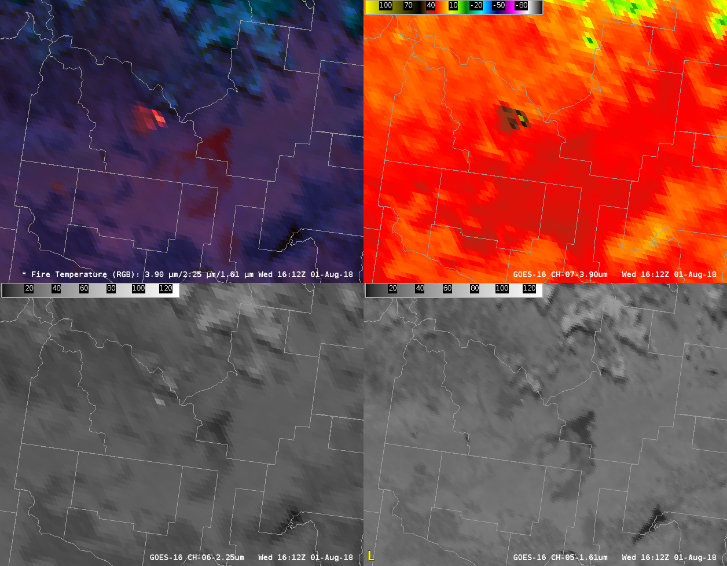
Fire Temperature
Quick Guide
RGB
3.9 μm
2.2 μm
1.61 μm
Notes:
For the Fire Temperature RGB, 3.9 μm data are used for the 'Red' Component, 2.24 μm is used for the green, and 1.61 μm is used for the blue. As a fire gets hotter and hotter, red data (which is almost always there) is augmented by first green (Red + green) makes yellow, and then blue. So as a fire develops and increases in intensity, its color will change from red to yellow to white. The plots here show the standard AWIPS displays for the three constituents in the RGB; The RGB uses only part of the dynamic range for each of the different bands. A Gamma of 2.5 is applied to the Red Component. . If gamma is >1, then the high end of the distribution is highlighted (so in this image, the hottest pixels are emphasized). If gamma is <1, then the low end of the distribution is highlighted (in this case, for the red, the cooler pixels would be highlighted). The Gamma of 2.5 makes the fire region pop.

Slide 32
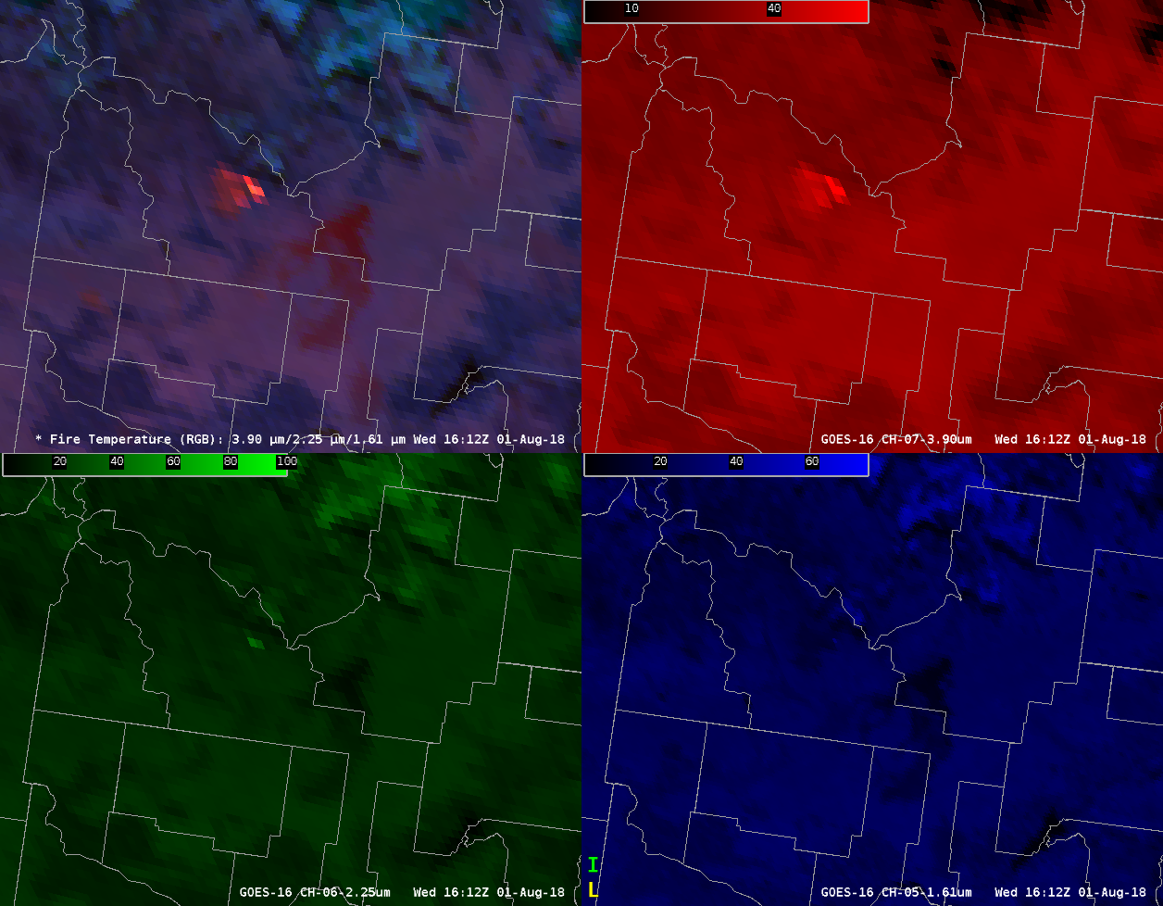
Fire Temperature
Quick Guide
RGB
3.9 μm
2.2 μm
1.61 μm
Notes:
Not all of the dynamic range in the channels is used in the RGB. That's shown here. for the Red Channel only temperatures between 0 - 60 C are considered; for the Green, reflectances of 0-100 considered; Blue, reflectances of 0-75 are used. In addition, a gamma of 2.5 is applied to the red. Gamma is a way to tweak how the component is presented. If gamma is >1, then the high end of the distribution is highlighted (so in this image, the hottest pixels are emphazied). If gamma is <1, then the low end of the distribution is highlighted (in this case, for the red, the cooler pixels would be highlighted)

Slide 33
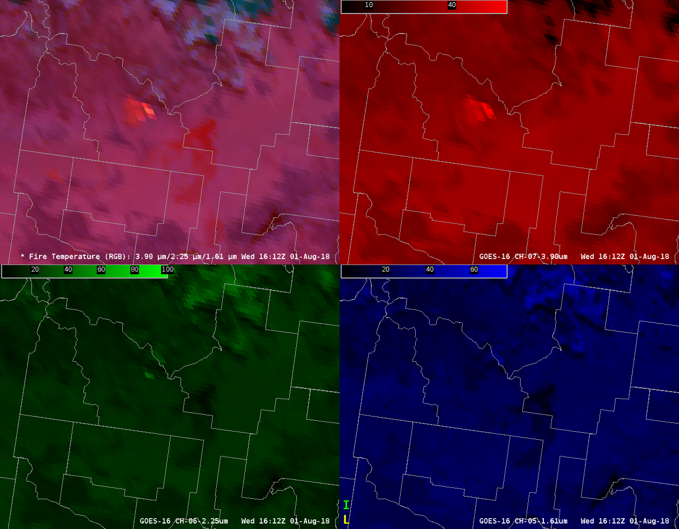
Fire Temperature
Quick Guide
RGB
3.9 μm
2.2 μm
1.61 μm
Notes:
Here's the same RGB but with gamma =1. Features outside the fire become more apparent in the RGB when the red gamma is reduced. If gamma was made very small, then the fire would be hard to see in this RGB because all the contrast in the red would be focused at the cold end of the scale.

Slide 34
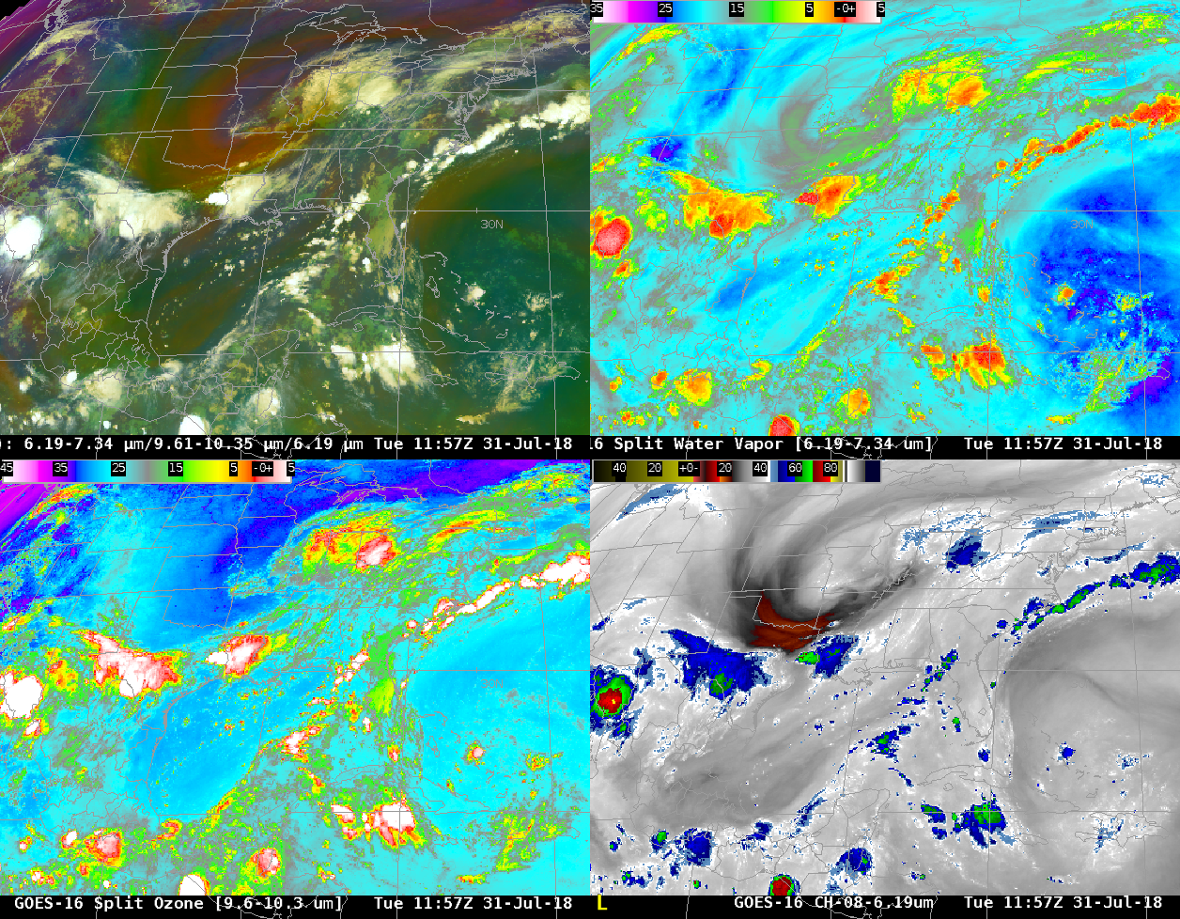
Air Mass
Quick Guide
RGB
6.19 μm – 7.34 μm
9.6 μm – 10.3 μm
6.19 μm
Notes:
The Air Mass RGB has a long history. It uses the split Water Vapor channel as its red component, the split ozone as green, and the upper level water vapor as the blue.
Channel differences used in this RGB -- and in others -- are in AWIPS. For information on why the channel difference is part of the RGB, consult the Quick Guides for those channel differences. The orange regions of the airmass RGB, such as over OK and AR, correlate very well with potential vorticity anomalies

Slide 35

Air Mass
Quick Guide
RGB
6.19 μm – 7.34 μm
9.6 μm – 10.3 μm
6.19 μm
Notes:
The Split water vapor values used for the red component range from 0.6 to -26.2 ; Split Ozone values for the Green range from 6.7 to -43.2 ; and water vapor values range from -64.7 to -29.3 for the blue.

Slide 36

Nighttime Microphysics
Quick Guide
RGB
12.3 μm – 10.3 μm
10.3 μm – 3.9 μm
10.3 μm
Notes:
Nighttime Microphysics is another RGB with a long history of use. It uses the Split Window Difference as its red component, the night fog brightness temperature difference as its green component, and the clean window channel, 10.3 micrometers, Band 13, as its blue component.
Note that Quick Guides for RGBs in AWIPS have been developed and are available in the AWIPS Interactive Resource and in VLab.

Slide 37

Nighttime Microphysics
Quick Guide
RGB
12.3 μm – 10.3 μm
10.3 μm – 3.9 μm
10.3 μm
Example 1
Example 2
Example 3
Notes:
Ranges for the components are 2.6 to -6.7 for Red; 5.2 to -3.1 for Green ; and 19.5 to -29.5 for Blue.

Slide 38

Day Snow Fog
Quick Guide
RGB
0.87μm
1.61 μm
3.9 μm - 10.3 μm
Notes:
Day Snow Fog combines the Veggie Band, 0.87 micrometers, the Snow/Ice Channel at 1.61 micrometers, and the Day Fog Brightness Temperature Difference (3.9 micrometers - 10.3 micrometers)

Slide 39

Day Snow Fog
Quick Guide
RGB
0.87μm
1.61 μm
3.9 μm - 10.3 μm
Notes:
Reflectances values for the 0.87 micrometer and 1.61 micrometer bands are 0 -100 ; Brightness temperature difference values between 30 to 0 are used. Additionally, a gamma of 0.59 is applied to all 3 components. This emphasizes the low ends of the scales.

Slide 40

Day Snow Fog
Quick Guide
RGB
0.87μm
1.61 μm
3.9 μm - 10.3 μm
Notes:
Here's what the RGB looks like with gamma equal to 1, rather than 0.59/

Slide 41

Day Land Cloud
Quick Guide
RGB
1.61 μm
0.87 μm
0.64 μm
Notes:
Day Land Cloud is another daytime only RGB, using the 1.61 micrometers band in the Red, the Veggie 0.87 micrometer band in the green, and the red visible 0.64 micrometer in the blue.

Slide 42

Day Land Cloud
Quick Guide
RGB
1.61 μm
0.87 μm
0.64 μm
Notes:
This RGB is similar to one that is called 'Natural Color'. It uses reflectance values between 0-97.5 in the red, between 0 and 108.6 in the Green and 0-100 in the Blue.

Slide 43


CIMSS True Color
Quick Guide
GeoColor Quick Guide
Notes:
CIMSS Natural True Color simulates true color imagery from ABI even though a green visible channel is not present. It uses reflectance information in the Veggie Band as a proxy for Green. It is similar to a product like GeoColor -- which is also in AWIPS -- but CIMSS Natural Color has a simpler construct and less processing, and it better approximates what you might see from space. GeoColor is sharpened by removing the effects of Rayleigh Scattering, but if you’re looking at the Earth from space, your eye will see light that has been changed by Rayleigh Scattering.

Slide 44

CIMSS True Color
Quick Guide
RGB
0.64 μm
0.87 μm
0.47 μm
Notes:
Red is the ‘Red Visible’; Green is derived from the veggie band ; blue is the ‘blue visible’

Slide 45

“Gamma” function in AWIPS
Right-click on ‘RGB’ and choose ‘Composite Options’
Notes:
I've mentioned gamma a couple times with the RGBs. AWIPS includes gamma control to manipulate the look of RGBs under the 'Composite Options' menu item in AWIPS (To access the control, right-click on the annotation label in the RGB image, and then click on 'Composite Options'.) Gamma controls where the most contrast exists in the RGB - for smaller values, the darker part of a greyscaled image from dark (Warm) to light (cold) shows more contrast, and for larger values the brighter part of the image shows more contrast. In addition to gamma, the Min/max values for each input can also be adjusted.

Slide 46

“Gamma” function in AWIPS
Notes:
Here's the same image as the last slide but with the gamma changed from .6 ot .2 for the green part of the RGB. The warmer part of the Green -- the low-level water vapor -- is emphasized now and those features become more apparent (and greener) in the RGB

Slide 47
Considerations
RGB composites do not show you “more” than the individual bands – but they can enhance features that are present
Interpretation of RGBs is almost always easier if the individual component bands are available for review
For a three unique bands, there are six ways to combine them into an RGB composite
  Some may be more visually appealing than others, but one is not more scientifically valid than the others
  There are best practices websites available
There are 16 bands on ABI – imagine the possibilities – when you start including band differences! With band differences, you can also restrict the differences to a range.
If a band includes 3.9 μm or near-infrared data, beware solar contamination and sunglint.
Interpretation of an RGB might change as view angle changes because some absorptive bands change more than others with the view angle.
Notes:
The 16 bands on ABI offer unprecedented geostationary observing capabilities. Each individual band can be used to observe phenomena, and band combinations (or differences) can highlight features or levels in the atmosphere. Furthermore, RGB imagery can further bring out information that is present in component bands. A good practice when interpreting difference fields or RGBs is to have the component pieces at hand – fields in one can be better interpreted if you the ability to interrogate fields in the originals.

Slide 48
Internet Resources
Journal article (Lindsey et al.) on Split Window Difference (Second Article on GOES-16 use of SWD)
Dust Detection using Split Window Difference
GOES-R ABI Fact Sheets in Vlab
COMET Training on RGB imagery at GOES-R Website
Japan Meteorological Agency (JMA) RGBs
Best Practices for RGBs from Eumetsat, WMO
Quick Guides on Individual Channels, Band Differences and RGBs (Second Link)
List of Quantitative Products available using GOES-R data to complement multi-channel approaches
Thanks to Tim Schmit, Jordan Gerth and Mat Gunshor at CIMSS, and Andrew Molthan at NASA/SPoRT
Notes:
Here are some internet resources to browse. This includes Quantitative Products that are available -- they nicely complement channel differences or RGB products that are more qualitative. Quick Guides on Channels, Channel Differences, RGBs and Baseline Products are also available at the links.

Slide 49
Conclusions
16 ABI Channels allow comparisons that exploit differences in absorption, reflectance, transmission and/or emissivity that reveal something about the atmosphere.
There are Channel Differences available in AWIPS
RGBs combine information from ABI is ways that can help highlight features. If an AWIPS RGB exploits a Channel Difference, then that Channel Difference is likely available in AWIPS as well.
AWIPS includes the ability to load level 2 quantitative values underneath the RGB. (Link to Satellite Book Club presentation on this capability)
Notes:
This concludes the Multi-Channel Interpretation part of the Satellite Foundational Course for GOES-R. Thanks for listening.

