Slide 1
Satellite Foundational Course for JPSS (SatFC-J)

Slide 2
Influence of Clouds and Precipitation

Slide 3
Learning Objectives
Understand how microwave sensors provide moisture, cloud properties, and precipitation information against different surface backgrounds (land vs. ocean).
Interpret Precipitable Water (TPW, ALPW), Cloud Liquid Water (CLW), Rain Rate (RR), and Snowfall Rate (SFR, mSFR) products from example imagery.
Describe how blended microwave and infrared precipitation products are used to improve coverage of significant precipitation events.

Slide 4
Advantage of Microwave Remote Sensing
  Non-precipitating clouds are transparent
    Microwave detects moisture at all levels
    Infrared can detect moisture at different levels, but only in cloud-free regions

Slide 5
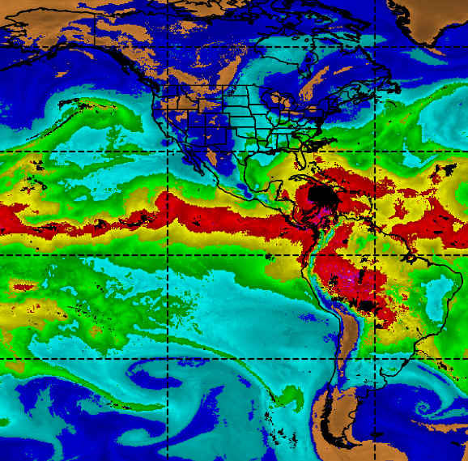
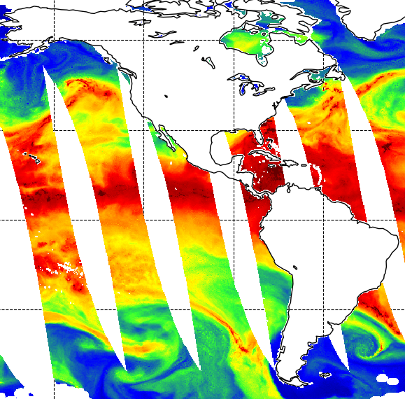
Total Precipitable Water (TPW)
Definition:
  Liquid water equivalent if all the water vapor within a column of the atmosphere were condensed.
Observation Region:
  global, over the oceans
  excluding areas of precipitation
Observation Range:
  0-75 mm
AMSR-2 Total Precipitable Water: 2025/10/27
Blended
Blended TPW
POES microwave data, GOES data, and GPS data (land)
Observation Region:
  global, excluding areas of precipitation
0 15 30 45 60 75 (mm)
AMSR-2 Product Maps: https://www.ospo.noaa.gov/products/suites/gaasp/maps.html?GPLCT#gpdsMaps
Blended TPW: https://www.ospo.noaa.gov/products/bTPW/Overview.html

Slide 6
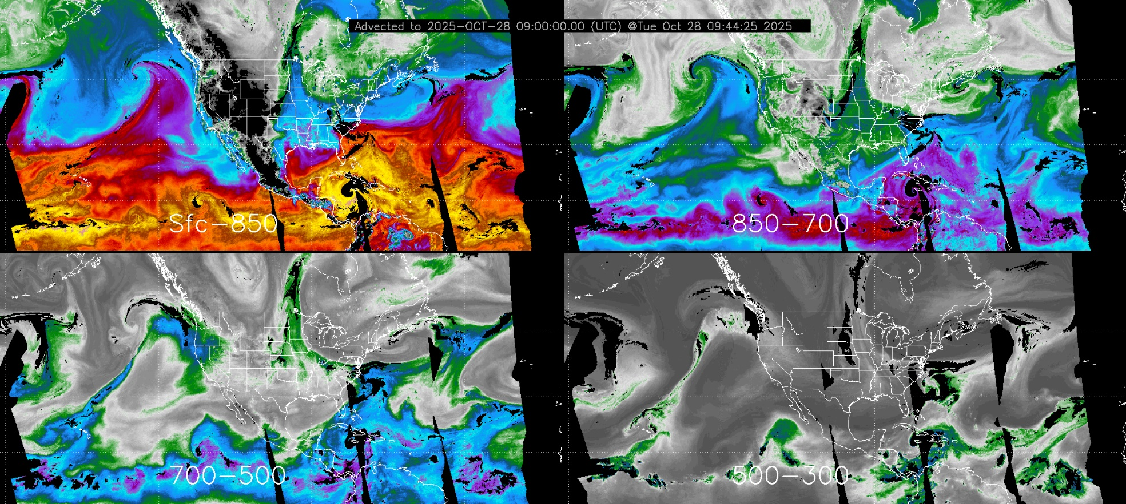
Advected Layered Precipitable Water (ALPW)
0 4 8 12 16 20 24 28 32 (mm)
Vertical Layers: surface-850 mb, 850-700 mb, 700-500 mb, 500-300 mb
Observation Region: global, excluding areas of precipitation
CIRA: https://cat.cira.colostate.edu/SPoRT/Layered/Advected/ALPW_Hourly.htm
NOAA OSPO: https://www.ospo.noaa.gov/products/atmosphere/alpw/

Slide 7
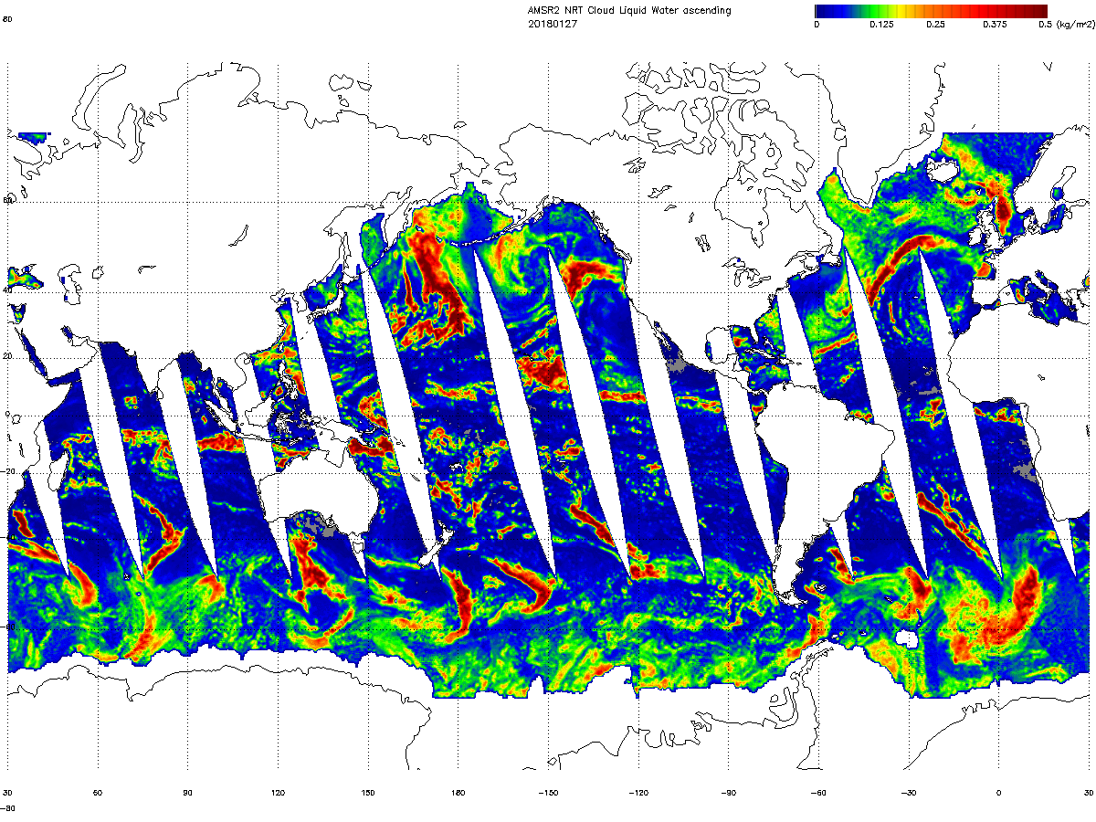
Cloud Liquid Water (CLW)
AMSR-2 Cloud Liquid Water: 2018/01/27
Definition:
  Depth of water if all the cloud droplets were accumulated within a column of the atmosphere
Observation Region:
  global, over the oceans
  excluding areas of sea ice and precipitation
Observation Range:
  0-1.0 mm
0 0.125 0.25 0.375 0.5 (mm)
NOAA Operational GCOM-W1 AMSR-2 Product Maps
https://www.ospo.noaa.gov/products/suites/gaasp/maps.html?GPLCT#gpdsMaps

Slide 8
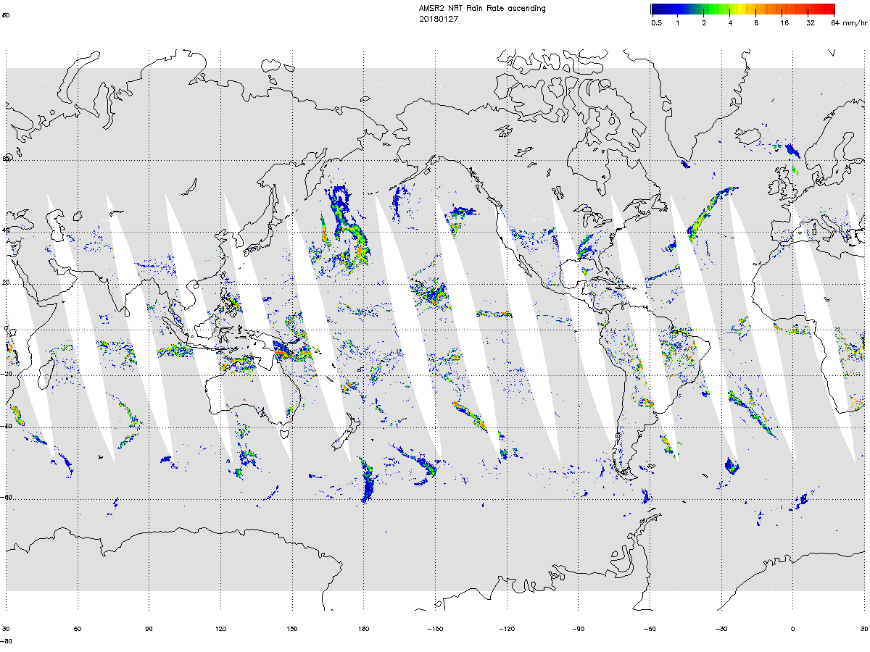
Rain Rate (RR)
AMSR-2 Rain Rate: 2018/01/27
Definition:
  Depth of hourly rainfall at the ground surface
Observation Region:
  tropical to mid-latitude
  higher accuracy over ocean than over land
Observation Range:
  0-50 mm/hr
0.5 1 2 4 8 16 32 64 (mm/hr)
NOAA Operational GCOM-W1 AMSR-2 Product Maps
https://www.ospo.noaa.gov/products/suites/gaasp/maps.html?GPLCT#gpdsMaps

Slide 9
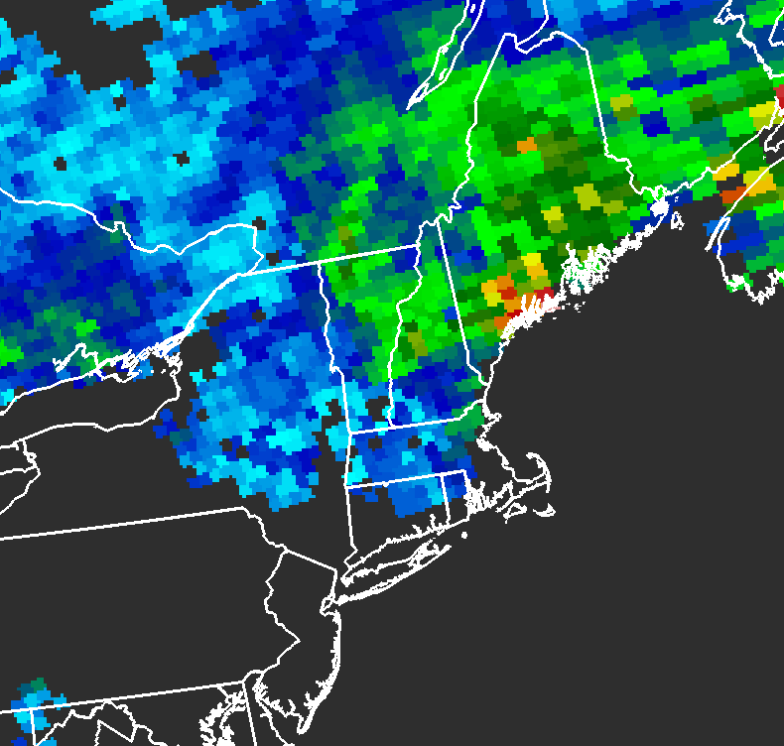
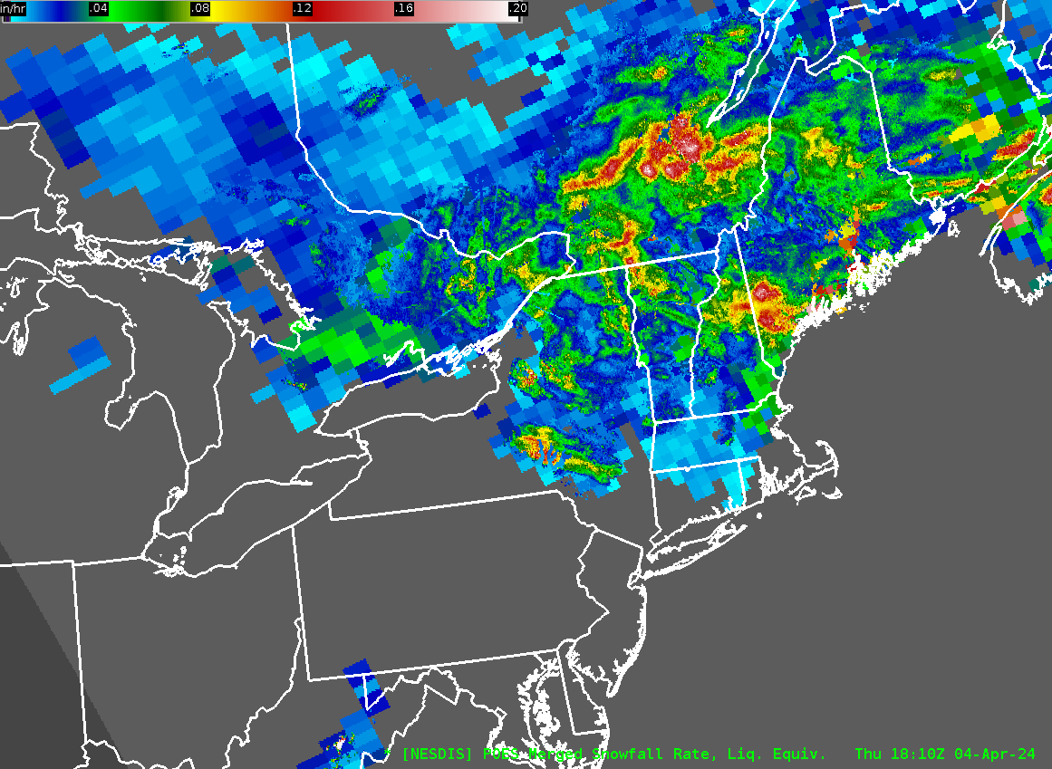
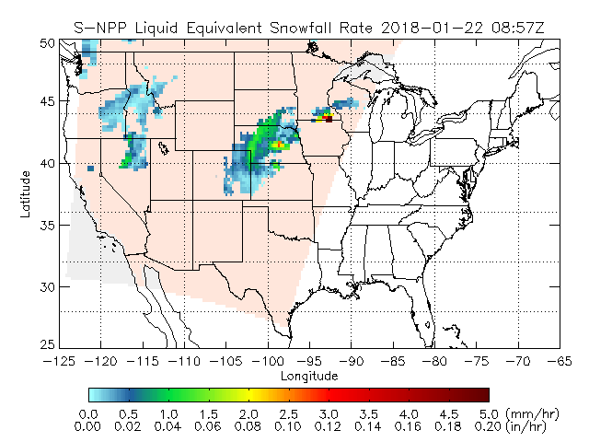
Snowfall Rate (SFR)
merged Snowfall Rate: 2024/04/04 18:10Z
POES Snowfall Rate: 2024/04/04 17:55Z
Definition:
  Instantaneous liquid equivalent snowfall rate
Observation Region:
  Global coverage
Observation Range:
  0.00079 - 0.39 in/hr (liquid)
merged Snowfall Rate (mSFR)
Merges SFR and MRMS instantaneous snowfall rate
Observation Region:
  CONUS
https://sfr.umd.edu/

Slide 10
Rain Rate from Infrared
Basic assumptions for opaque mid-latitude clouds:
Cloud-top temperature (IR) is related to cloud-top height
Cloud-top height is related to the strength of the updraft and rain rate
T_{b}= -73 °C
T_{b}= -61 °C
T_{b}= -50 °C
T_{b}= -43 °C
SatFC-G: GOES-R Rainfall Rate product (modified)
-70
-20
20
Warmer cloud tops ≈ lighter (or no) rain
Colder cloud tops ≈ heavier rain
Temperature (°C)

Slide 11

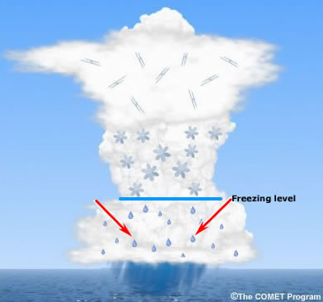
Microwave Interaction with Rain Cloud
36 GHz
89 GHz
Ice particles
Liquid raindrops
Scattering
ice particles
Higher frequencies (> 60 GHz)
hail / graupel
Absorption / emission
freezing level
Lower frequencies (< 22 GHz)
raindrops
(modified)
Displacement due to viewing geometry (parallax error) is greater for ice than for raindrops.
parallax error (raindrop)
parallax error (ice particle)

Slide 12
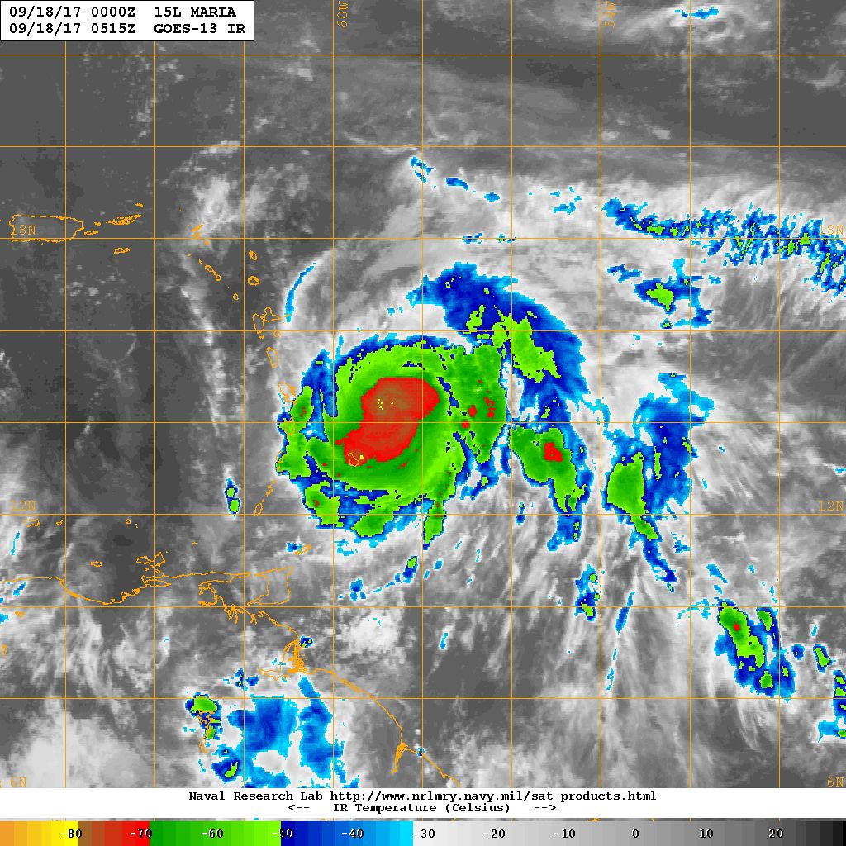
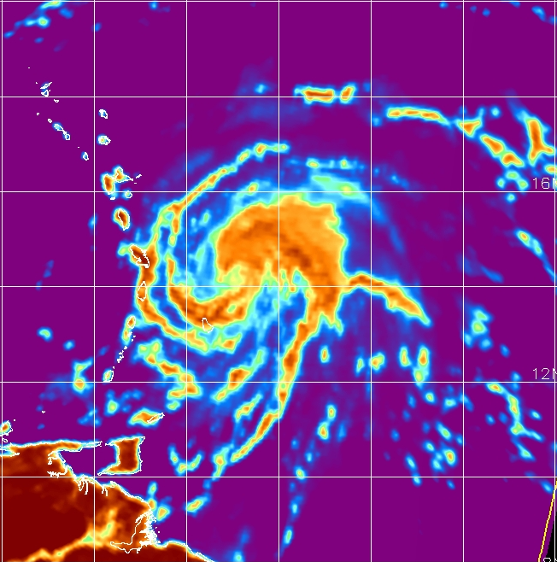
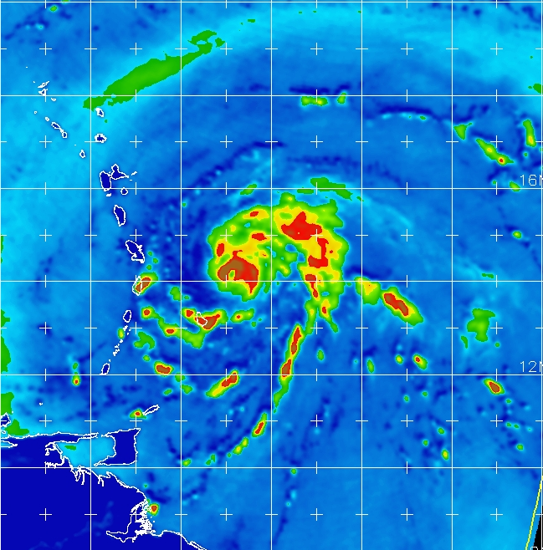
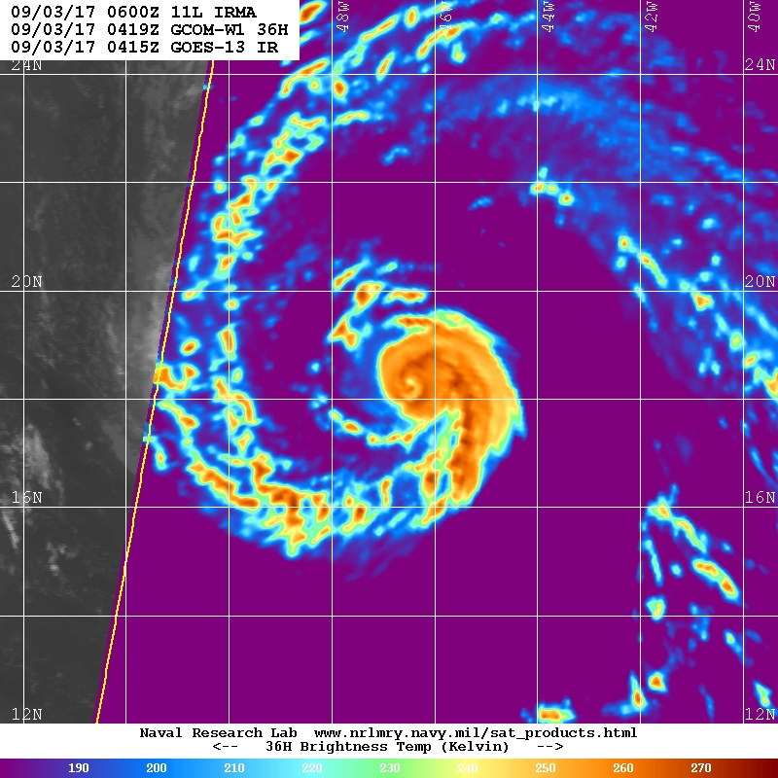
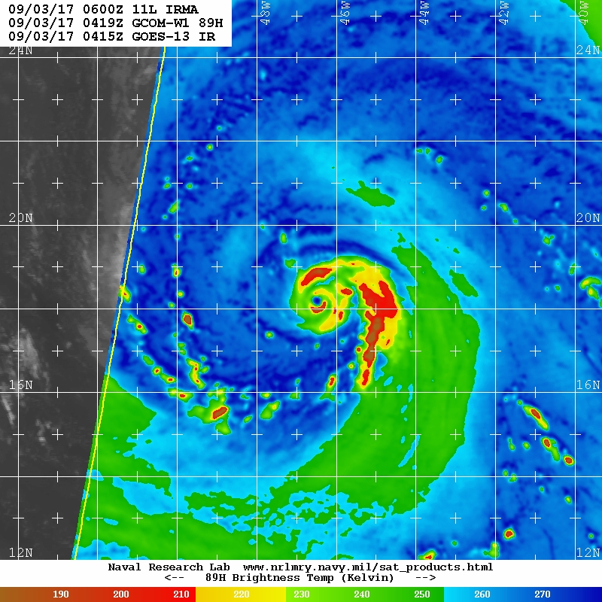
Tropical Cyclone Analysis
The low-level center and convective rain bands directly related to tropical cyclone intensity are often obscured by high clouds in visible, infrared, and water vapor imagery
~36 GHz able to sense clouds and moisture close to the surface
~89 GHz sensitive to both rain and ice rates
https://science.nrlmry.navy.mil/geoips/tcweb4/
Hurricane Maria: 18 September 2017
GOES-13 Infrared
AMSR-2 36 GHz H-pol
AMSR-2 89 GHz H-pol
60 W
56 W
16 N
12 N
0515 UTC
0516 UTC
0516 UTC
190 210 230 250 270 290
190 210 230 250 270
190 210 230 250 270
Brightness Temperature [K]
Brightness Temperature [K]
Brightness Temperature [K]

Slide 13
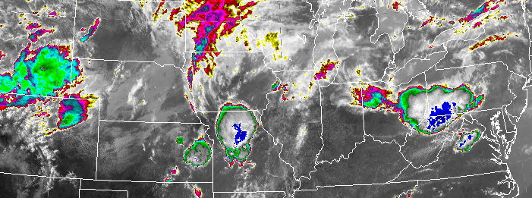
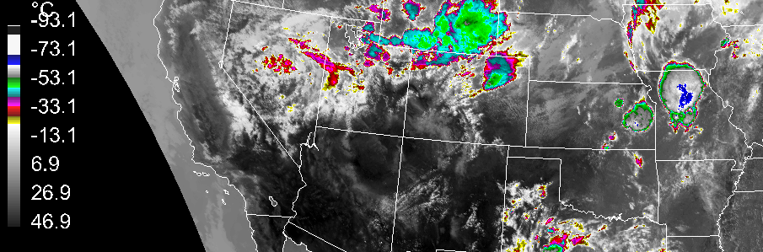
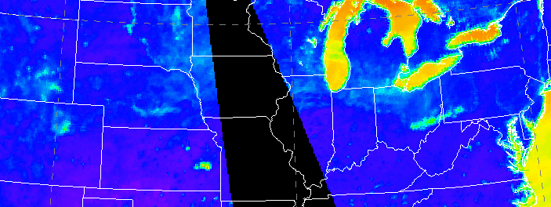
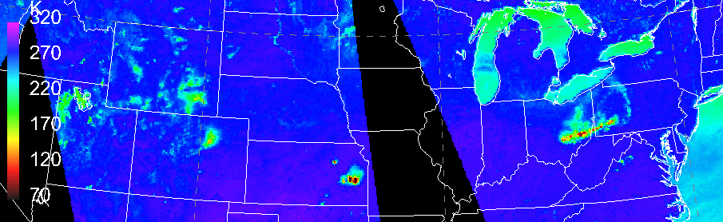
Thunderstorms
14 May 2018
Brightness Temperature
GOES-16 10.3 µm Infrared
-75
-50
-25
0
25
50
Precipitating clouds are not transparent
What makes brightness temperatures cooler over land surfaces?
36 GHz:
rain and wet ground
89 GHz:
rain, ice, and wet ground
2007 UTC
AMSR-2 36 GHz H-pol
[°C]
swath
gap
320
270
220
170
120
70
wet ground
60 W
56 W
predominantly
rain signature
2000 UTC
1822 UTC
AMSR-2 89 GHz H-pol
cold ice signature
[K]
2000 UTC
1822 UTC

Slide 14
Summary
Microwave products related to atmospheric moisture include:
  Precipitable Water products
  Cloud Liquid Water
  Rain Rate
  Snowfall Rate products
The best precipitation estimation algorithms use a combination of:
  infrared data from geostationary satellites (temporal advantage)
  microwave data from polar-orbiting satellites (higher accuracy)
Precipitation estimation is more reliable over the ocean, which provides a cold contrasting background.

Slide 15

Resources
Microwave Remote Sensing: Applications for Water Vapor, Clouds and Precipitation https://learn.meted.ucar.edu/#/online-courses/6aaf6d26-1b18-4bc9-8834-3627d41ae826
A First Course in Atmospheric Radiation, 2nd Ed. (Petty 2006)
SatFC-G: GOES-R Rainfall Rate http://rammb.cira.colostate.edu/training/visit/training_sessions/goes_r_rainfall_rate/
Product Quick Guides: https://rammb2.cira.colostate.edu/training/visit/quick_reference/
Questions? Email: CIRA_Training@colostate.edu
Contributors: Erin Sanders, Bernie Connell, Jorel Torres,
Bob Kuligowski, Roger Edson, Huan Meng

