Slide 1
HFIP Ensemble Product Subgroup
Update on Prototype Products
Mark DeMaria
May 14, 2012 Conference Call

Slide 2
2 Prototype Ensemble Products
Planned for Aug. 1, 2012
Genesis ensembles from global models
  T. Marchok (lead)
Hybrid dynamical-statistical wind speed probabilities
  A. Schumacher, M. DeMaria (co-leads)
Regional model products were planned by NRL, but postponed due to funding limitations

Slide 3
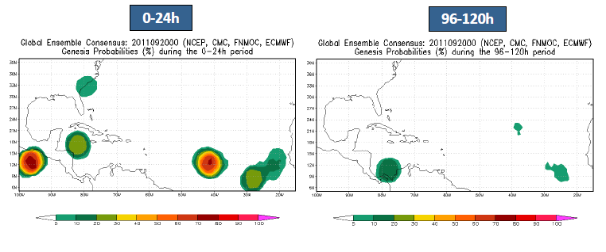
Prototype Genesis Product
T. Marchok, GFDL
Tracker run on NCEP, ECMWF, FNMOC, CMC models
Products displayed on EMC web page
Link from HFIP web page

Slide 4
Update on Hybrid Wind Speed Probability Product
Operational MC wind speed probability model being finalized for 2012 season
Hybrid version planned for Aug. 1, 2012
  Statistical track realizations replaced by ensemble tracks
    ECMWF, GFS
    Maybe FIM and experimental GFS
Products displayed on CIRA web page, link from HFIP web page
Digital data saved for post-season quantitative verification

