Slide 1
HFIP Regional Ensemble Call Audio = 1-800-857-6535 Passcode = 10606# Meeting ID = 917-288-618
14 May 2012

Slide 2
HFIP Regional Ensemble Call
Today’s Agenda
Genesis Product
Hybrid Wind Speed Probability Product
Regional HWRF Ensemble for Summer 2012

Slide 3
HFIP Ensemble Product Subgroup Update on Prototype Products
Mark DeMaria
May 14, 2012 Conference Call

Slide 4
2 Prototype Ensemble Products Planned for Aug. 1, 2012
Genesis ensembles from global models
T. Marchok (lead)
Hybrid dynamical-statistical wind speed probabilities
A. Schumacher, M. DeMaria (co-leads)
Regional model products were planned by NRL, but postponed due to funding limitations

Slide 5
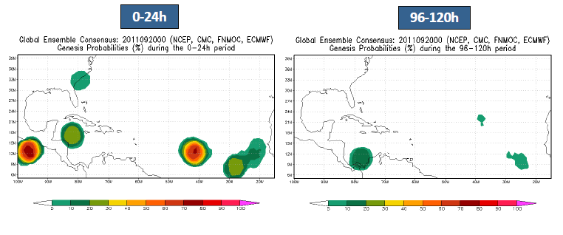
Prototype Genesis Product T. Marchok, GFDL
Tracker run on NCEP, ECMWF, FNMOC, CMC models
Products displayed on EMC web page
Link from HFIP web page

Slide 6
Update on Hybrid Wind Speed Probability Product
Operational MC wind speed probability model being finalized for 2012 season
Hybrid version planned for Aug. 1, 2012
Statistical track realizations replaced by ensemble tracks
ECMWF, GFS
Maybe FIM and experimental GFS
Products displayed on CIRA web page, link from HFIP web page
Digital data saved for post-season quantitative verification

Slide 7
HFIP Regional Ensemble
During Fall 2012 – a number of ensemble systems were presented:
Zhan Zhang
Others…
As summer 2012 approaches, do we want to add members for a 27k/9km/3km HWRF ensemble?
Thinking longer term: do we want to tie in products generation to an HWRF ensemble?

Slide 8
HFIP Regional Ensemble Call
Meeting summaries/presentations to be located here:
http://rammb.cira.colostate.edu/research/tropical_cyclones/hfip/add_conference_call_summaries.asp
Next Call
Tentatively scheduled for Monday, June 4th, at 11AM Pacific, Noon Mountain, 1PM Central, 2PM Eastern (Standard Time)
Speakers… to be determined!

