Slide 1
HFIP Ensemble Subgroup
Mark DeMaria
Oct 3, 2011 Conference Call

Slide 2
Suggestions for Prototype
Ensemble Products
Genesis ensembles from global models
Combined track/intensity/structure ensembles from regional models
Hybrid dynamical-statistical wind probabilities

Slide 3
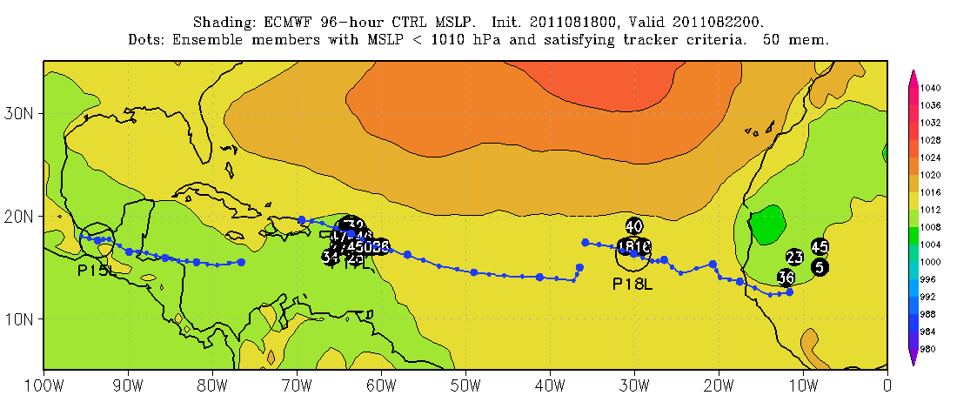
1. Genesis Ensembles
Use tracker code from multi-model ensembles
  GFS, ECMWF, NOGAPS, UKMet, etc
Positions or genesis density plots
Possible input from UM, ESRL, GFDL efforts

Slide 4
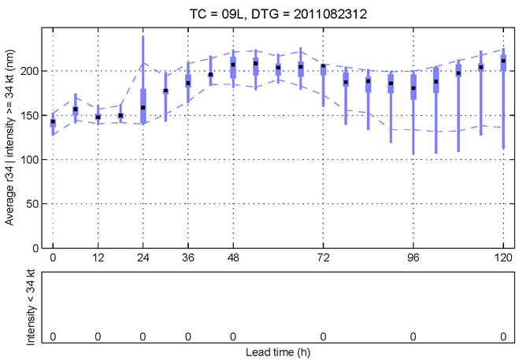
2. Regional Model Ensembles
Combine track, intensity, structure input from regional models
  Operational and experimental models
Could include EMC clustering and NRL prototype products
Wind speed probabilities

Slide 5
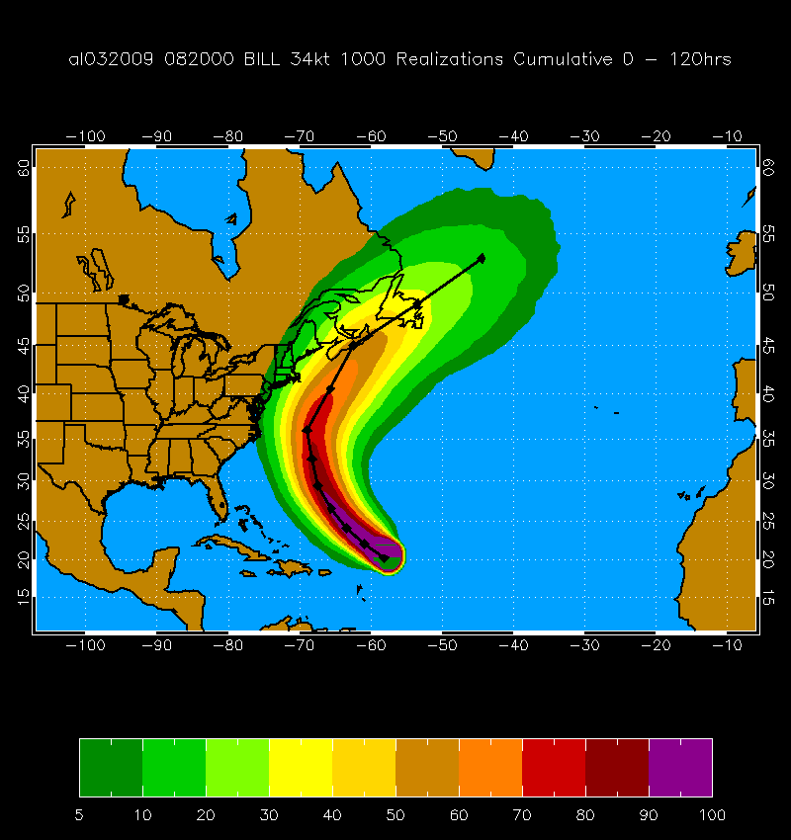
3. Hybrid Dynamical-Statistical Ensemble
Replace tracks in NHC wind speed probability model with dynamical model ensemble tracks
Estimate intensity and structure perturbations statistically
All NHC probability products can be generated

