Slide 1
HFIP Ensemble Subgroup
Mark DeMaria
Nov 21, 2011 Conference Call

Slide 2
3 Prototype Ensemble Products
Genesis ensembles from global models
  T. Marchok (lead), S. Majumdar, A. Schumacher, J. Whitaker, J. Peng
  Prototype summarized by T. Marchok on 10/31/11 call
  Remaining questions on separate slide
Combined track/intensity/structure ensembles from regional models
  J. Moskaitas (lead), W. Lewis, Z. Zhang, J. Peng, A. Aksoy, F. Zhang, R. Torn
  Initial ideas to be discussed on the next call
Hybrid dynamical-statistical wind probabilities
  M. DeMaria (lead), A. Schumacher, K. Musgrave, P. McCaslin
  Methods to utilized ensemble tracks under development
  Possible meeting with ESRL and CIRA early December

Slide 3
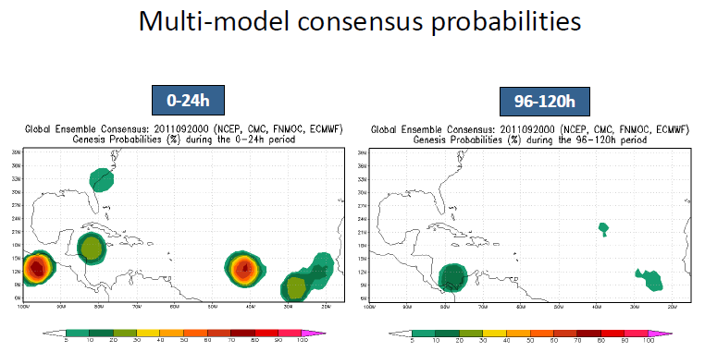
Prototype Genesis Product
NHC Feedback: Emphasize 0-48 and 0-120 hr

Slide 4
Remaining Issues for Genesis Product
Final set of model input
  Add deterministic runs from each system?
    GFS, ECMWF, CMC, NOGAPS
  Add HFIP global ensembles?
    FIM, Experimental GFS
Probability is counts per unit area
  What is best area to use? Should 350 km radius be adjusted?
  Need to account for existing storms
  More sophisticated method needed (clustering)?
Calibration issues
  Initial product uses unadjusted counts.
  Need previous years data for calibration
Product delivery
  Web page
  N-AWIPS?
  Timeliness

