Slide 1
Regional TC model ensemble forecast products
Jon Moskaitis and the regional model subgroup: W. Lewis, Z. Zhang, J. Peng,
A. Aksoy, F. Zhang, R. Torn, and M. Morin
12 December 2011
A few guidelines for product development:
Focus products on the variables NHC predicts: Position, intensity, wind radii
Products can be used for single-model ensemble or multi-model ensemble
Products scale up to many ensemble members

Slide 2
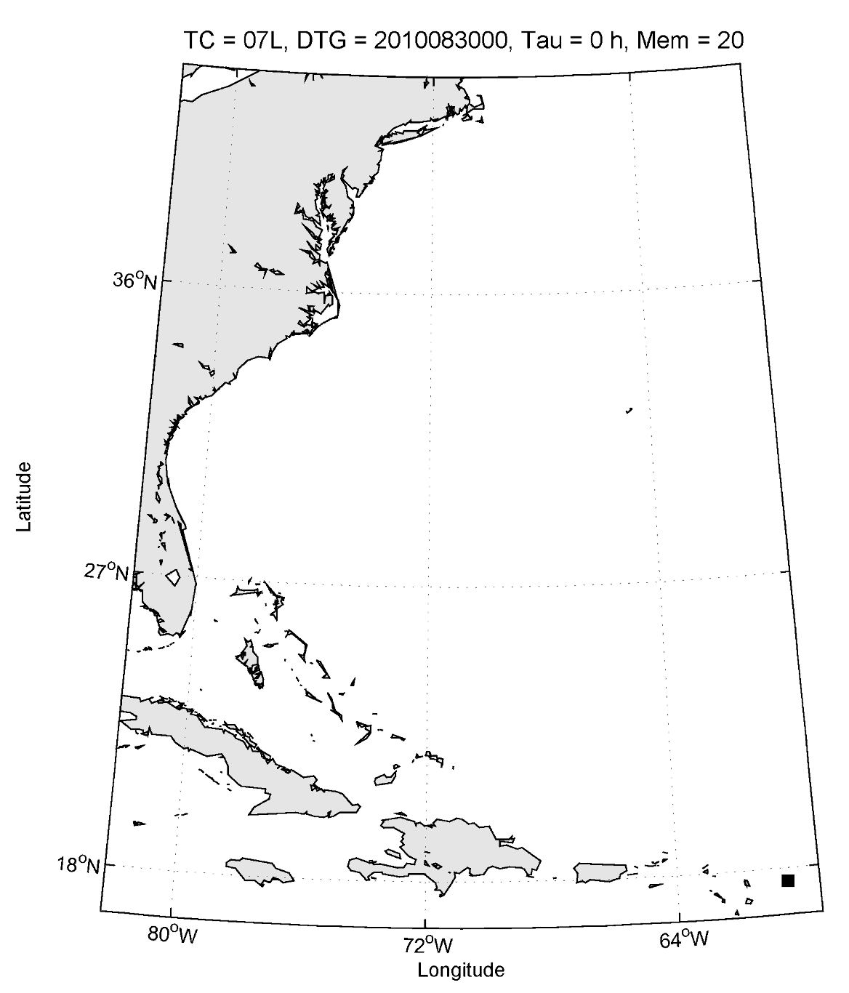
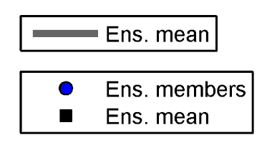
Ensemble track product
Loop over forecast lead time
Show track for ensemble mean only
Markers show ensemble mean and
ensemble member positions at
each lead time
Ellipses contain 2/3 of ensemble
member positions (black for
current lead time, gray for all
previous lead times)
Number of members specified for
each lead time

Slide 3
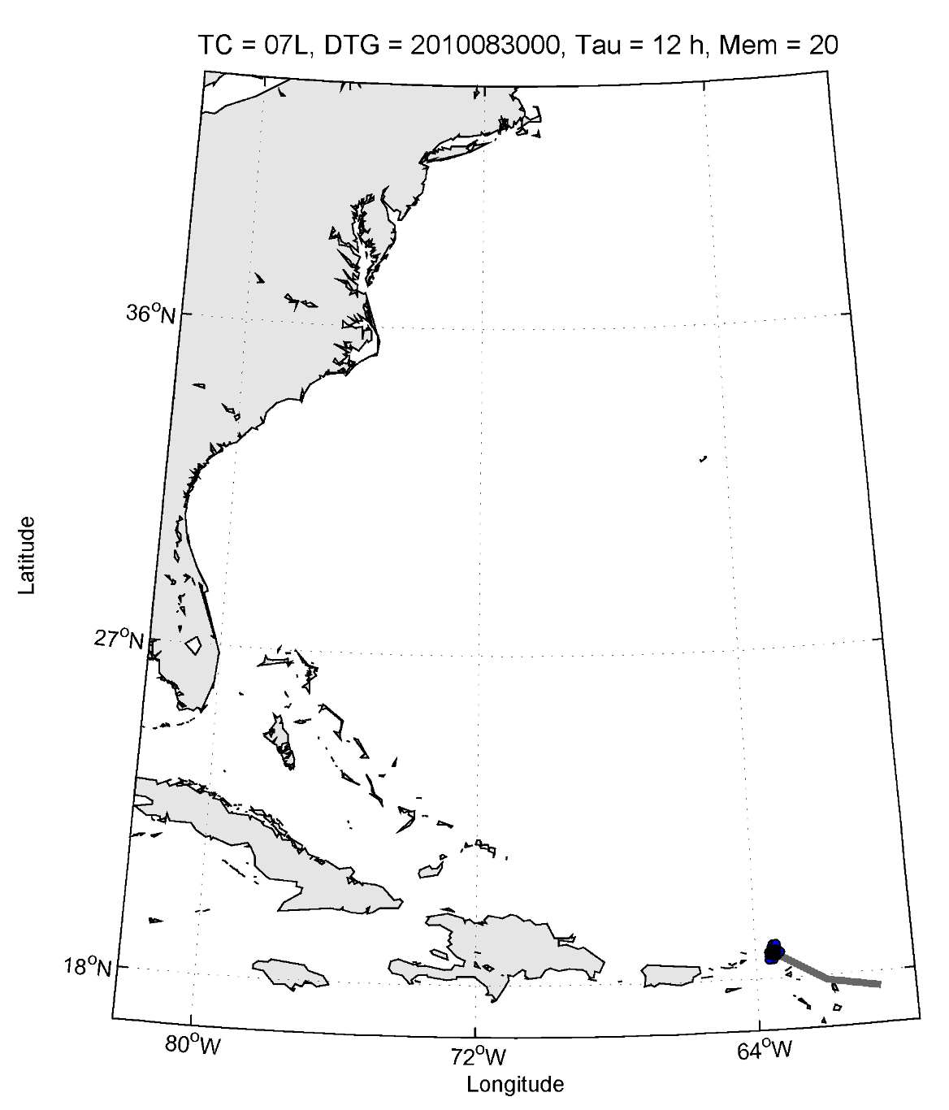
Ensemble track product
Loop over forecast lead time
Show track for ensemble mean only
Markers show ensemble mean and
ensemble member positions at
each lead time
Ellipses contain 2/3 of ensemble
member positions (black for
current lead time, gray for all
previous lead times)
Number of members specified for
each lead time

Slide 4
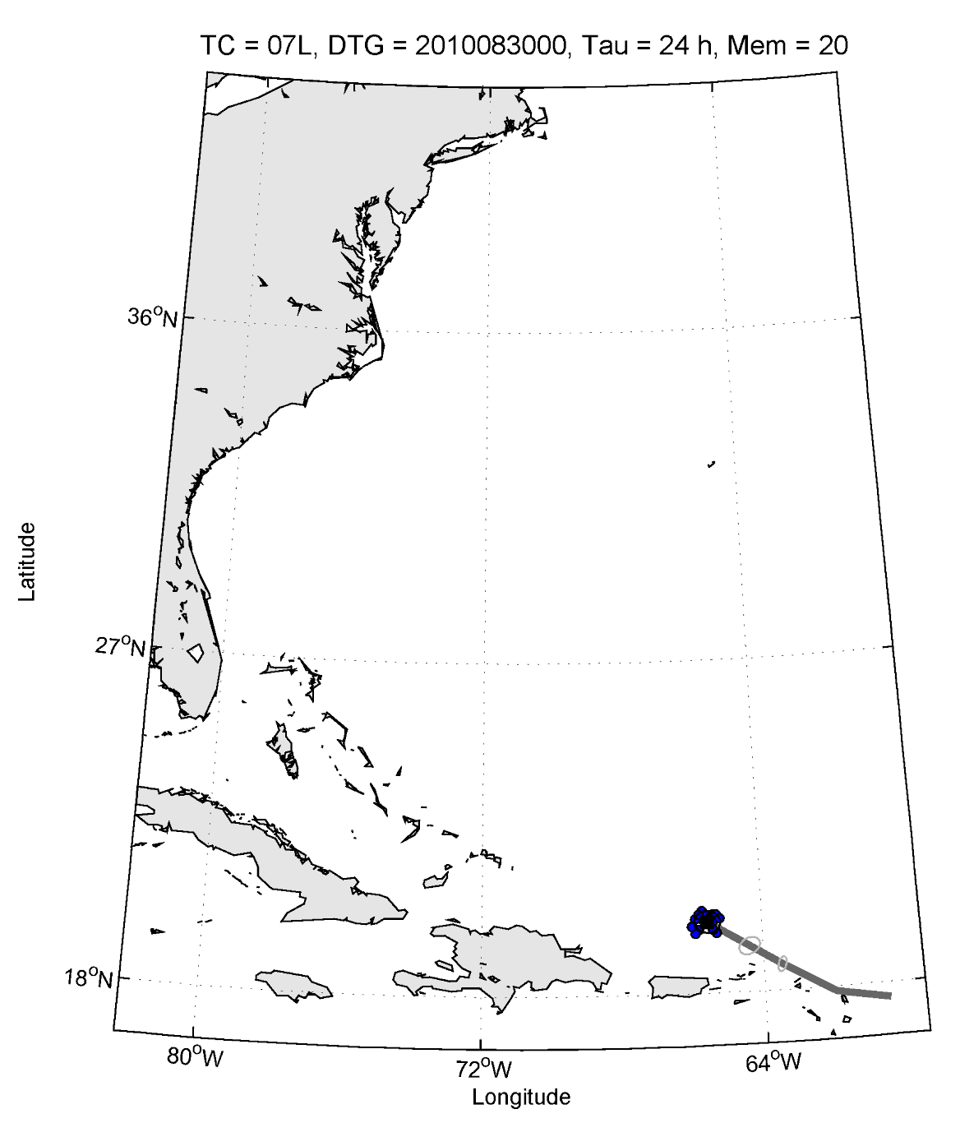
Ensemble track product
Loop over forecast lead time
Show track for ensemble mean only
Markers show ensemble mean and
ensemble member positions at
each lead time
Ellipses contain 2/3 of ensemble
member positions (black for
current lead time, gray for all
previous lead times)
Number of members specified for
each lead time

Slide 5
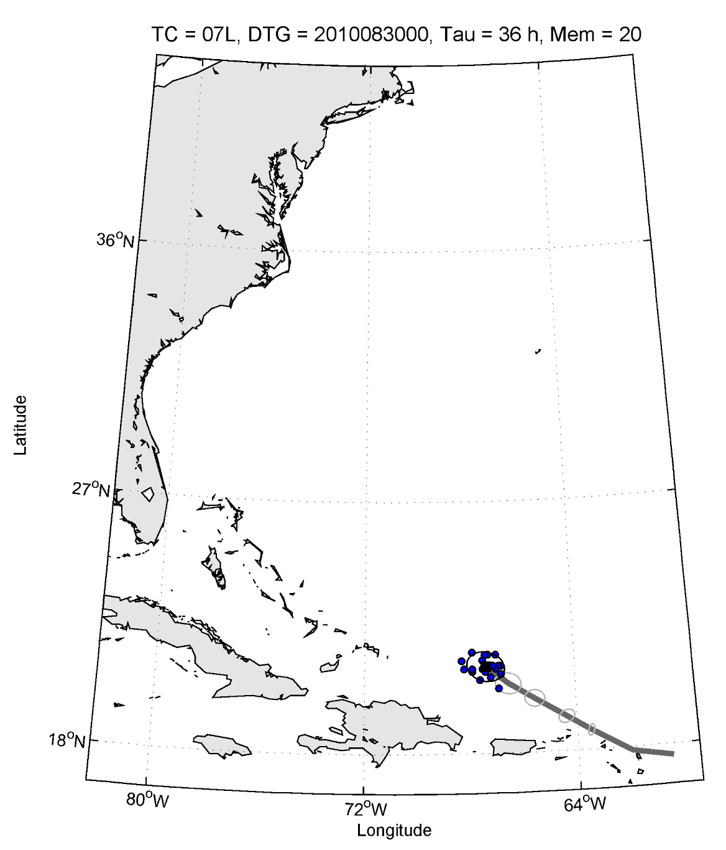
Ensemble track product
Loop over forecast lead time
Show track for ensemble mean only
Markers show ensemble mean and
ensemble member positions at
each lead time
Ellipses contain 2/3 of ensemble
member positions (black for
current lead time, gray for all
previous lead times)
Number of members specified for
each lead time

Slide 6
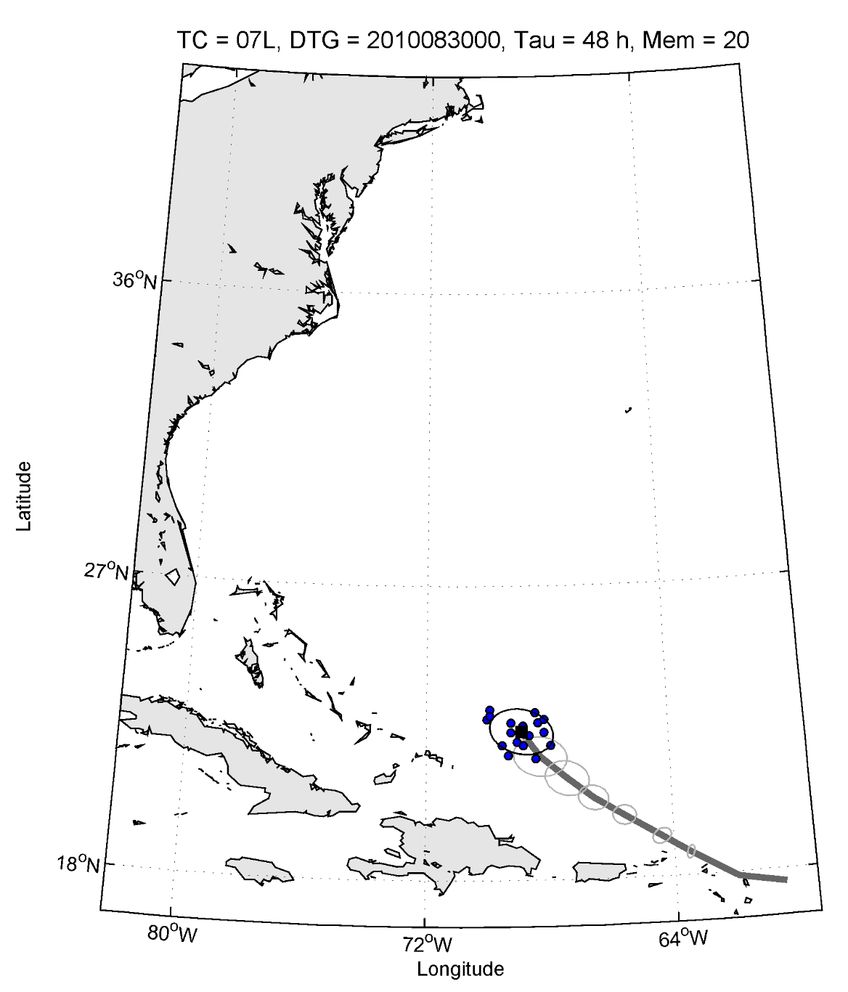
Ensemble track product
Loop over forecast lead time
Show track for ensemble mean only
Markers show ensemble mean and
ensemble member positions at
each lead time
Ellipses contain 2/3 of ensemble
member positions (black for
current lead time, gray for all
previous lead times)
Number of members specified for
each lead time

Slide 7
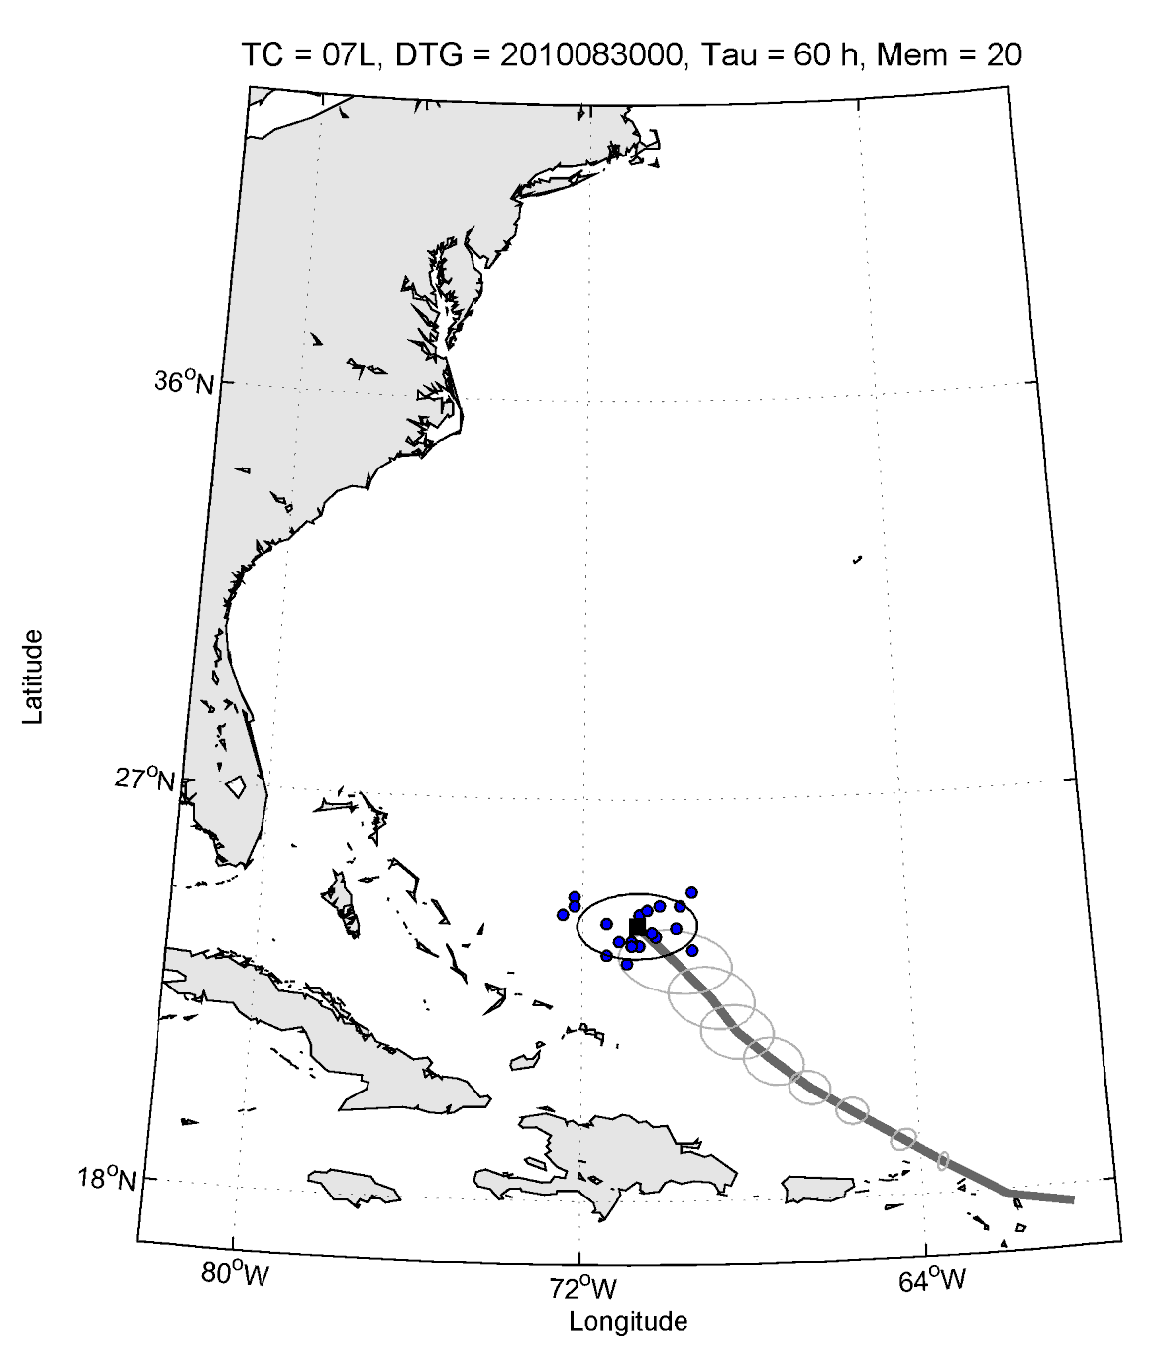
Ensemble track product
Loop over forecast lead time
Show track for ensemble mean only
Markers show ensemble mean and
ensemble member positions at
each lead time
Ellipses contain 2/3 of ensemble
member positions (black for
current lead time, gray for all
previous lead times)
Number of members specified for
each lead time

Slide 8
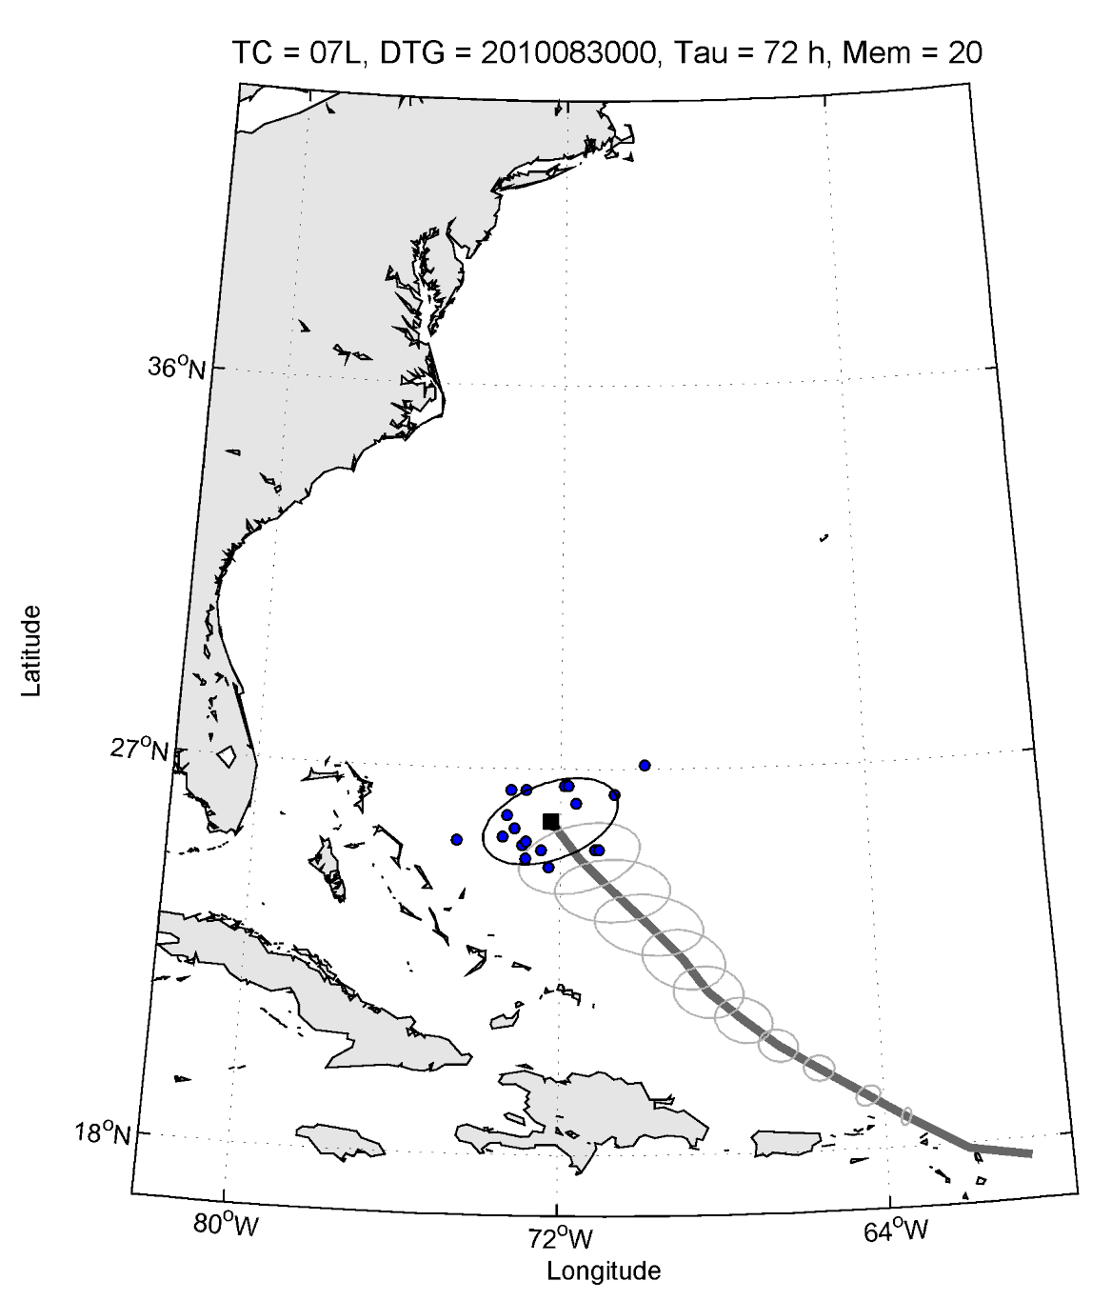
Ensemble track product
Loop over forecast lead time
Show track for ensemble mean only
Markers show ensemble mean and
ensemble member positions at
each lead time
Ellipses contain 2/3 of ensemble
member positions (black for
current lead time, gray for all
previous lead times)
Number of members specified for
each lead time

Slide 9
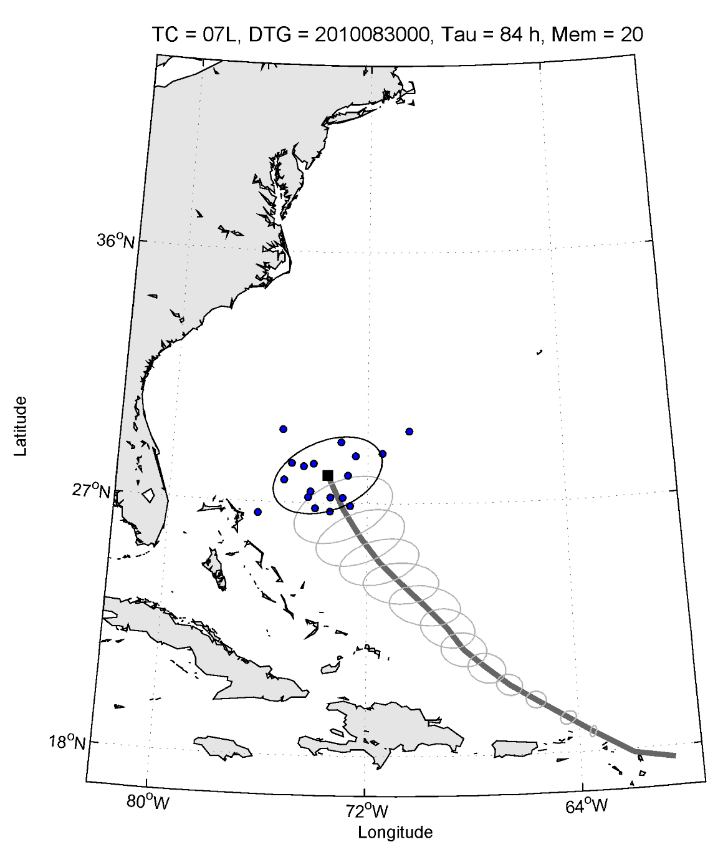
Ensemble track product
Loop over forecast lead time
Show track for ensemble mean only
Markers show ensemble mean and
ensemble member positions at
each lead time
Ellipses contain 2/3 of ensemble
member positions (black for
current lead time, gray for all
previous lead times)
Number of members specified for
each lead time

Slide 10
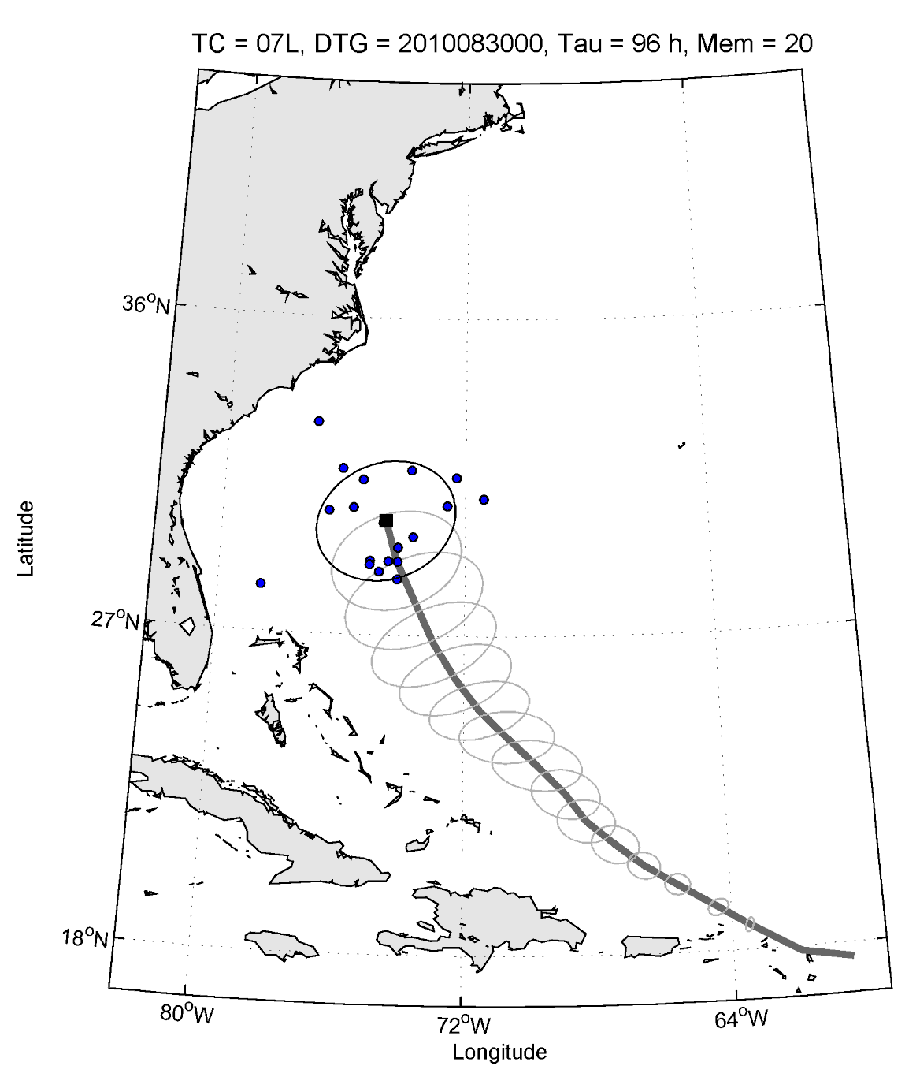
Ensemble track product
Loop over forecast lead time
Show track for ensemble mean only
Markers show ensemble mean and
ensemble member positions at
each lead time
Ellipses contain 2/3 of ensemble
member positions (black for
current lead time, gray for all
previous lead times)
Number of members specified for
each lead time

Slide 11
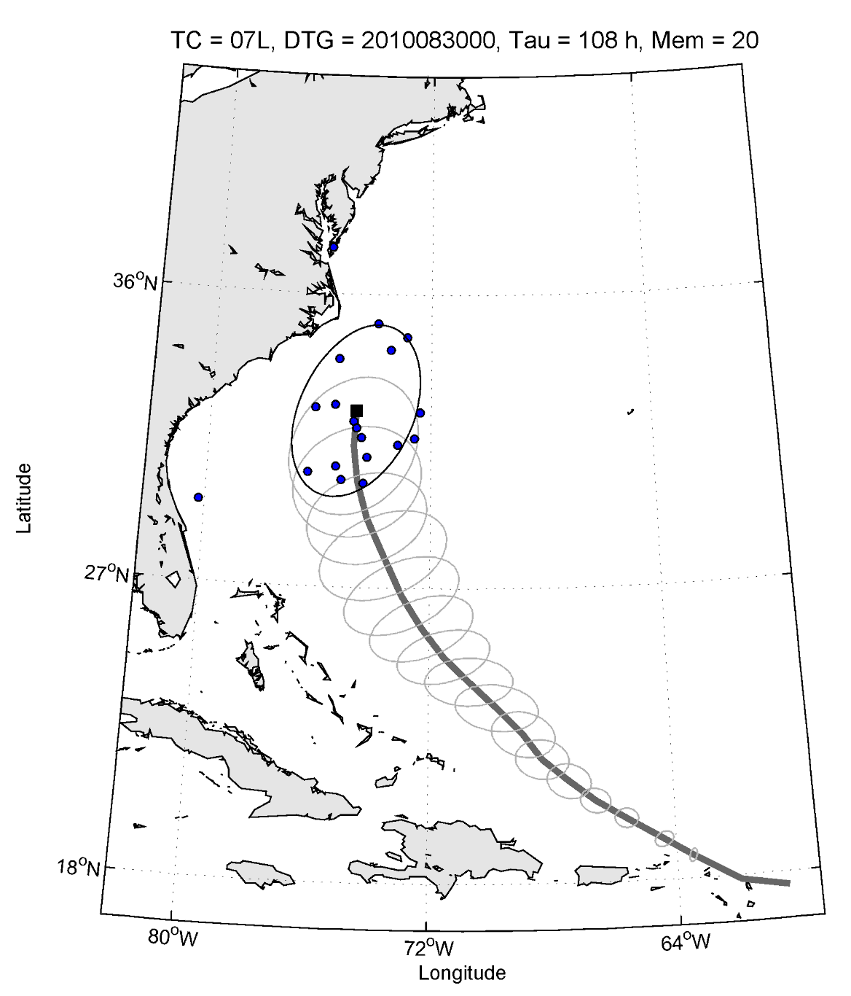
Ensemble track product
Loop over forecast lead time
Show track for ensemble mean only
Markers show ensemble mean and
ensemble member positions at
each lead time
Ellipses contain 2/3 of ensemble
member positions (black for
current lead time, gray for all
previous lead times)
Number of members specified for
each lead time

Slide 12

Ensemble track product
Loop over forecast lead time
Show track for ensemble mean only
Markers show ensemble mean and
ensemble member positions at
each lead time
Ellipses contain 2/3 of ensemble
member positions (black for
current lead time, gray for all
previous lead times)
Number of members specified for
each lead time

Slide 13
Ensemble track product
Loop over forecast lead time
Show track for ensemble mean only
Markers show ensemble mean and
ensemble member positions at
each lead time
Ellipses contain 2/3 of ensemble
member positions (black for
current lead time, gray for all
previous lead times)
Number of members specified for
each lead time
Multi-model ensemble idea: Each
ensemble has a different color for its
member positions, mean position,
and mean track. Overall mean in black.

Slide 14
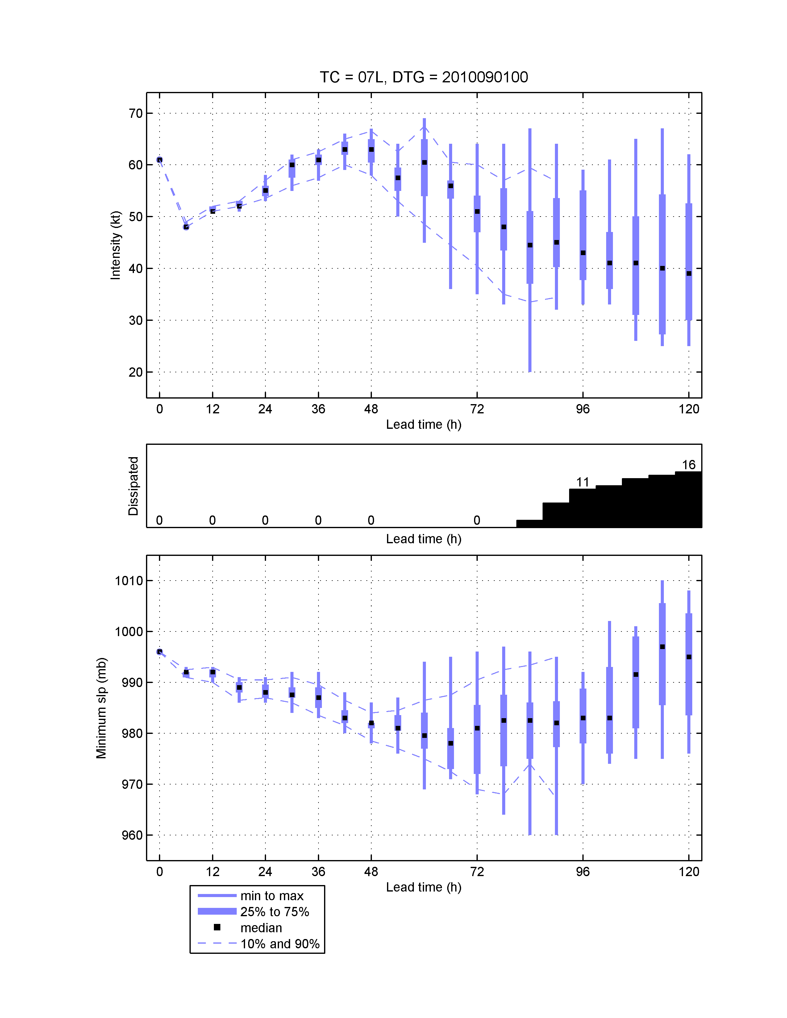
Ensemble intensity product
Box plot for each lead time
Box plot shows the extrema
and various quantiles of
the ensemble intensity
distribution
Bar graph shows number of
members for which the TC
dissipated. In next version,
show % of members
dissipated
Multi-model ensemble idea:
Add marker for median of each component ensemble

Slide 15
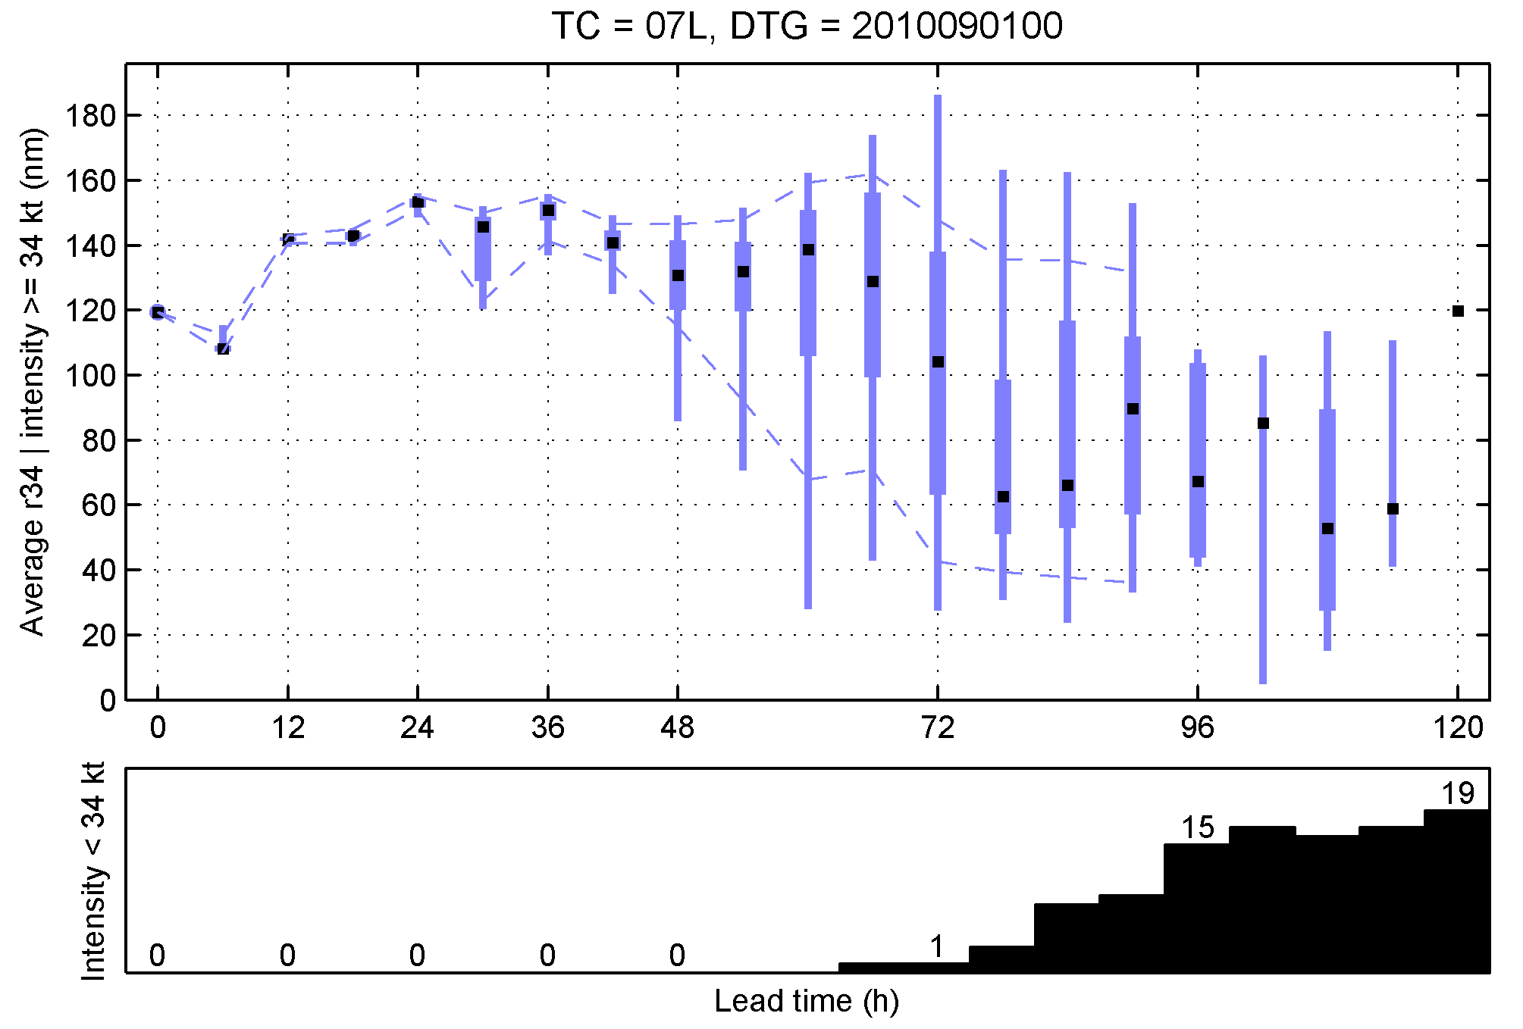
Ensemble wind radii product
Box plot shows average 34 kt
wind radius forecast, for
members with intensity of
at least 34 kt
Bar graph shows number of
members weaker than 34 kt
or dissipated (should use %)
May be better to have a plot for
each of the 4 quadrants … but
that’s a lot of plots

Slide 16
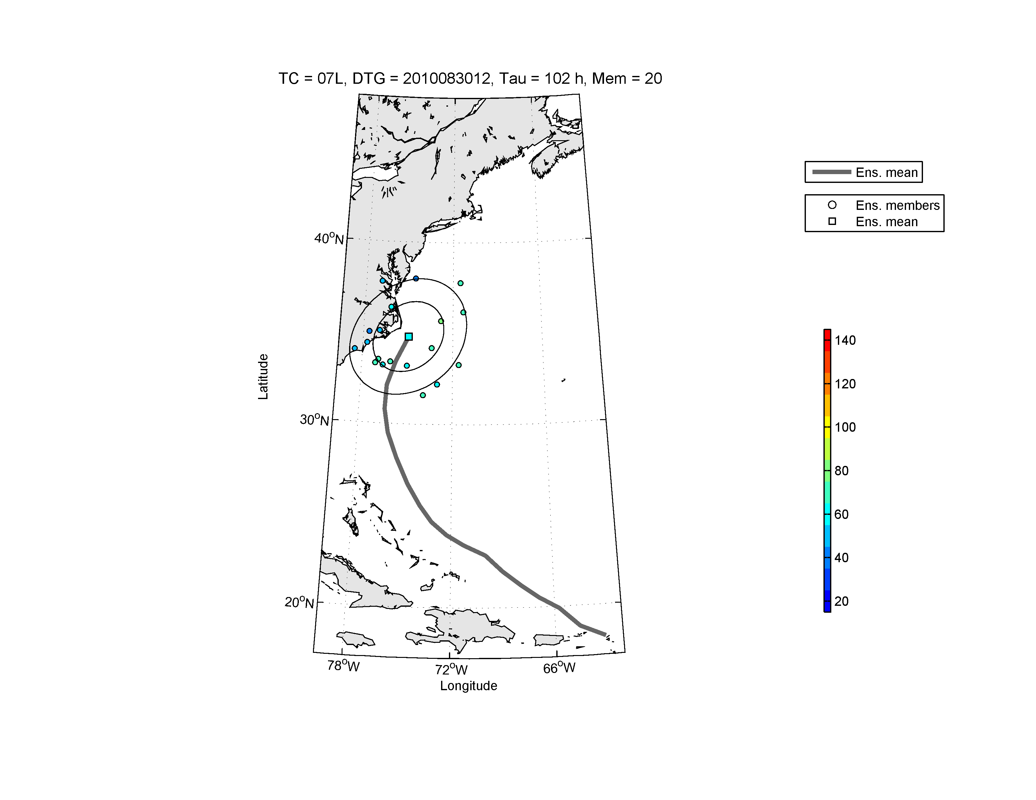
What about covariances between the forecast variables?
Ensemble forecast distributions of TC position, intensity, and wind radii are not independent. The forecast variables have non-zero covariances.
Joint distribution
Intensity (kt)
R34
Intensity
Intensity and wind radii
Position and Intensity

Slide 17
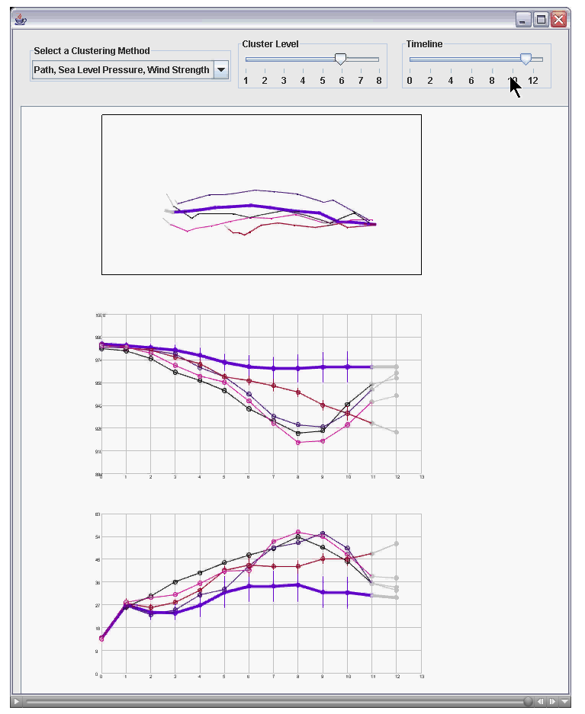
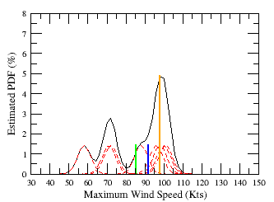
More advanced statistical post-processing
Cluster analysis of ensemble forecast
Gaussian Kernel Density Estimated PDF
Earl 2010, Initial time: 2011082900
24h
Mean=71.8
Median=77.0
mode= 76.0
Zhan Zhang will gives details about
this in the next talk

Slide 18
Discussion
What does NHC want to see in terms of regional ensemble forecasts?
Which variables? What about joint distributions?
Mechanics of making a multi-model ensemble product: What models are
included, when are the forecasts available, etc.
Verification: Rank histograms, reliability diagrams, Brier score, etc.
Other product ideas? We’re still in the early stages of this effort, so we
are certainly not limited to the product examples in this presentation

