Slide 1


Ensemble Forecasting of Hurricane Intensity based on Biased and non-Gaussian Samples
Zhan Zhang, Vijay Tallapragada, Robert Tuleya
HFIP Regional Ensemble Conference Call
Dec. 12, 2011

Slide 2
Motivation
Generate a regional ensemble prediction system which includes important uncertainties in model initial conditions and model physics;
Hurricane intensity forecast error PDF is generally biased and non-Gaussian distributed: arithmetic mean is not necessarily the best estimate of ensemble intensity forecasts;
Method: bias correction and Kernel Density Estimation (KDE) based mode analysis.

Slide 3
OUTLINE
Single Model, Multi-Initial Condition Ensembles:
HWRF-GEFS based regional ensemble prediction system;
Intensity forecast error PDF;
Bias correction;
Multi-Physics, Multi-Model Ensembles:
Experiment design;
Kernel density estimation (KDE) intensity forecast error PDF;
KDE based mode analysis;

Slide 4
HWRF-GEFS based Ensembles
Ensemble Member ID | Input Data | Convection Scheme | PBL Scheme
Control | GFS (T574L64) | SAS | GFS PBL
M00 – M20 | GEFS (T190L28) | SAS | GFS PBL
M21 – M41 | GEFS (T190L28) | Kain-Fritsch | GFS PBL
M42 – M62 | GFS (T190L28) | Batts-Miller | GFS PBL
Storm tracks are generally dictated by large scale environment flows;
Large scale flow uncertainties are included in GEFS;
The uncertainties in the model physics have great impacts on storm intensity forecasts;
Storms conducted:
Earl: 2010082512-2010090412
Alex: 2010062606-2010070106
Celia: 2010061912-2010062812

Slide 5
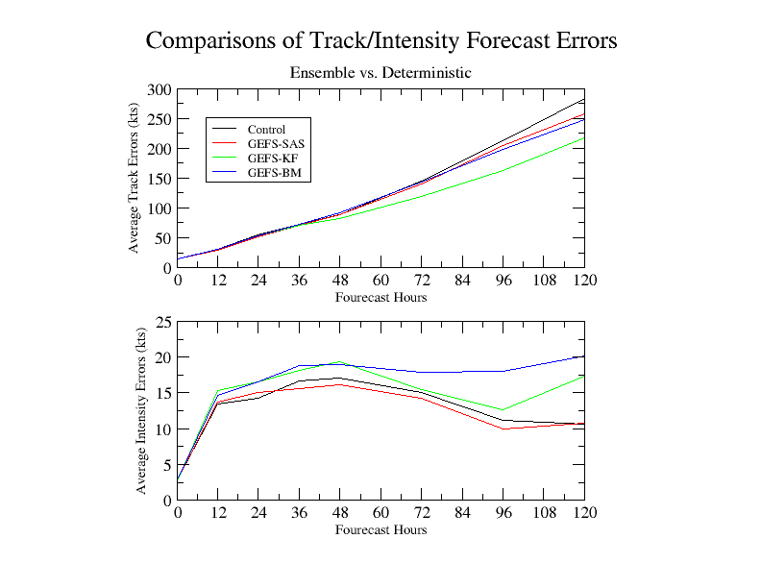
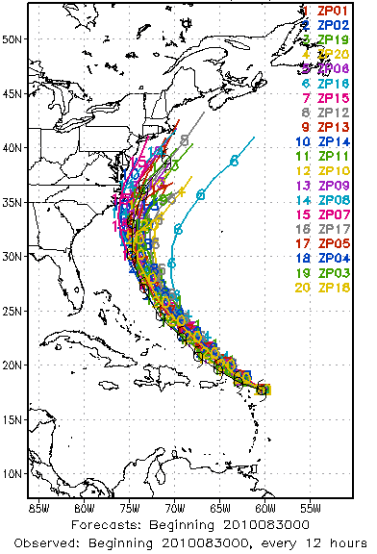
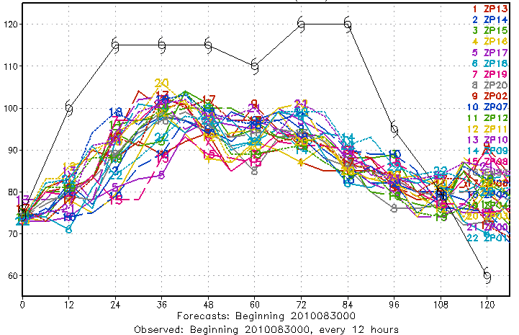
Track/Intensity Errors from Ensemble Mean
deterministic forecast
deterministic forecast

Slide 6
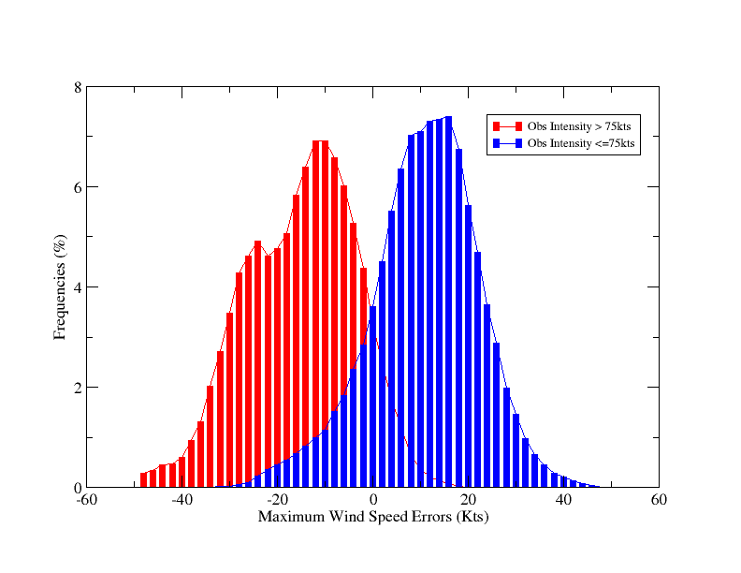
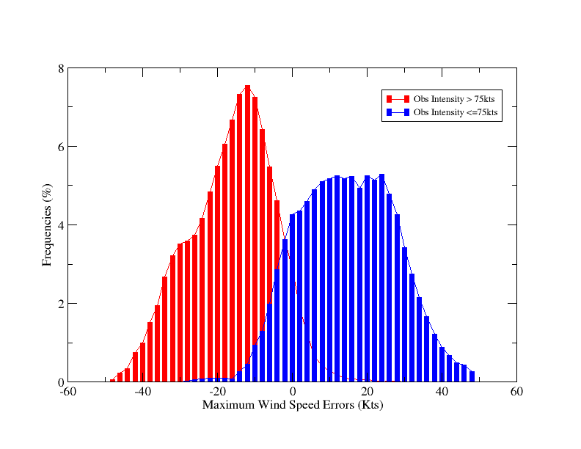
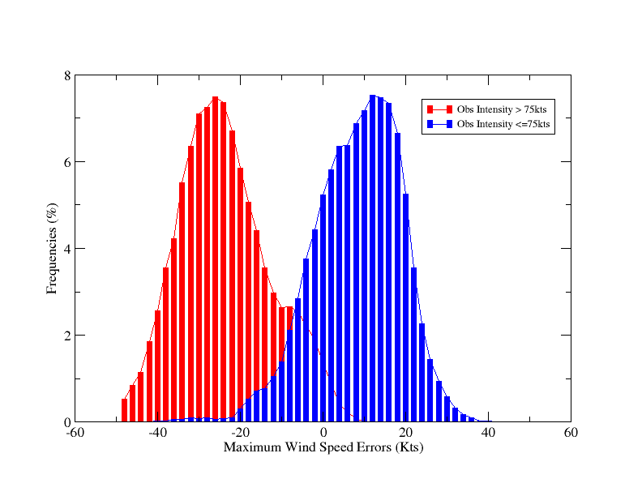
Average Intensity Forecast Error PDF
SAS
KF
Skewed
-28kts bias
Negative bias (-15kts) for strong storms (int > 75kts), positive bias (+15kts) for weaker storms);
Non-Gaussian: skewed, rectangular distribution for weaker storms for KF;
BM has even stronger bias.
BM

Slide 7
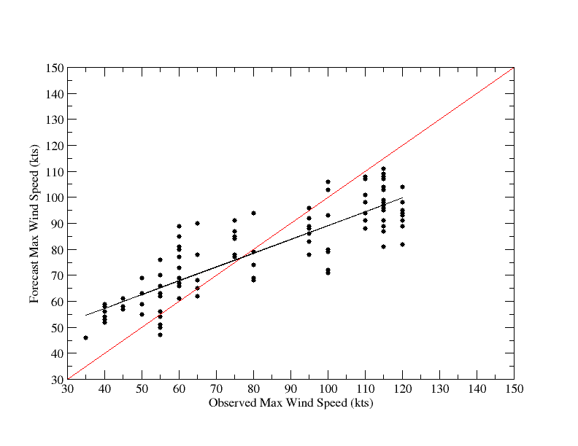
Comparison Forecast Intensity and Observed Intensity
Over-predicted
under-predicted

Slide 8

Bias Correction Method
Where is bias corrected forecast intensity, is model intensity output, =75kts is hurricane threshold, is a tunable parameter and could be function of forecast time. It ranges from 1.1 to 1.6.

Slide 9
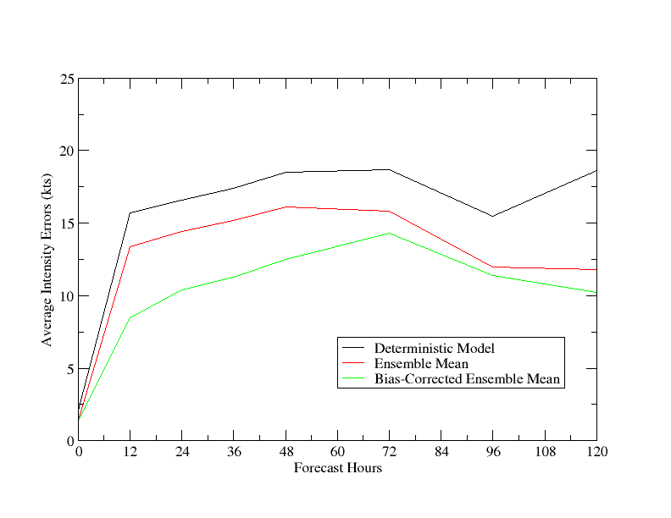
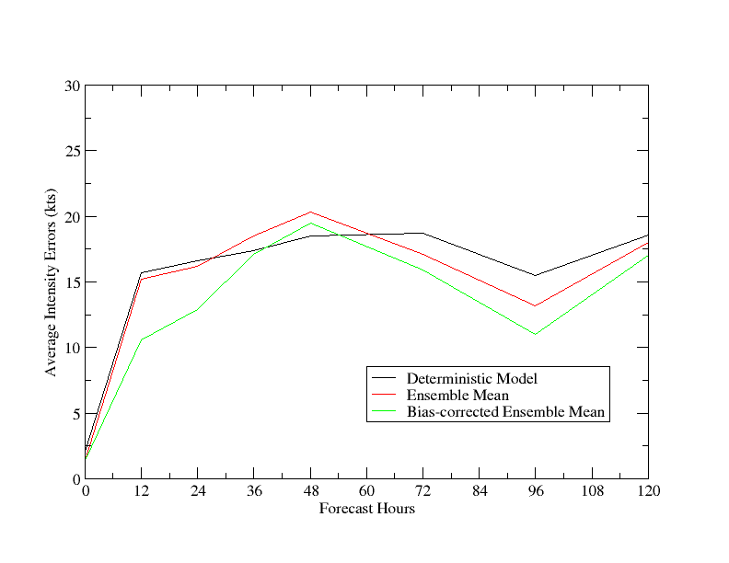
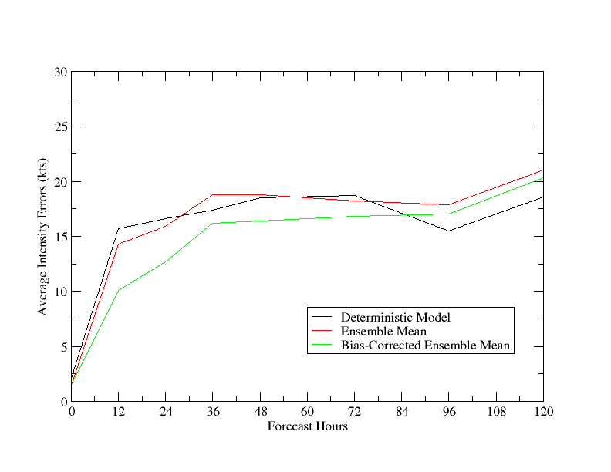
Comparison of Average Intensity Errors
Hurricane Earl (Total Sample: 41)
GEFS-SAS
GEFS-KF
GEFS-BM
Intensity forecast Improvement after BC (%)
Fcst hour | 12 | 24 | 36 | 48 | 72 | 96 | 120
GEFS/SAS | 36 | 28 | 26 | 22 | 10 | 5 | 14
GEFS/KF | 31 | 20 | 8 | 4 | 7 | 16 | 5
GEFS/BM | 30 | 20 | 14 | 13 | 8 | 5 | 3

Slide 10
Multi-Model, Multi-Physics Ensembles
CTRL: Operational HWRF model;
GFDL: Operational GFDL model;
HR43: High resolution (27-9-3) HWRF model;
HWF1: HWRF V2, SAS, GFS PBL;
HWF2: HWRF V2, SAS, MYJ PBL;
HWF3: HWRF V2, Kain-Fritsch, GFS PBL;
HWF4: HWRF V2, Batts-Miller, GFS PBL;
HWF5: HWRF V2, Batts-Miller, MYJ PBL.
Hurricane Earl, 2010. Total 8 ensemble members

Slide 11
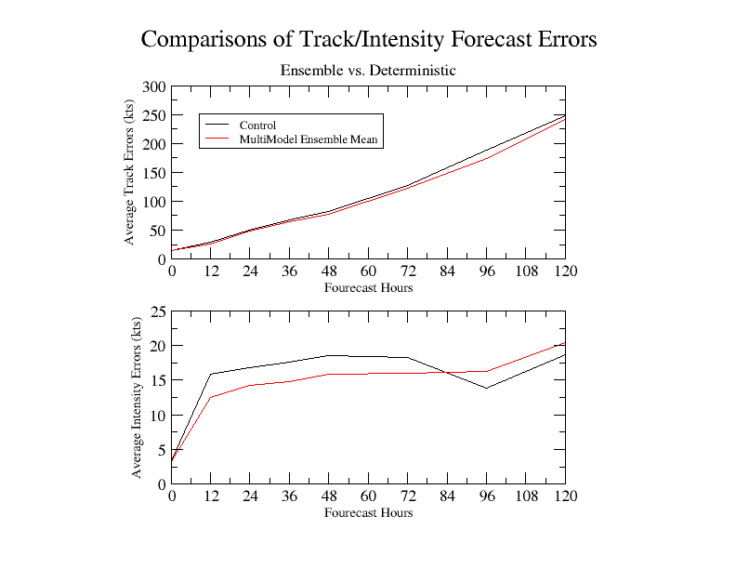
Ensemble tracks consistently better
Ensemble intensity skills are inconclusive

Slide 12
Kernel Density Estimation (KDE)
Where is a set of samples drawn from some distribution with an unknown density f. K(*) is the kernel. h is a smoother parameter or bandwidth .
Application:
Compute PDF with small sample size;
Mode analysis

Slide 13
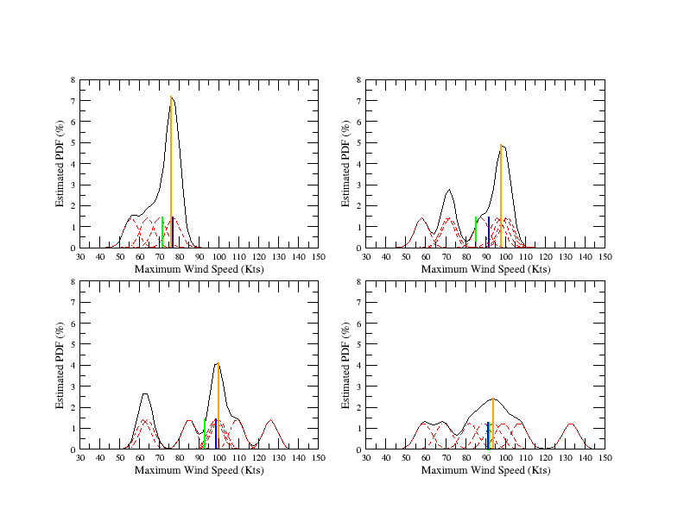
Gaussian Kernel Density Estimated PDF
Earl 2010, Initial time: 2011082900
obs=80.0
Mean=71.8
Median=77.0
mode= 76.0
obs=115.0
Mean=85.5
Median=92.0
mode= 98.0
24h
48h
72h
obs=115.0
Mean=92.9
Median=98.5
mode= 100.0
96h
obs=120.0
Mean=91.5
Median=91.5
mode= 94.0
Mean
Median
Mode
Ens members
Fcst Int PDF

Slide 14
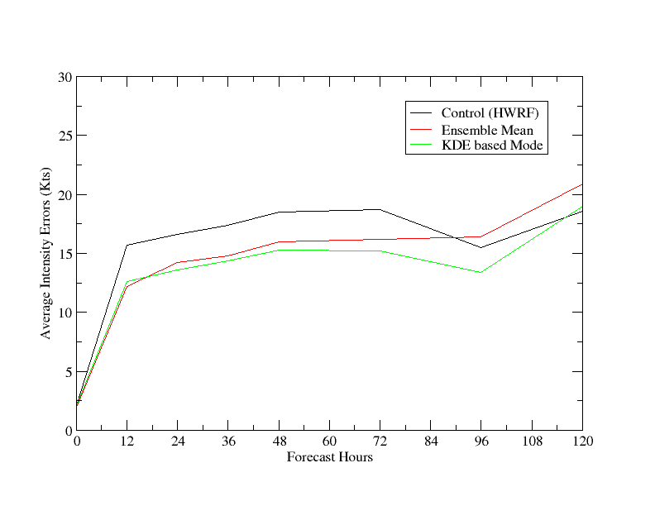
Comparison of Average Intensity Errors
Hurricane Earl (Total Sample: 41)
KDE based mode analysis further improves intensity forecasts.
~22%
~20%
~8%

Slide 15
Summary and Conclusion
HWRF-GEFS EPS includes uncertainties in initial large scale environment flows and LBC;
Track forecast skills from HWRF-GEFS EPS are improved by arithmetic ensemble mean;
Ensemble intensity forecast errors are generally non-Gaussian distributed, biased, skewed, and have multi-modes;
Improved intensity forecast skills are obtained by applying a simple bias correction method based on ensemble PDF;
Systematic model bias can be efficiently reduced by using multi-model, multi-physics EPS;
KDE based ensemble mode outperforms arithmetic ensemble mean in intensity forecasts;
Less intensity bias in the currently updated version of HWRF system.

Slide 16
Future work:
Test the HWRF-GEFS EPS in real time for 2012 hurricane season;
Combine HWRF-GEFS and multi-model, multi-physics EPS to account for all possible uncertainties;
Provide flow dependent error covariance for DA.

