Slide 1
HFIP Ensemble Subgroup Prototype Ensemble Products Hybrid Dynamical-Statistical Wind Probabilities
Andrea Schumacher
9 Jan 2012 Teleconference

Slide 2
Monte Carlo Wind Probability Model
Estimates probability of 34, 50 and 64 kt wind to 5 days
Implemented at NHC for 2006 hurricane season
Replaced Hurricane Strike Probabilities
1000 track realizations from random sampling NHC track error distributions
Intensity of realizations from random sampling NHC intensity error distributions
Special treatment near land
Wind radii of realizations from radii CLIPER model and its radii error distributions
Serial correlation of errors included
Probability at a point from counting number of realizations passing within the wind radii of interest
*See DeMaria et al. 2009 for more details

Slide 3
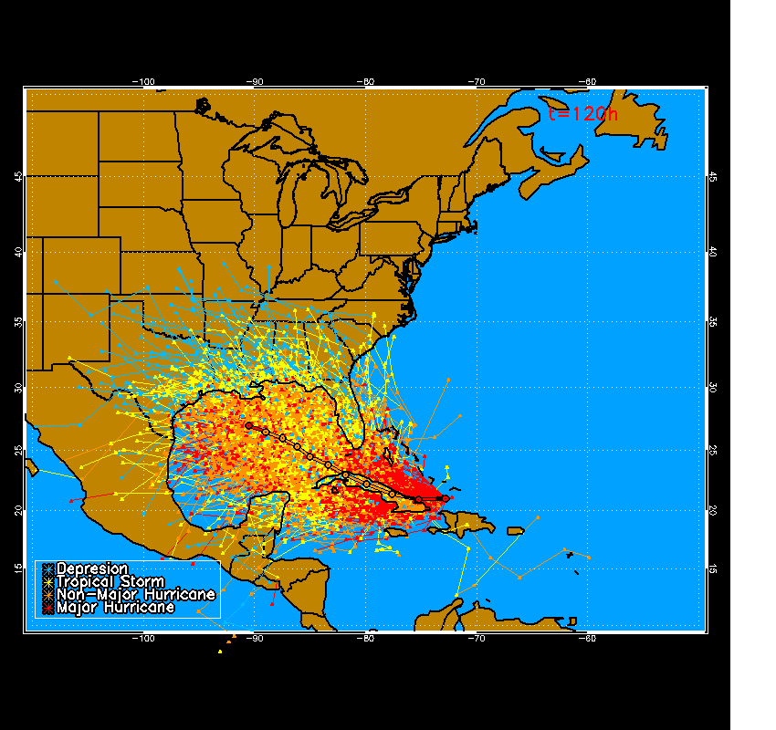
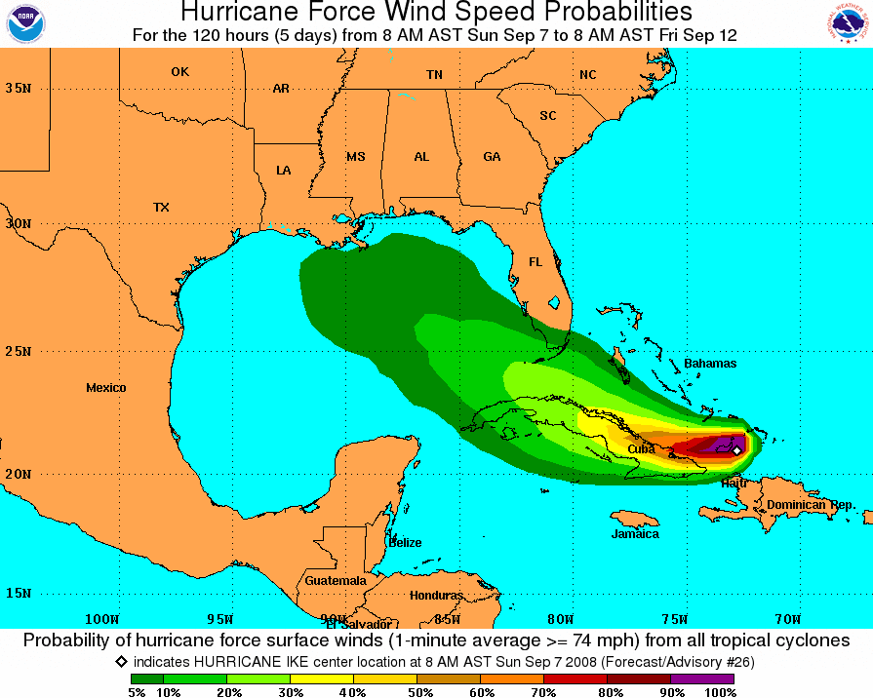
MC Probability Example
Hurricane Ike 7 Sept 2008 12 UTC
1000 Track Realizations 64 kt 0-120 h Cumulative Probabilities

Slide 4
Developing Hybrid Statistical-Dynamical Wind Probabilities
Atlantic Basin only (to start)
Track realizations from global model ensemble tracks
Intensity of realizations from random sampling NHC intensity error distributions
Special treatment near land
Wind radii of realizations from radii CLIPER model and its radii error distributions
Serial correlation of errors included
Probability at a point from counting number of realizations passing within the wind radii of interest

Slide 5
Data (2011)
Tropical cyclone advisories and forecasts
a-decks, b-decks and e-decks
Global numerical model ensemble forecasts (T. Marchok)
GFS (control + 20 perturbations)
CMC (control + 20 perturbations)
ECMWF (control + 50 perturbations)
93 model track/intensity forecasts total
Note: ECMWF runs only available at 12z
For initial development, only ran MCP at 12z
Limited size of sample to N = 99

Slide 6
Monte Carlo Probability (MCP) Configuration
2011 operational version
Sample forecast errors from 2006-2010
Domain: 0 to 50°N, 10-100°W
Resolution: 0.5 degree latitude-longitude grid
Runs
1000 realizations (sampling climatological track & intensity forecast errors)
93 realizations (sampling climatological track & intensity forecast errors)
93 realizations (model tracks, sampling climatological intensity forecast errors)
93 realizations (model tracks & intensities)

Slide 7
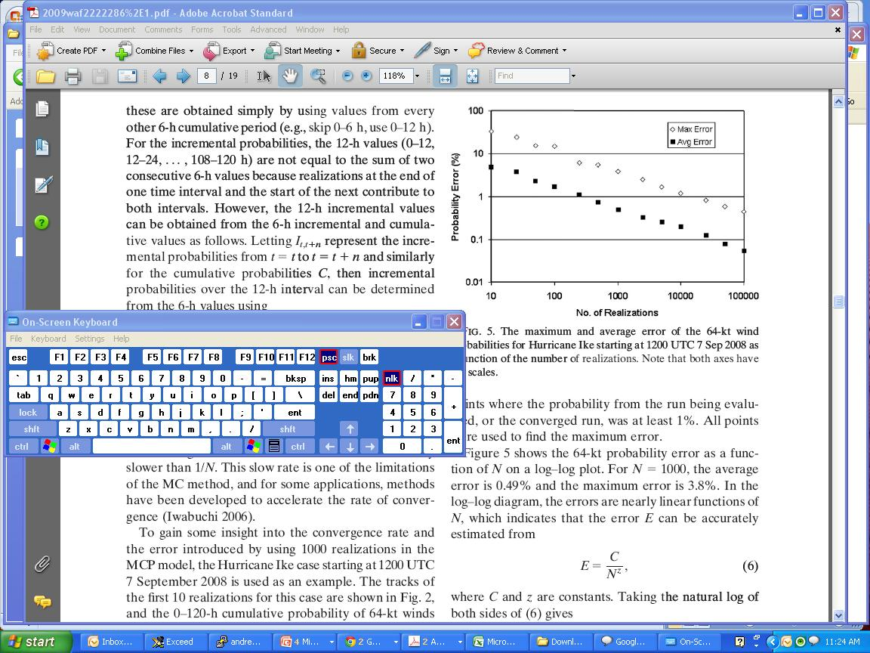
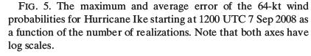
Number of Realizations and Convergence
In the log-log diagram, errors (E) are nearly a linear function of N:
E = C / N^{z}
(6)
Where C and Z are constants. Taking the natural log of both sides gives
y = mx + b
Where y = ln(E), x = ln(N), b = ln(C), and m = -z.
(7)
Maximum and average errors are both inversely proportional to the square root of N:
E ~ 1/N^{0.5}
For N = 1000, avg E = 0.5%
For N = 100, avg E = 1.6%
i.e., factor of 10 reduction in N
Yields smaller increase in E (~factor of 3)
Fitting (7) to max. error data yields:
z = 0.485, C = 109.2%
Fitting (7) to avg. error data yields:
z = 0.490, C = 15.8%

Slide 8
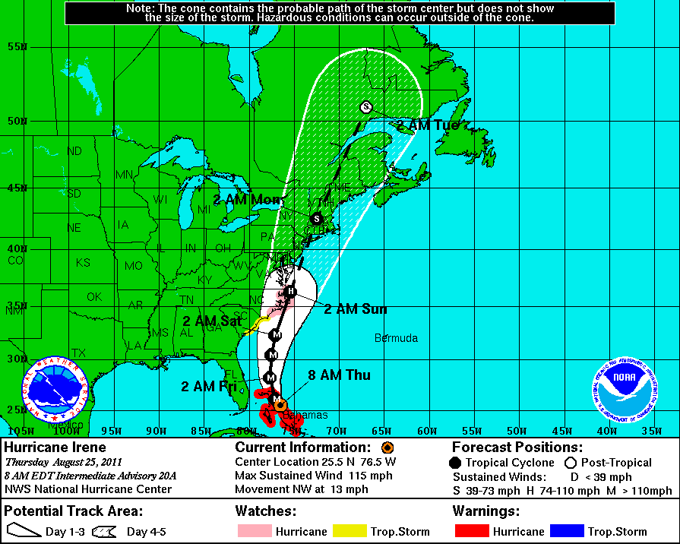
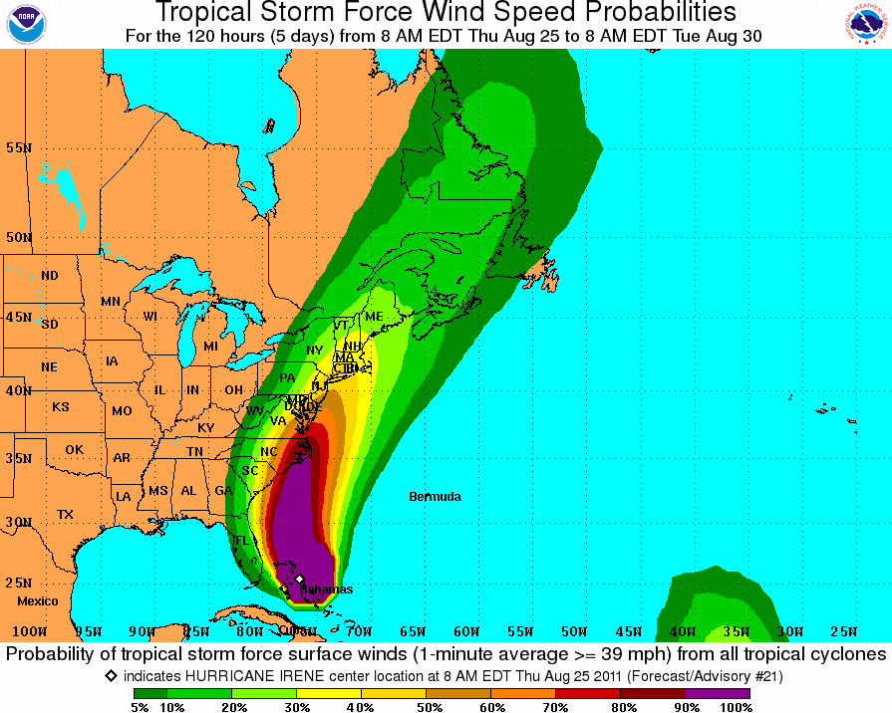
Example #1: Irene 25 Aug 2011 at 12Z

Slide 9
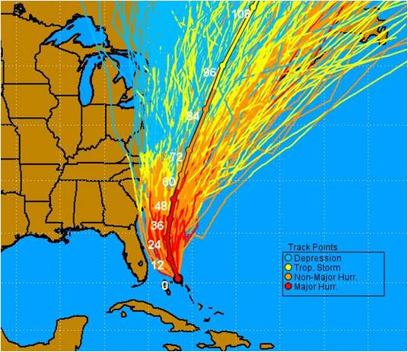
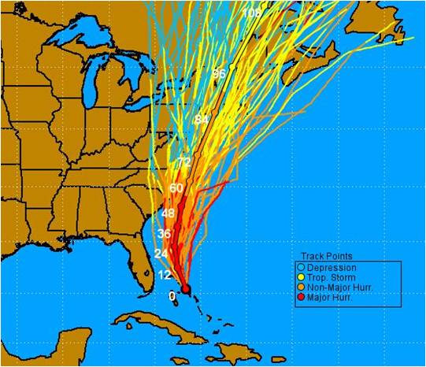
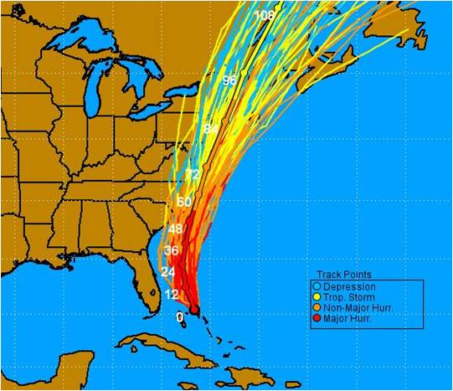
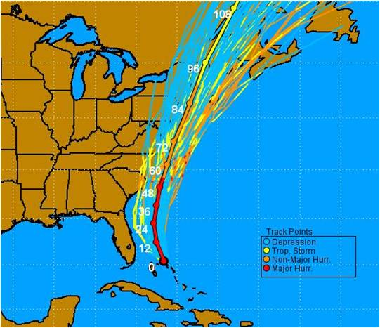
Realizations
MCP (N = 1000)
MCP (N = 93)
MCP w/ ensemble
tracks & intensities (N=93)
MCP w/ ensemble
tracks (N=93)

Slide 10
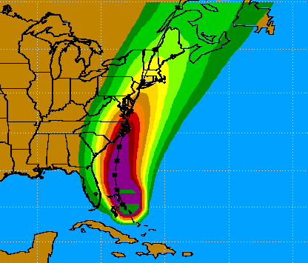
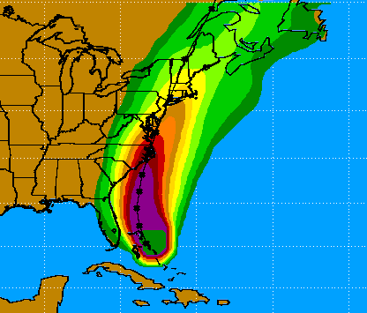

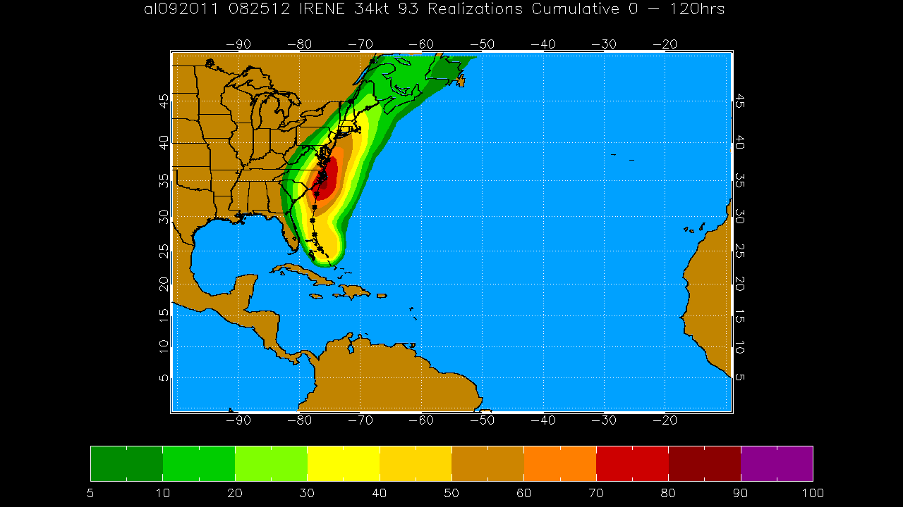
34-kt Wind Speed Probabilities
MCP (N=1000)
MCP (N=93)
MCP w/ ensemble
tracks & intensities (N=93)
MCP w/
ensemble
tracks
(N=93)

Slide 11
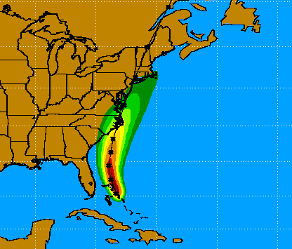

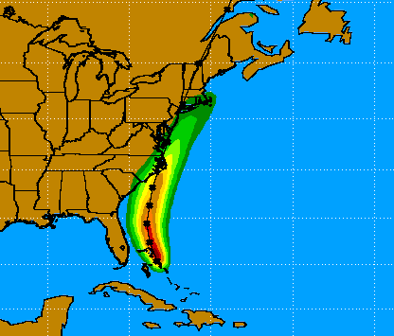

64-kt Wind Speed Probabilities
MCP (N=1000)
MCP (N=93)
MCP w/ ensemble
tracks & intensities (N=93)
MCP w/
ensemble
tracks (N=93)

Slide 12
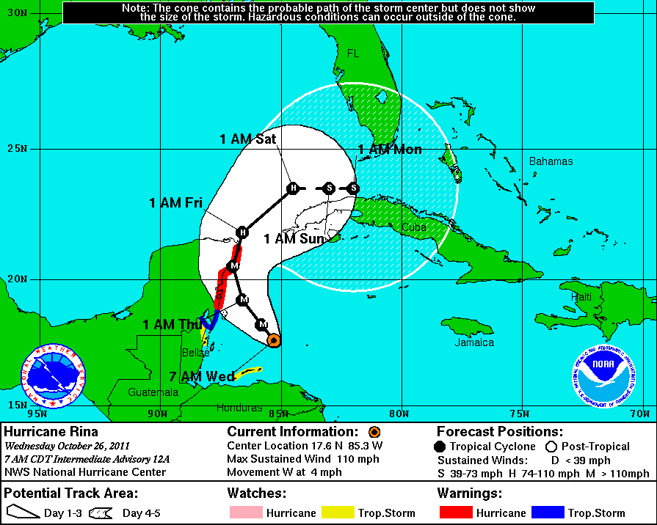
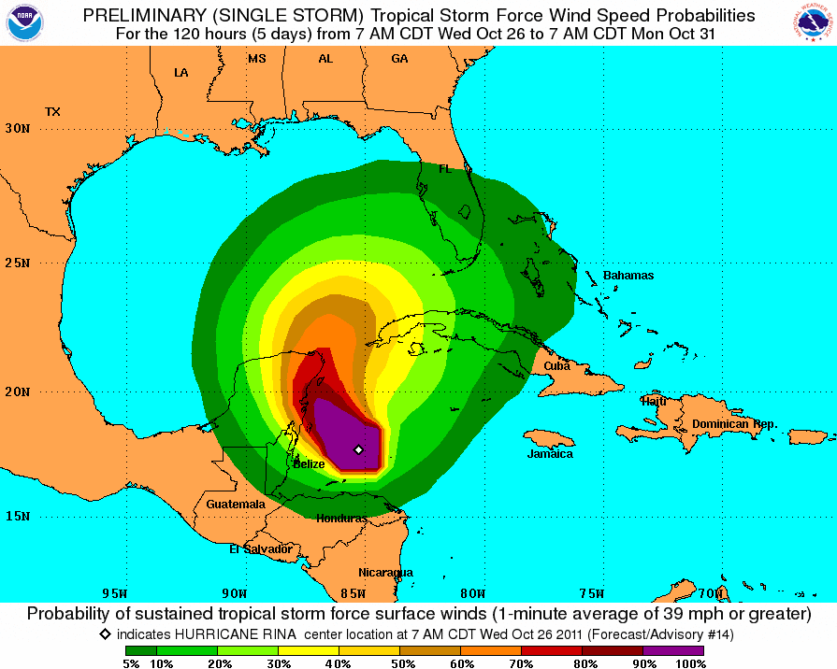
Example #2: Rina 26 Oct 2011 at 12z

Slide 13
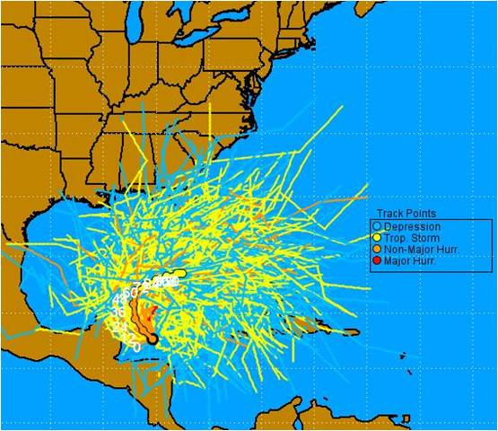
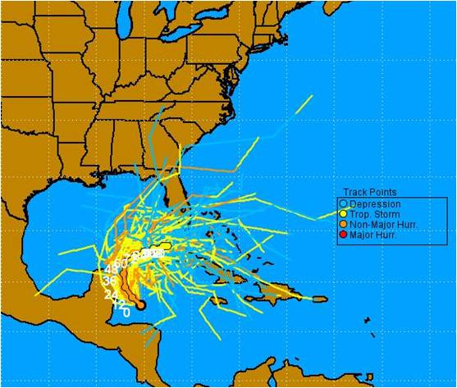
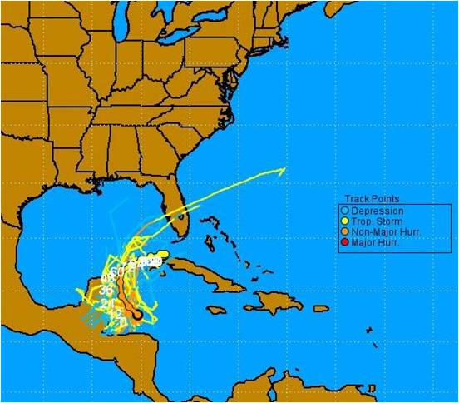
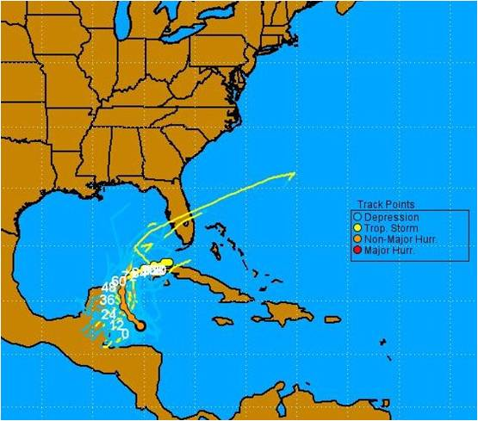
Realizations
MCP (N=1000)
MCP (N=93)
MCP w/
ensemble
tracks (N=93)
MCP w/ ensemble
tracks & intensities (N=93)

Slide 14
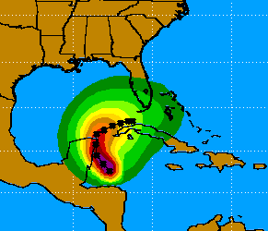

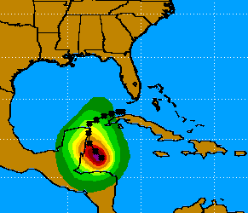
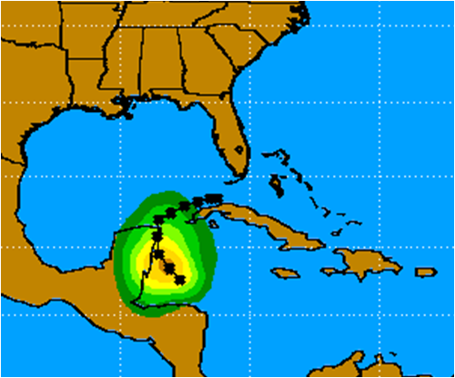
34-kt Wind Speed Probabilities
MCP (N=1000)
MCP (N=93)
MCP w/
ensemble
tracks (N=93)
MCP w/ ensemble
tracks & intensities (N=93)

Slide 15



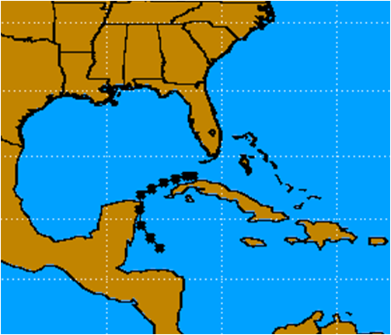
64-kt Wind Speed Probabilities
MCP (N=1000)
MCP (N=93)
MCP w/
ensemble
tracks (N=93)
MCP w/ ensemble
tracks & intensities (N=93)

Slide 16
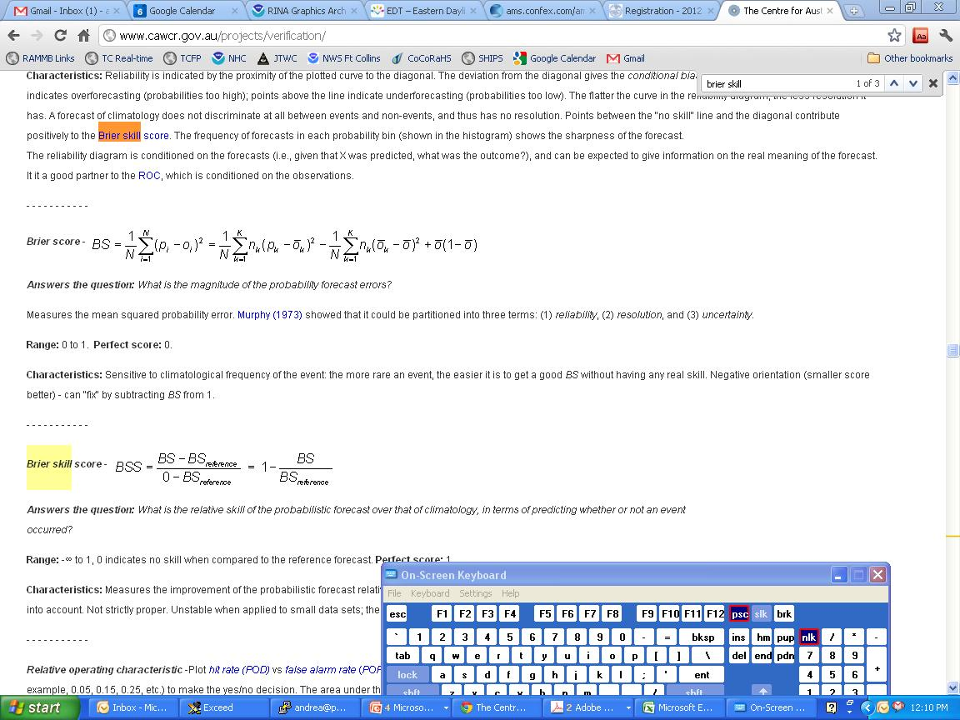
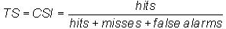
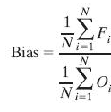
2011 Atlantic Basin Verification Statistical MCP vs. Hybrid MCP
Brier Skill Score: Reference forecast assumes p = 0% everywhere
Threat Score: Averaged over all probability thresholds
Multiplicative Bias:
where

Slide 17
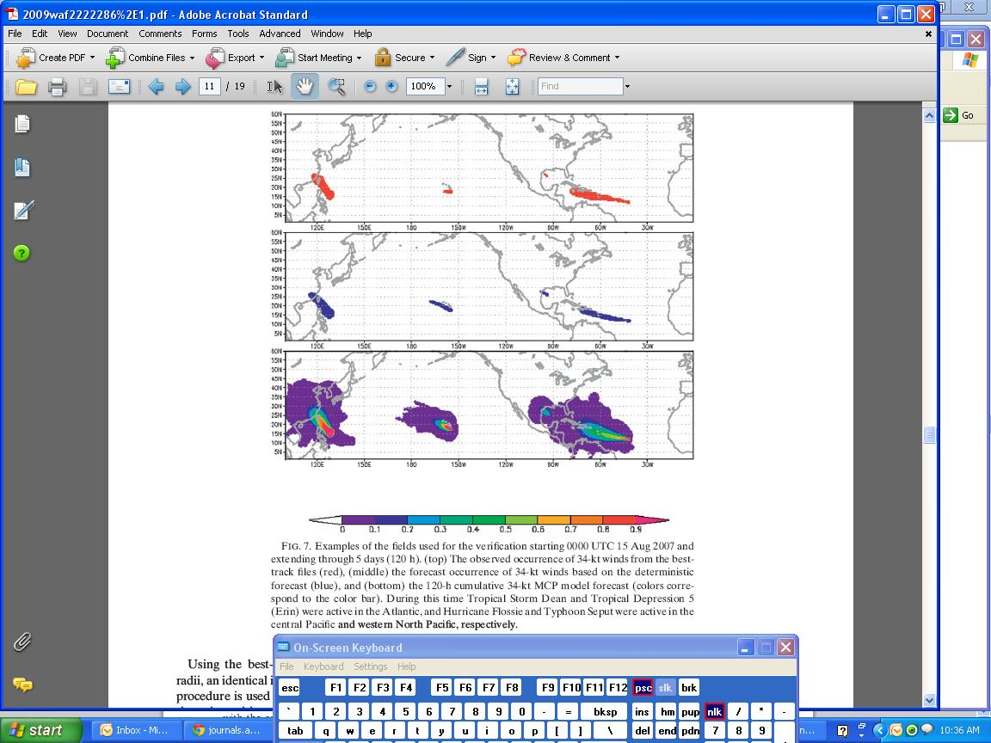
2011 Atlantic Verification (Cont…) (Example: 34-kt wind speed probabilities from 0 UTC 15 Aug 2007)
Observed
MCP Model
*See DeMaria et al. 2009 for more details

Slide 18
Results – Brier Skill Scores
N = (99 cases)(18281 grid points) = 1846381
Notes:
TS → How well did forecast “yes” correspond to observed “yes”

Slide 19
Results – Threat Scores
N = (99 cases)(18281 grid points) = 1846381
Notes:
BS → Magnitude of errors

Slide 20
Results - Multiplicative Bias
N = (99 cases)(18281 grid points) = 1846381

Slide 21
Summary
Hybrid statistical-dynamical wind probability model has been developed for Atlantic
Uses ensemble tracks, MCP intensity and wind radii
Using ensemble intensities degrade forecast considerably
Lower number of realizations does not degrade wind probabilities significantly
Smaller number of model ensembles available not expected to degrade MCP skill substantially
Hybrid MCP improvement over MCP at longer forecast times
Brier skill score for 64-kt cumulative wind probabilities larger after 24 hours
Threat score for 34-kt (64-kt) cumulative wind probabilities larger after 84 hrs (after 72 hrs)

Slide 22
Continuing work
Explore other methods for including ensemble tracks
Differential weighting of members
Kernel density estimation techniques → more realizations
Examine weak tropical storm cases
Since global model ensemble members usually initialized at lower vmax, many ensemble members drop out at t = 0 → lower wind probabilities
Set minimum v_{max} for Hybrid Wind Probabilities?
Develop and test for E. Pacific and W. Pacific

Slide 23
References
DeMaria, M., J. A. Knaff, R. Knabb, C. Lauer, C. R. Sampson, R. T. DeMaria, 2009: A New Method for Estimating Tropical Cyclone Wind Speed Probabilities, Wea. and Forecasting, 24, pp. 1573-1591

