Slide 1
HFIP Ensemble Products Subgroup
Sept 2, 2011 Conference Call

Slide 2
Outline
Ensemble Products for TC genesis
S. Majumdar
EMC Ensemble Team
Jiayi Peng and Zhan Zhang
Regional model ensemble products
Will Lewis
NHC wind speed probability products
Mark DeMaria
NRL ensemble products
Jon Moskaitis
Next steps

Slide 3

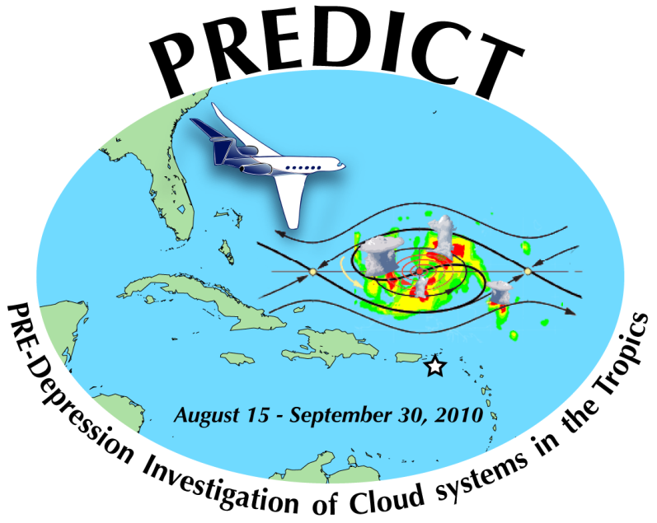
Ensemble-based prediction and diagnostics for tropical cyclogenesis
Sharan Majumdar (RSMAS / U. Miami)
Collaborators: Ryan Torn & the PREDICT team
9/2/11

Slide 4
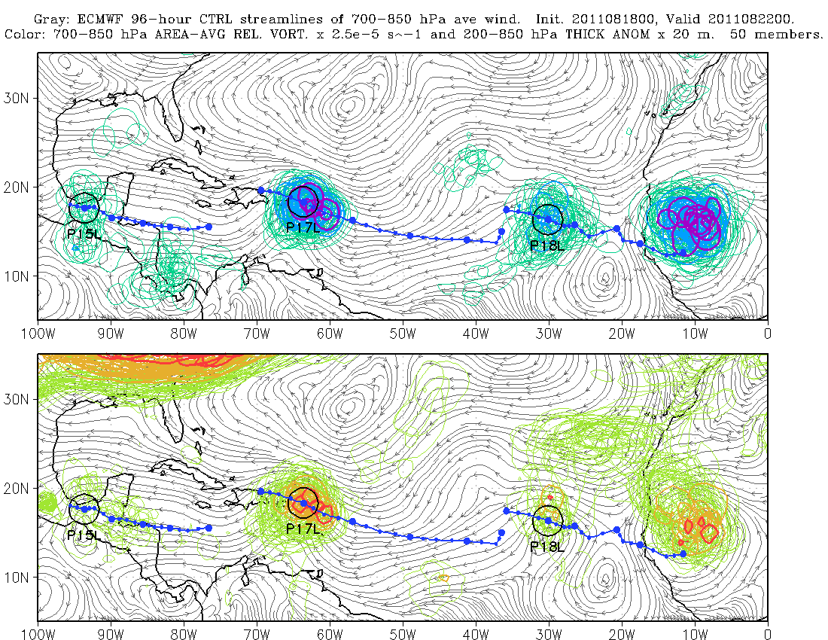
Real-time ensemble products, Aug-Sep 2011
http://www.rsmas.miami.edu/personal/smajumdar/predict/

Slide 5
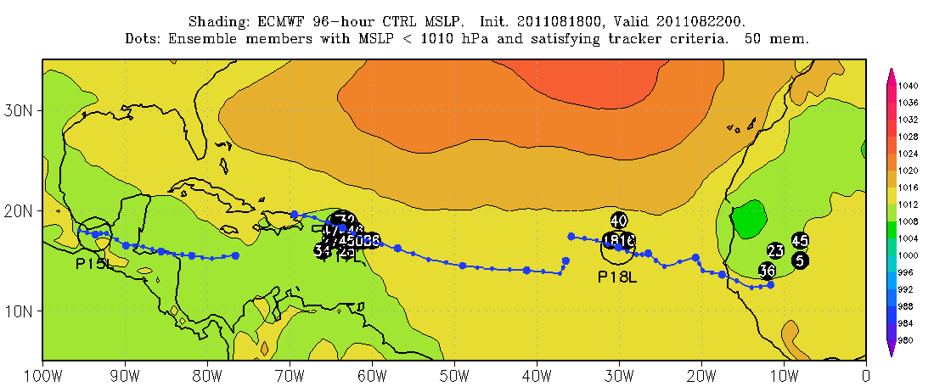
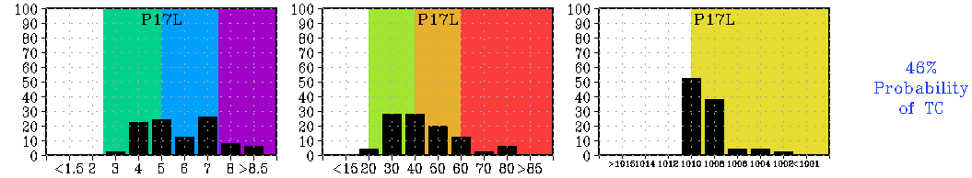
Pre-Irene: 4-day ECMWF ensemble forecast

Slide 6
Plans for evaluation
Converge on reliable quantitative metric for a tropical cyclone
Area ave. rel. vort. > 5 x 10⁻⁵ s⁻¹
Local 200-850 hPa thickness anomaly > 40 m
Local MSLP minima < 1010 mb
Probabilistic verification of genesis and non-genesis cases, for 0-10 day ECMWF and NCEP (and other?) ensemble forecasts in 2010-2011
Genesis probabilities
PDFs

Slide 7
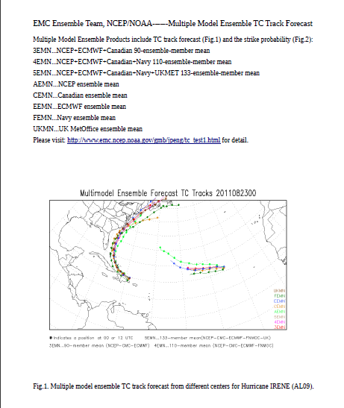
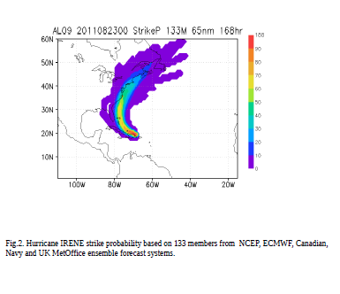
Jiayi Peng
And Zhan Zhang

Slide 8
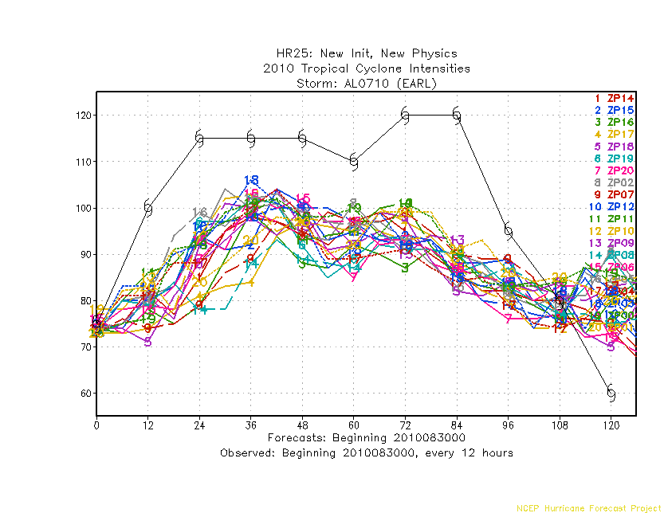
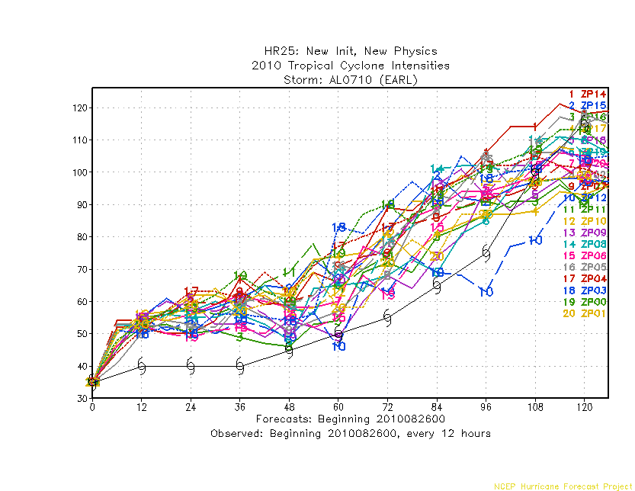
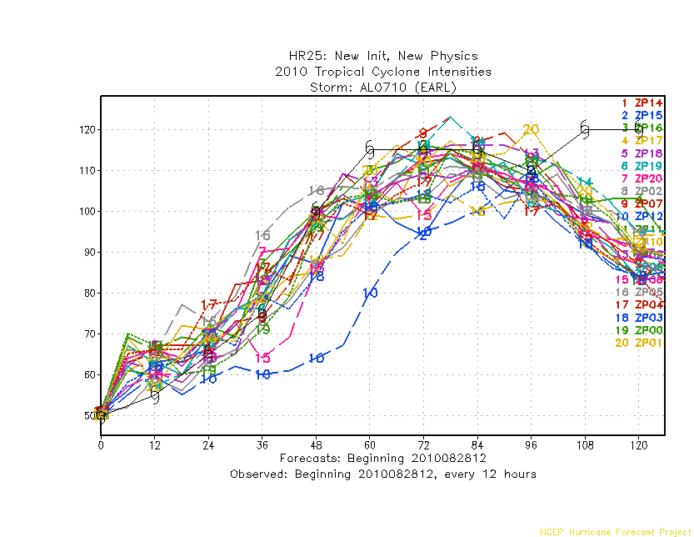
Init intensity=35kts
Init intensity=75kts
Positive bias for weaker storm
Negative bias for stronger storm
For Earl, there are overall strong negative sample bias.
Init intensity=50kts

Slide 9
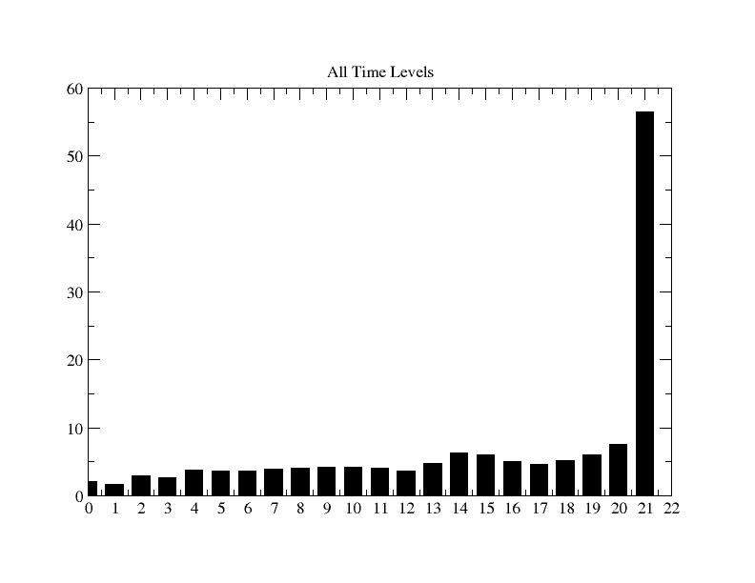
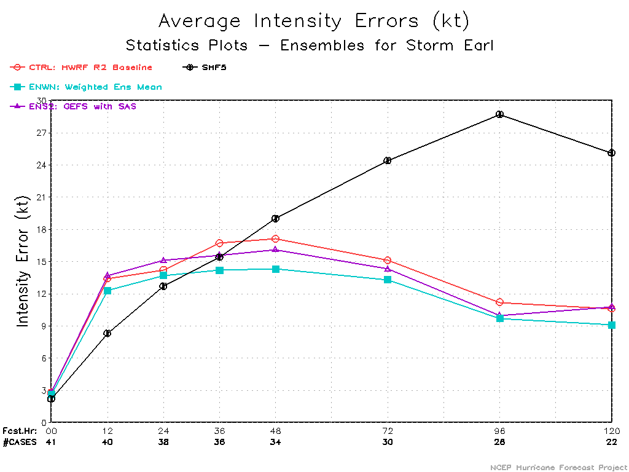
Ranked Histogram for 10m Max Wind Speed
Hurricane Earl, 2010
In order to remove model bias..
Relative Frequency (%)
For single model, initial condition based ensemble, regression model can be used to determine the weights on each of the ranked ensemble members;
The weights are functions of maximum wind speed, basins, etc.
Strong negative sample bias
Ranked Ensemble members
Intensity forecast skills improved ~15% with weighted ensemble mean

Slide 10
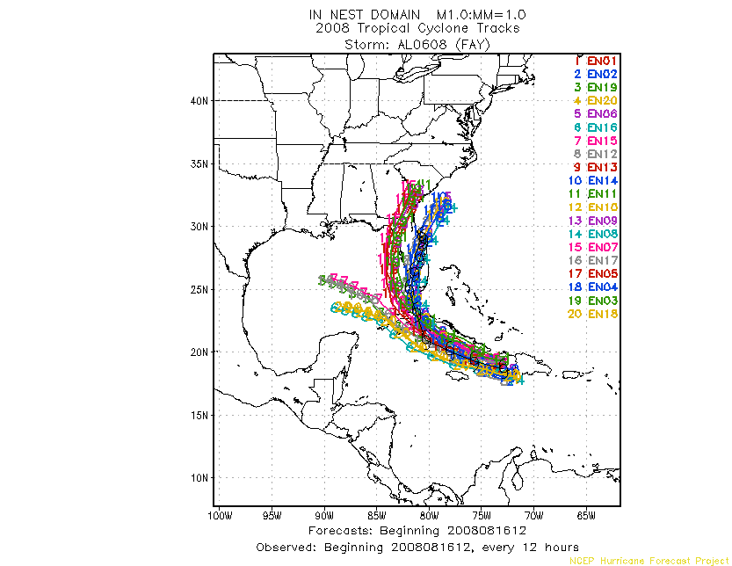
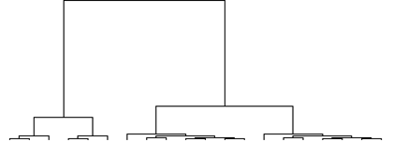
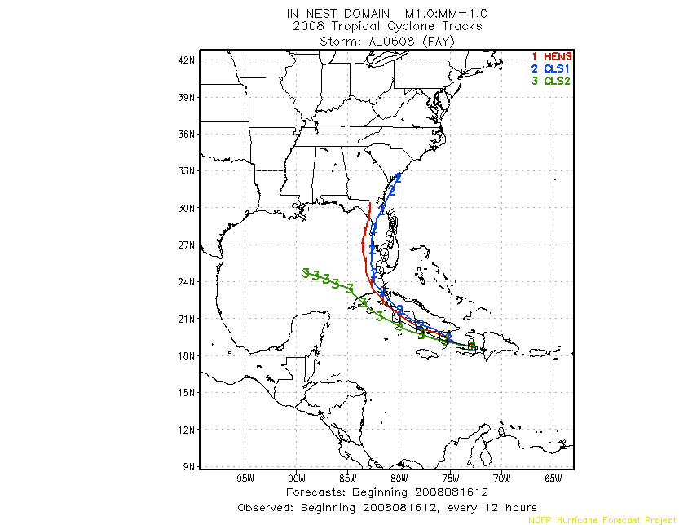
Hierarchical Cluster Analysis
Example of cluster analysis
Methodology
Total ensemble mean
Compute distance (or similarity) among each ensemble member;
Initially each member is treated as a cluster;
Join two closest cluster to form a new cluster;
Repeat the process until only one cluster remains;
Can be applied to intensity analysis as well.
The vertical length measures the similarities among the clusters
Cluster 1
Cluster 2
20 18 16 19 17 15 12 14 06 10 04 08 02 11 13 05 09 03 07 01
Ensemble Member ID

Slide 11
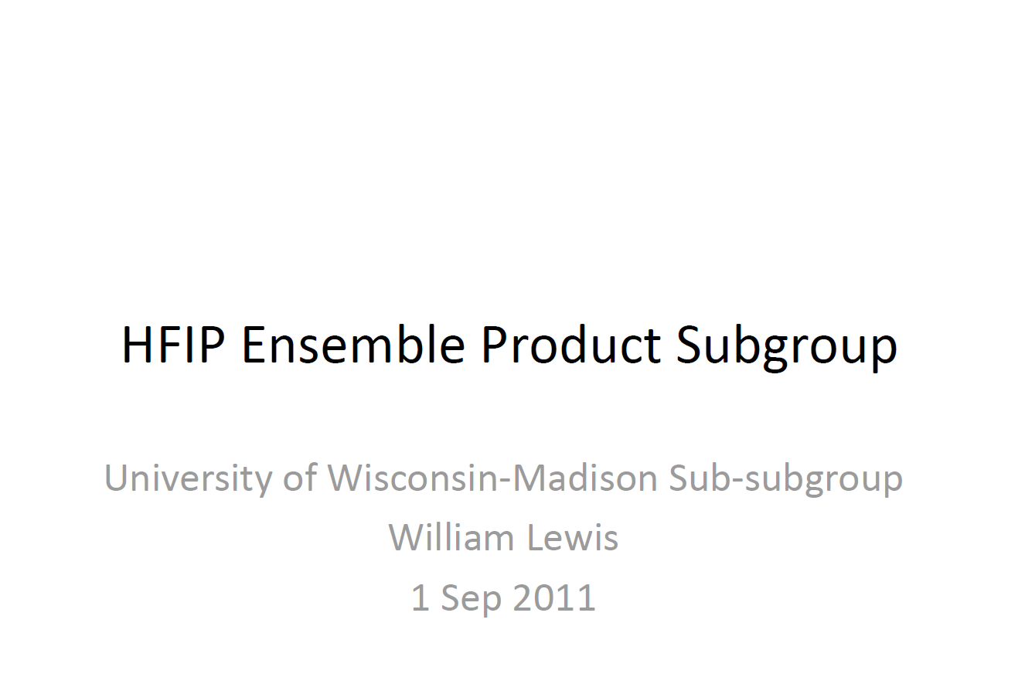

Slide 12
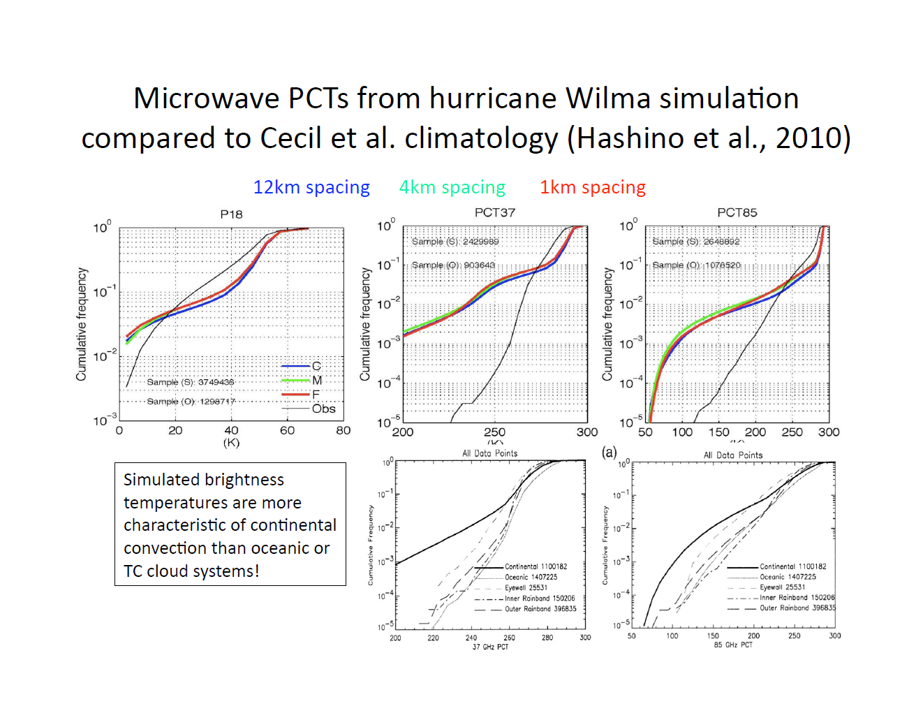

Slide 13
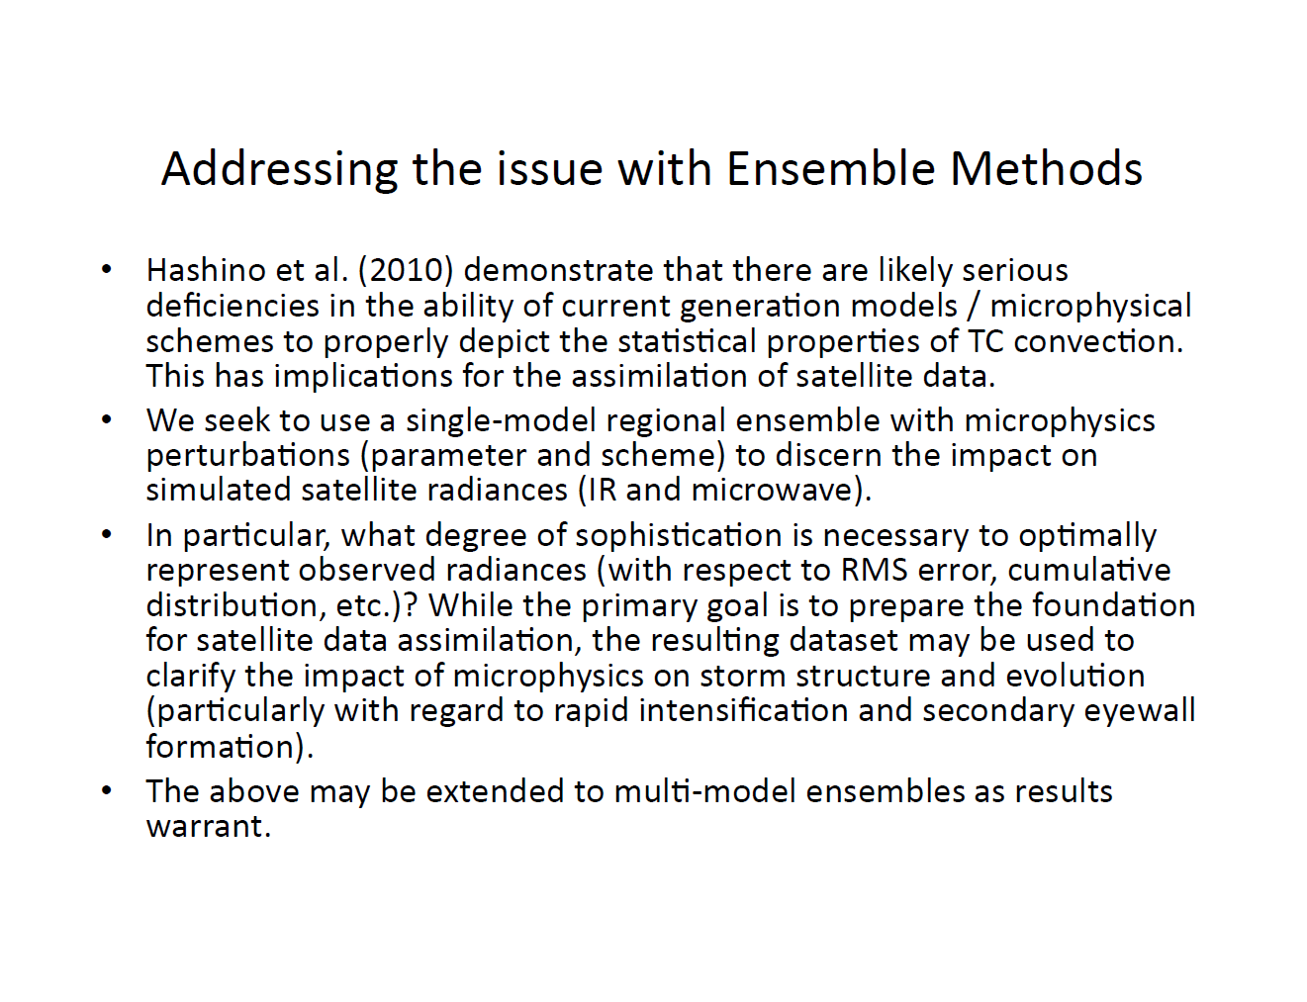

Slide 14
Products Adapted from NHC Wind Speed Probabilities M. DeMaria
Monte Carlo method using random sampling of NHC historical errors provides 1000 tracks, max surface winds, and radii of 34, 50 and 64 kt surface winds
Many products derived from the information
Some are candidates for dynamical ensemble systems
Two examples
Wind speed probabilities
Watch/Warning guidance

Slide 15
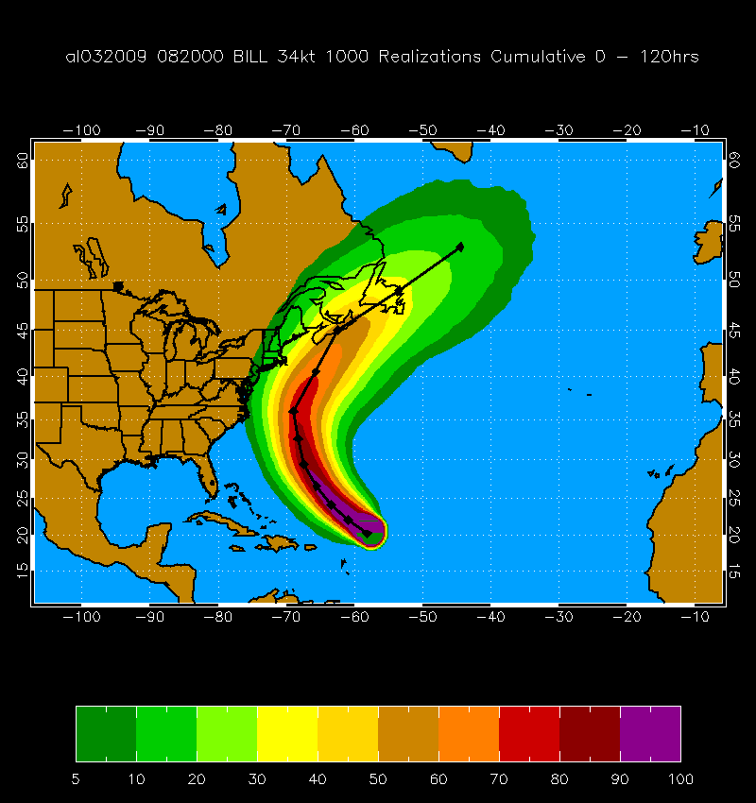
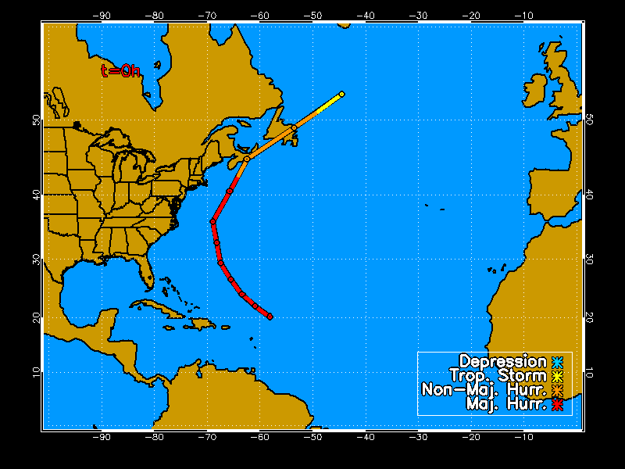
MC Probability Example
Hurricane Bill 20 Aug 2009 00 UTC
1000 Track Realizations 34 kt 0-120 h Cumulative Probabilities

Slide 16
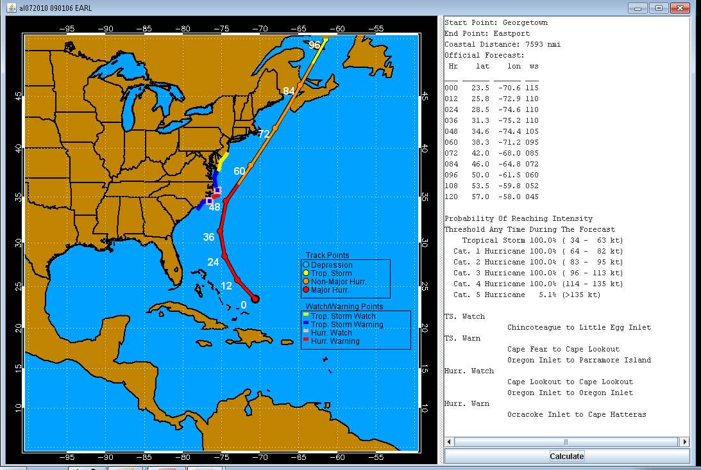
Automated Watch/Warning Guidance
Based on 34 and 64 kt probability threholds

Slide 17
Verification Methods
Wind speed probabilities
Use NHC 34, 50 and 64 kt wind radii from best track as ground truth
Multiplicative Bias, reliability diagrams, threat score, Brier Score
Use NHC deterministic forecast as basis for skill
Covert to binary probability
Watch/Warning guidance
Use best track to identify areas with hurricane winds
Hit rate and false alarm rate
Use NHC official watch/warnings as skill measure

Slide 18


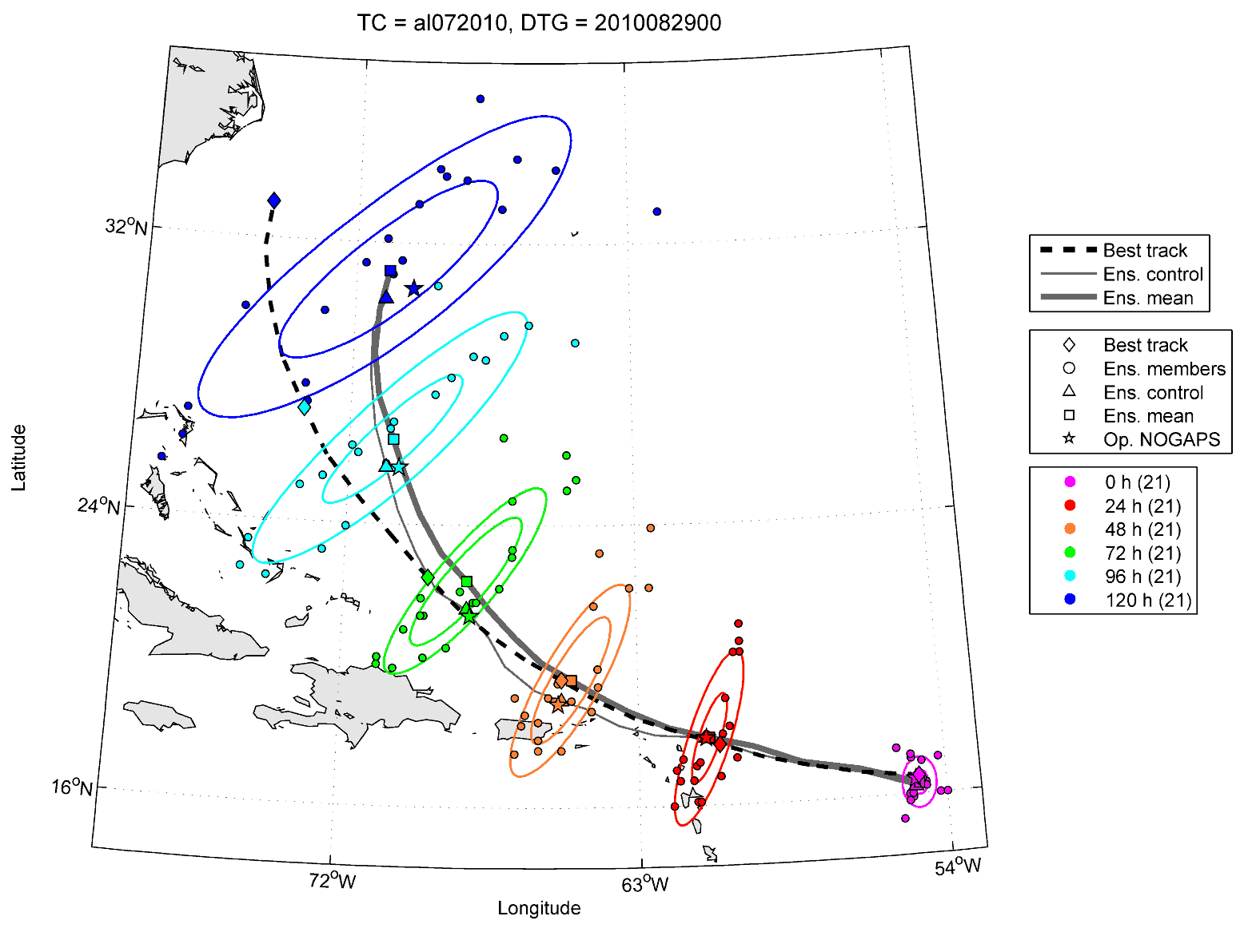
NRL TC ensemble products and verification
Jon Moskaitis, Carolyn Reynolds, Alex Reinecke
Initial Goal: Effectively display basic track/intensity/wind radii forecasts from our
two real-time ensemble systems: (1) NOGAPS global and (2) COAMPS-TC regional
TC track ensemble
display example
from NOGAPS
(Hurricane Earl)
Number of
ensemble
members
The two ellipses per lead
time contain 1/3 and 2/3
of the ensemble member
TC positions, respectively

Slide 19
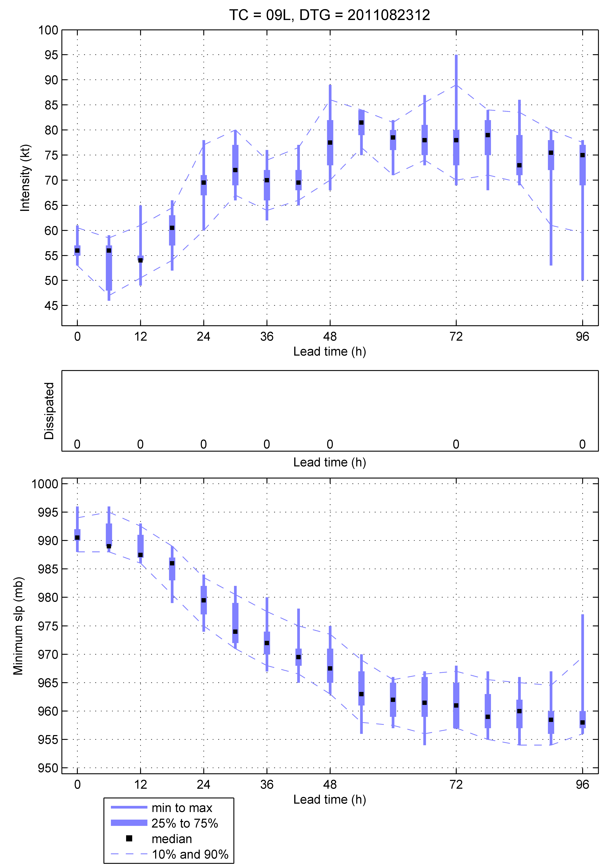
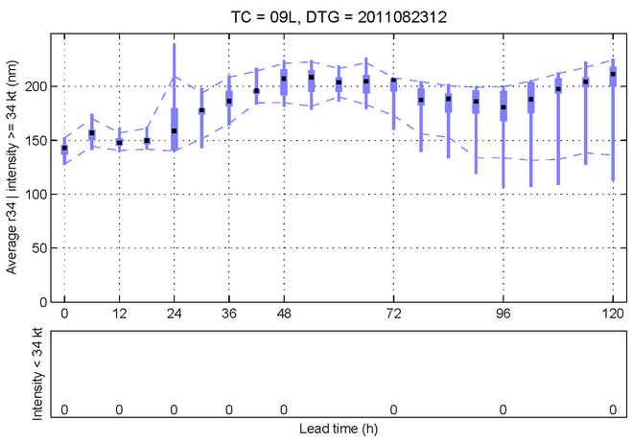
NRL TC ensemble products and verification
TC intensity/min slp/r34 ensemble
display example from COAMPS-TC
(Hurricane Irene)
Intensity (kt)
Real-time COAMPS-TC ensemble forecasts at
http://www.nrlmry.navy.mil/coamps-web/web/ens
Average r34 (nm)
Minimum slp (mb)

Slide 20
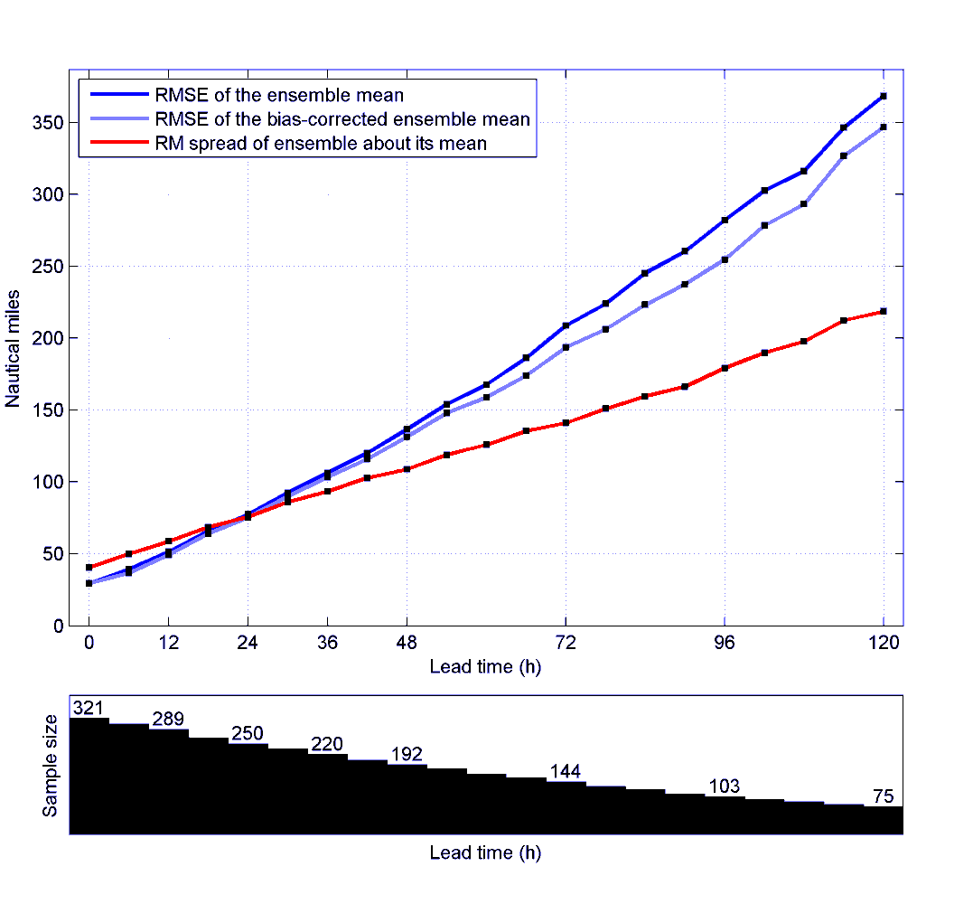
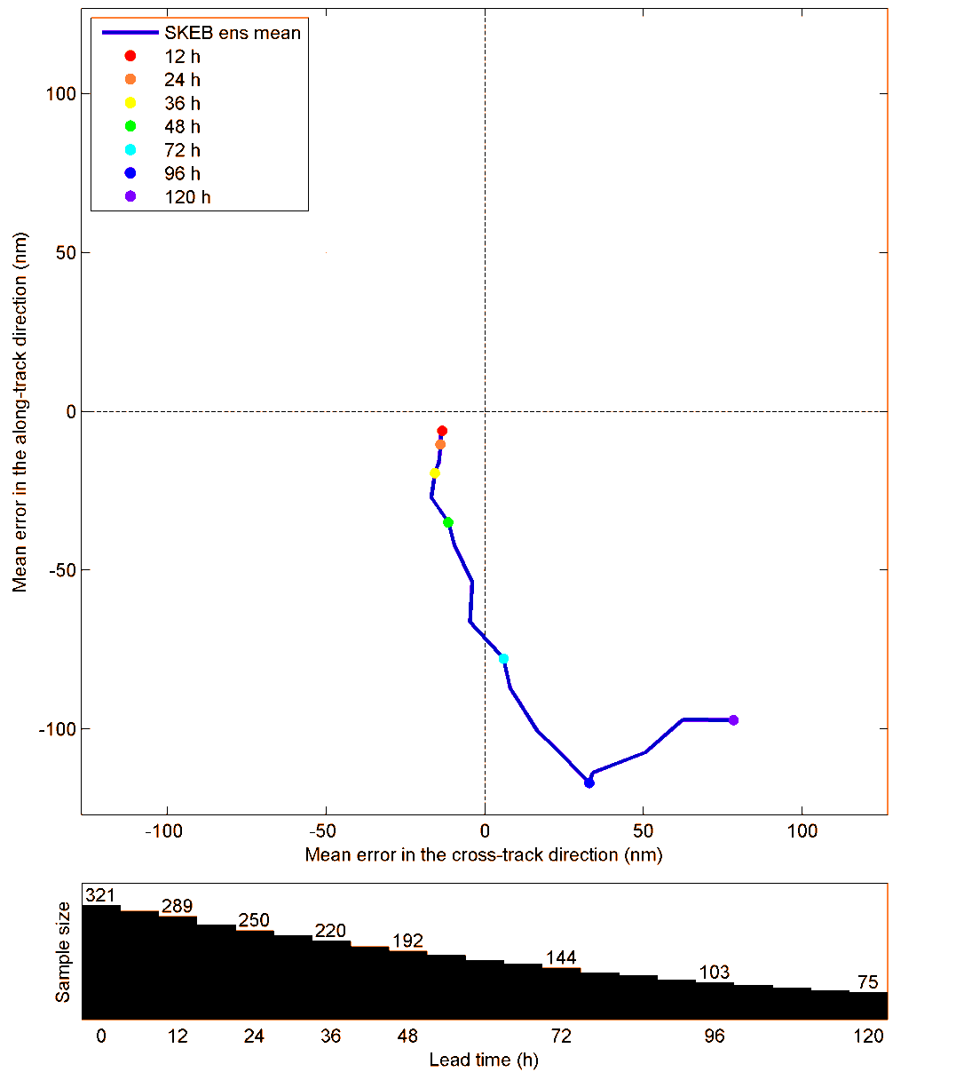
NRL TC ensemble products and verification
NOGAPS ensemble mean
Storm relative mean error
NOGAPS spread-skill comparison
AHEAD
LEFT
RIGHT
BEHIND
Future verification work:
Reliability diagrams
Rank histograms
Fit continuous probability distribution
and verify with CRPS

Slide 21
Next Steps
Develop list of potential ensemble products
Track only
Track, intensity
Track, intensity, structure
TC genesis
Other?
Metrics for evaluation
Subsets for real time evaluation
Inter-comparison between research groups

