Slide 1
HFIP Ensemble Product Subgroup
Update on Prototype Products
Mark DeMaria
March 12, 2012 Conference Call

Slide 2
3 Prototype Ensemble Products
Genesis ensembles from global models
  T. Marchok (lead)
Combined track/intensity/structure ensembles from regional models
  J. Moskaitis (lead)
Hybrid dynamical-statistical wind speed probabilities
  A. Schumacher, M. DeMaria (co-leads)

Slide 3
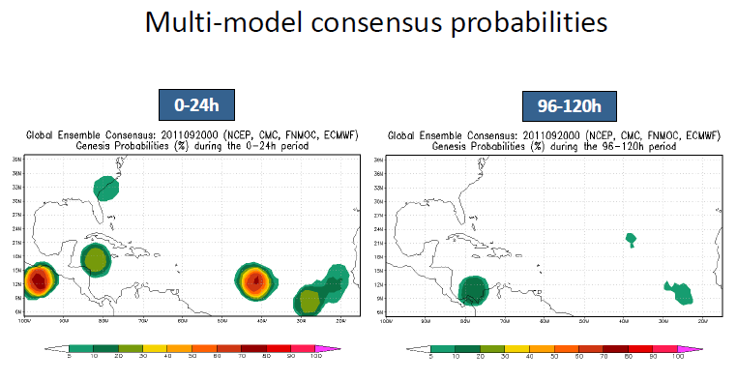
Prototype Genesis Product
NHC Feedback: Emphasize 0-48 and 0-120 hr

Slide 4
Update on Genesis Product
Scripts for automated product development
Lead times changed based on NHC input
  0-48 h and 0-120 h
Product to be displayed on EMC genesis tracking web page
Link on HFIP product web page?

Slide 5
Regional Model Products
Several prototypes available from J. Moskaitis
Final set needs to be selected
Display options
  NRL web page
  HFIP web page

Slide 6
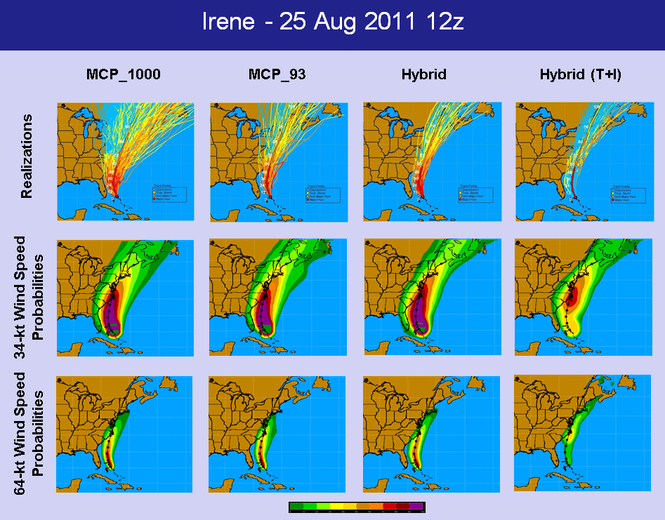

Slide 7
Implementation of Hybrid Product
Decide on final set of tracks
  Operational GFS and ECMWF
  Include HFIP Ensembles (FIM and experimental GFS)?
Source of ensemble tracks
Product timing
  Use late global models, run as early model?
Automated scripts under development at CIRA
Product display
  CIRA web page or HFIP product page?

