Slide 1
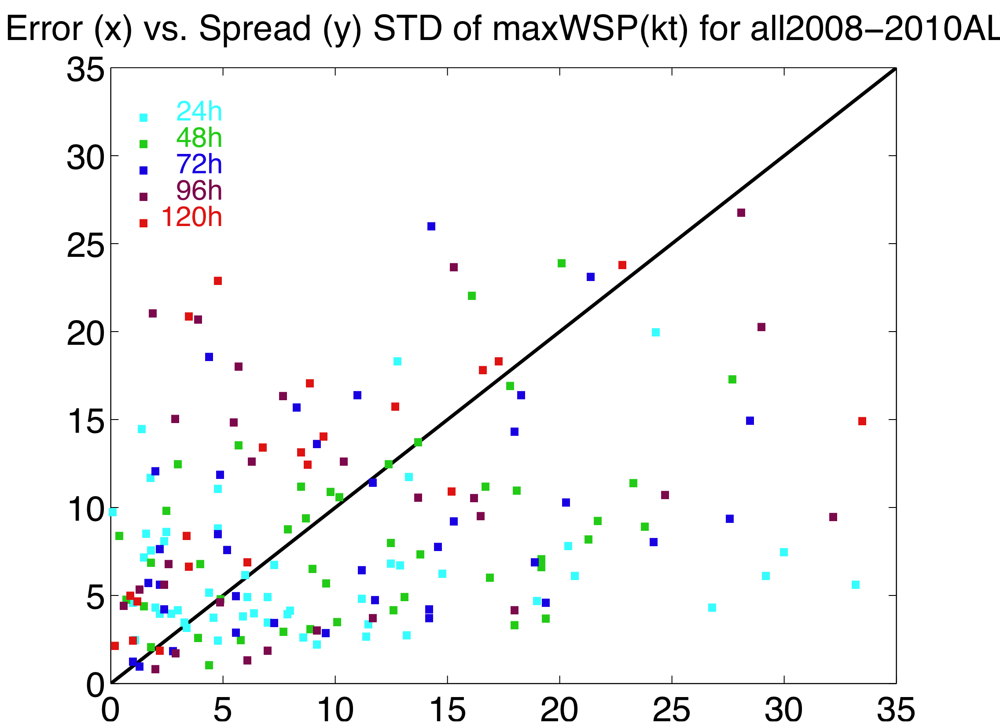
PSU realtime ensemble with ARW-EnKF
3 domains (40.5, 13.5&4.5km), 60-member ensemble, assimilate TDR Vr
Notes: (1) mean of 60-member ensemble forecast has similar performance to the forecast from initial EnKF mean; (2) ensemble is rather unbiased; (3) correlation of the forecast error versus spread is not great; (4) unclear how much we gain from the EF
Notes:
Also thank Meng Zhang and Dr. Yunghui Weng

Slide 2
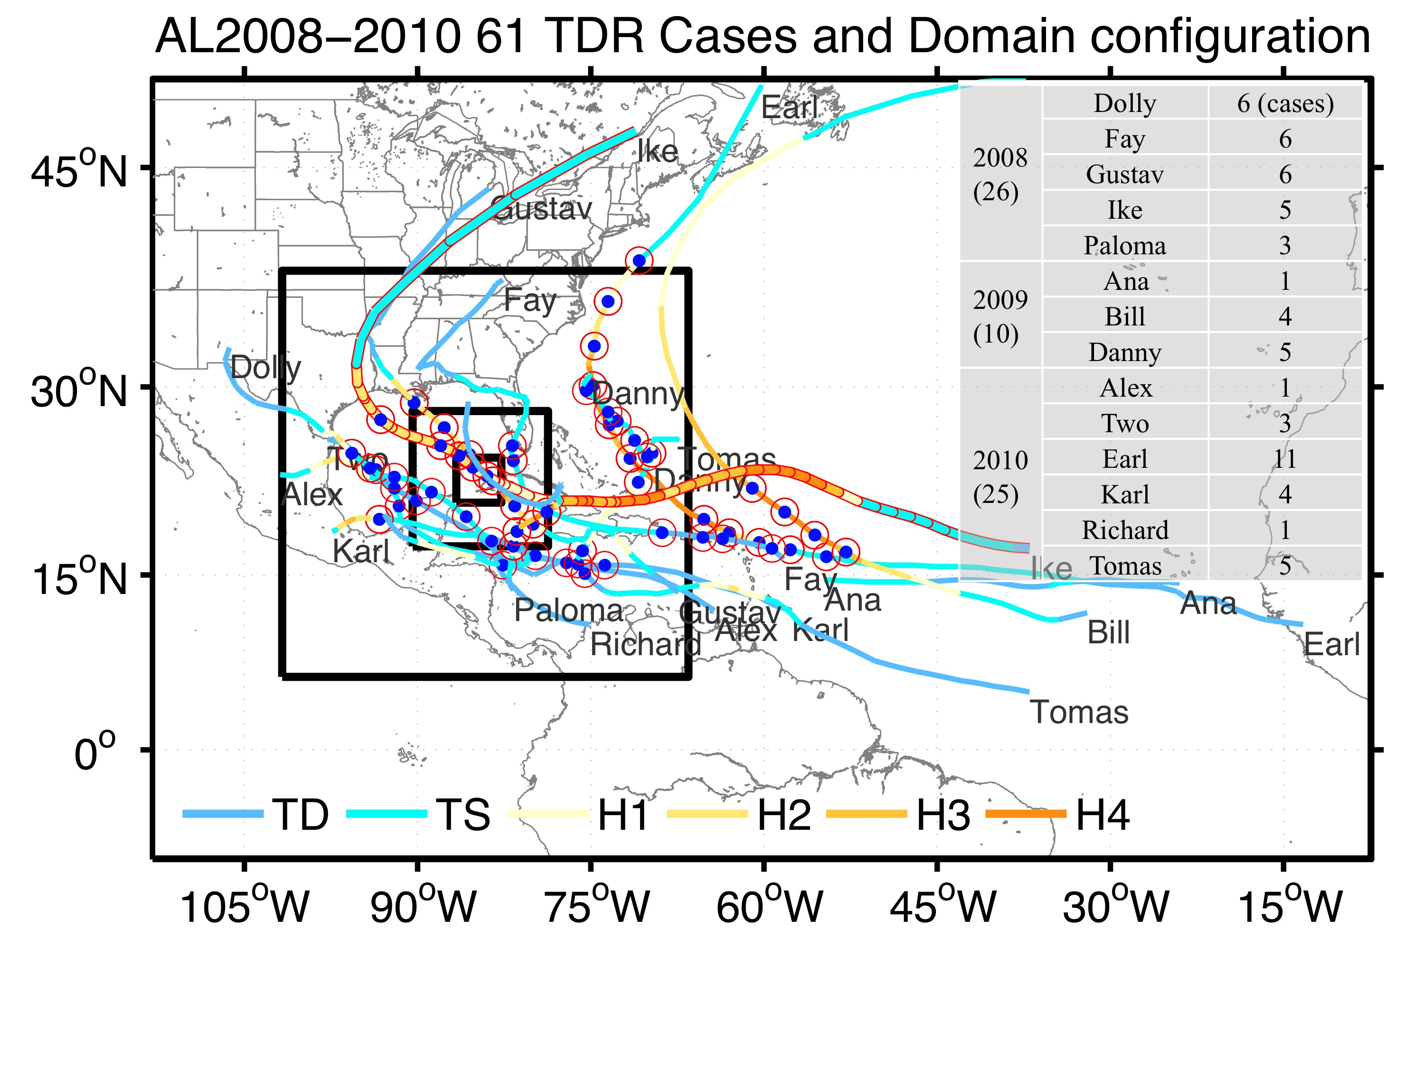
 | Storms | P3 Missions
2008 (26) | Dolly | 6
 | Fay | 6
 | Gustav | 6
 | Ike | 5
 | Paloma | 3
2009 (10) | Ana | 1
 | Bill | 4
 | Danny | 5
2010 (23) | Alex | 1
 | Two | 3
 | Earl | 11
 | Karl | 4
 | Richard | 1
 | Tomas | 3

Slide 3
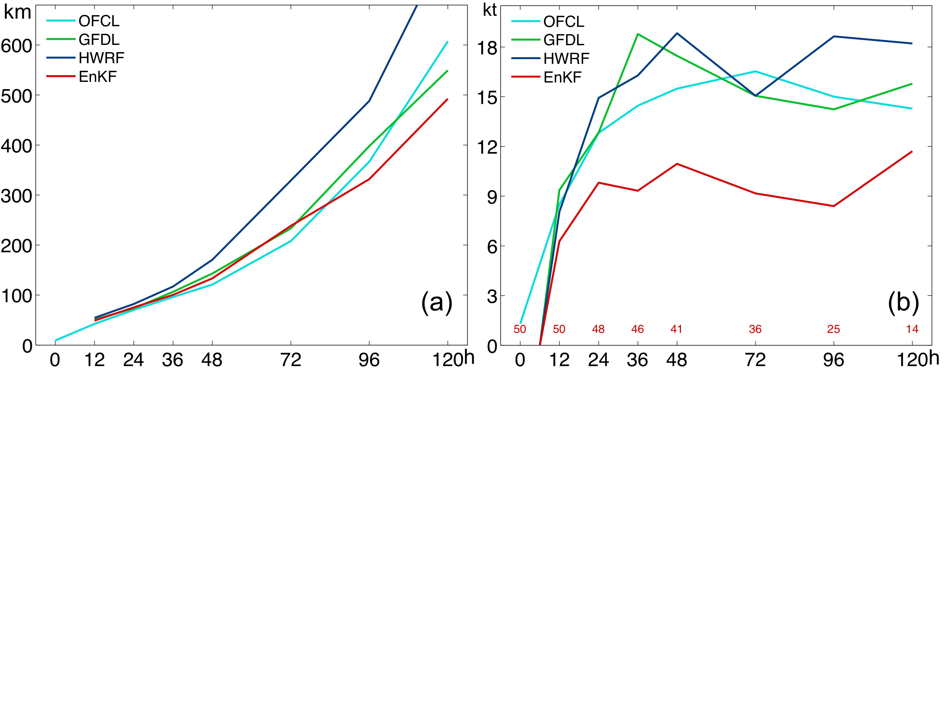
WRF-EnKF Performance Airborne Vr for 2008-2010 Mean absolute track (km) & intensity (kts) error for all applicable P3 missions

Slide 4
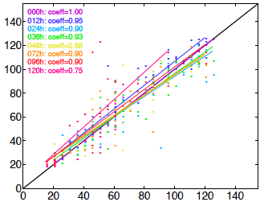
WRF-EnKF Performance Airborne Vr for 2008-2010 1.5-km EnKF Predicted versus Best-track Maximum Wind Speed Error (kts)
A1PS: EnKF 1.5-km control run
A4PS: EnKF 4.5-km control run
P400: EnKF 4.5-km ensemble mean

Slide 5
Consistency between Ensemble Spread and Error Mean Absolute Error and Ensemble Spread for all 59 cases 2008-2010

Slide 6
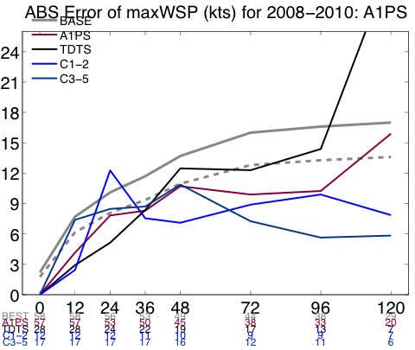
Forecast Error as a Function of Initial Intensity

Slide 7
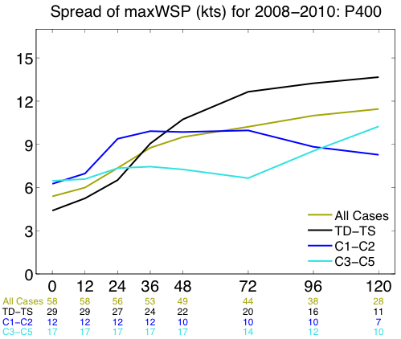
Ensemble Spread As a Function of Initial Intensity

