Slide 1
COAMPS-TC DA Ensemble
80-member ensemble for DA
GFS-EnKF lateral boundary conditions
45-15-5 km 2-way interactive nests for each storm
Atlantic, EastPac, and WestPac
Nest relocated to ensemble mean position for DA
Serial EnKF (DART)
Two-way interactive DA – highest resolution nest defines the innovation
Observations: Surface/ship stations, cloud-track winds, aircraft data, dropsondes, radiosondes, SSMI/S and WindSat TPW
15 and 5 km nest follows storm independently for each member
GFS-EnKF fields interpolated to COAMPS grid for the initial ensemble
6-hr update cycle
Distance based localization, multiplicative based inflation

Slide 2
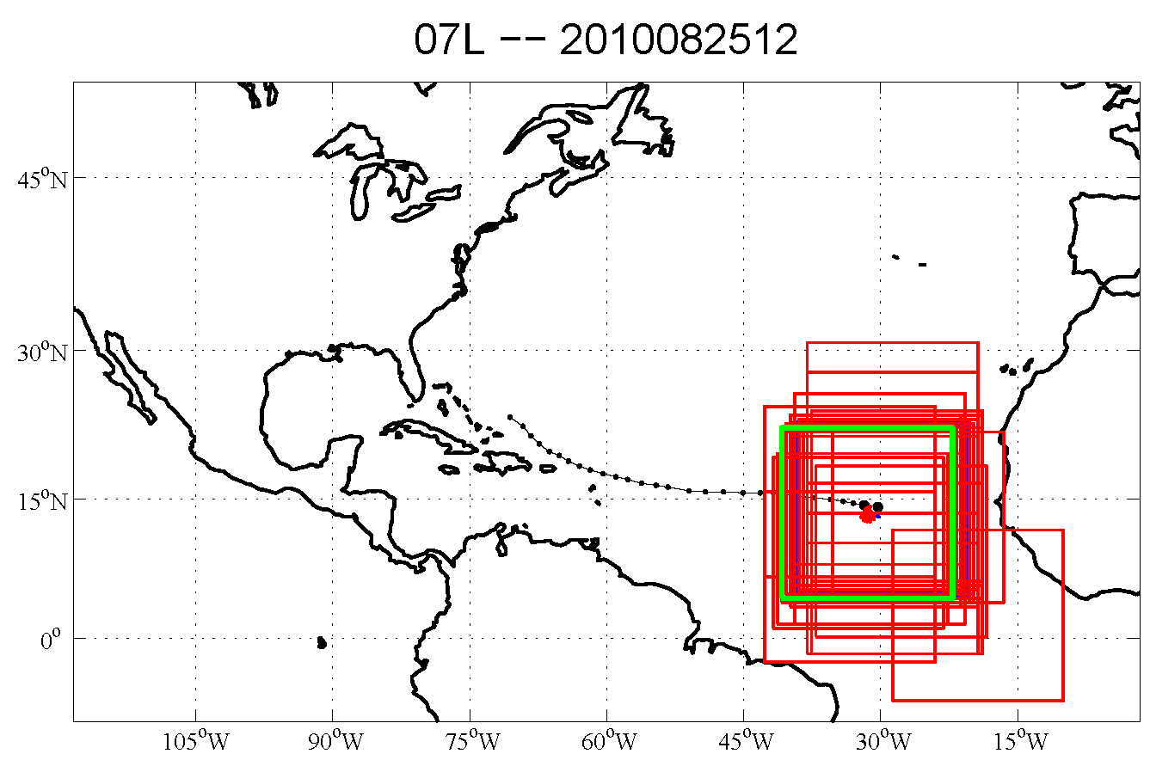
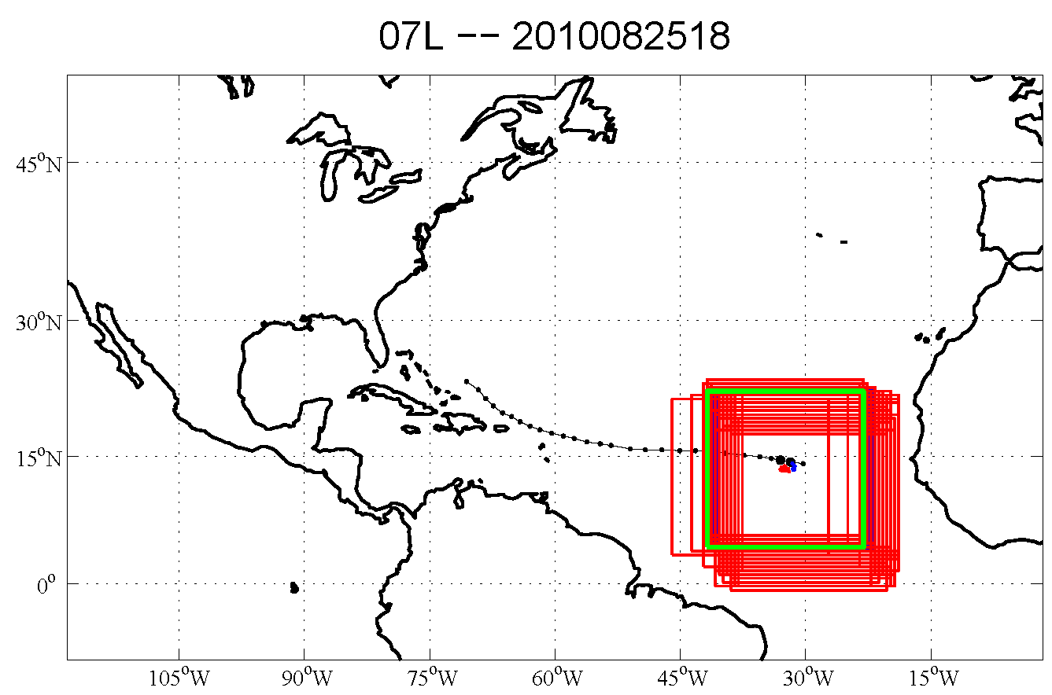
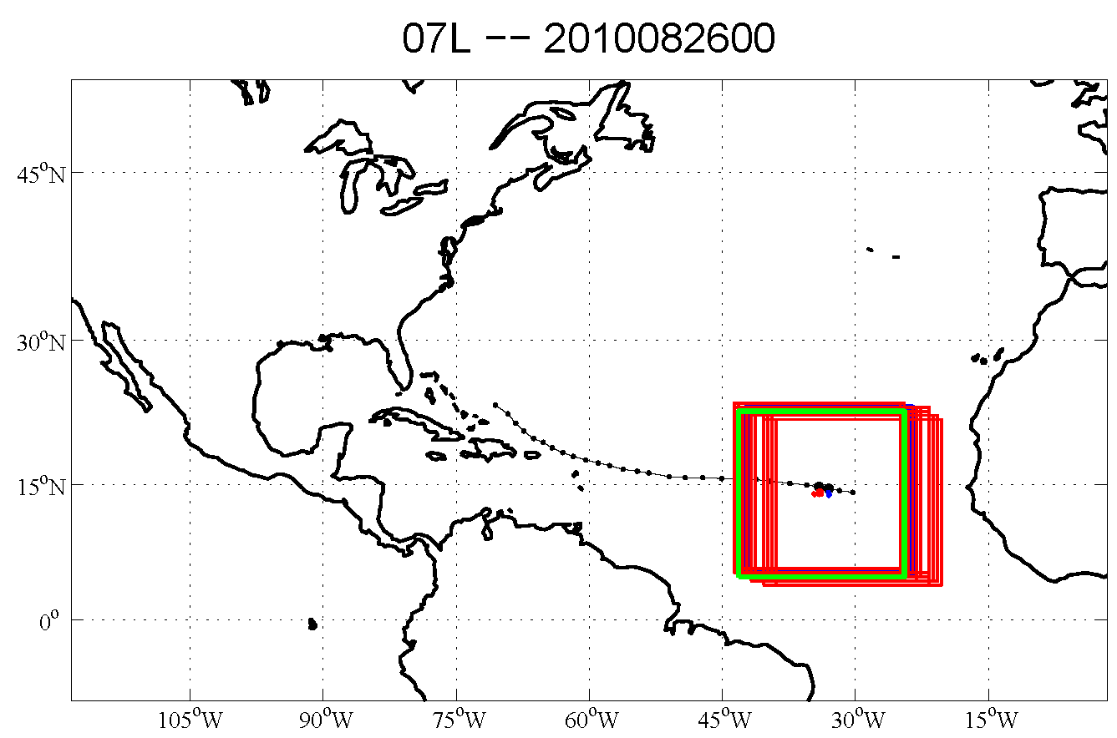
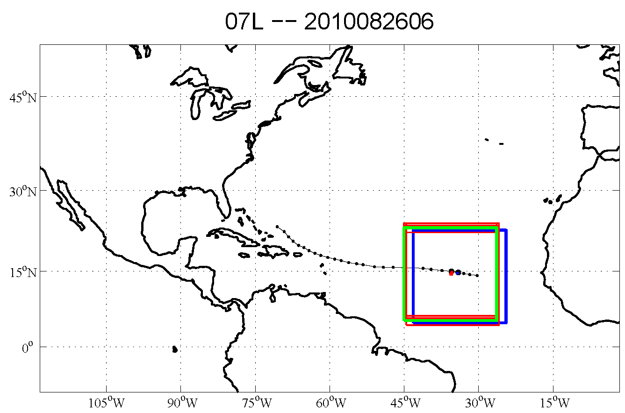
Ensemble of Moving Nests
Earl -- 2010
45-km outer domain
15-km moving nest
Best Track
Ensemble Members
Relocated Nest
For initial ensemble nests move in an inconsistent manner
As ensemble spins-up, nests location nearly converged
Each member tracks storm independently – nests not constrained to a predefined track

Slide 3
COAMPS-TC Forecast Ensemble
10-members (option to run 20-members)
120-h lead time twice daily (00 and 12 UTC)
GFS-EnKF lateral boundary conditions
Perturbations
IC perturbations from member 1-10 of the DA ensemble
No perturbations to model parameterizations
Graphics output to web
15 and 15 km mesh graphics computed in storm relative coordinate
Summary plots for intensity, size, and track

Slide 4
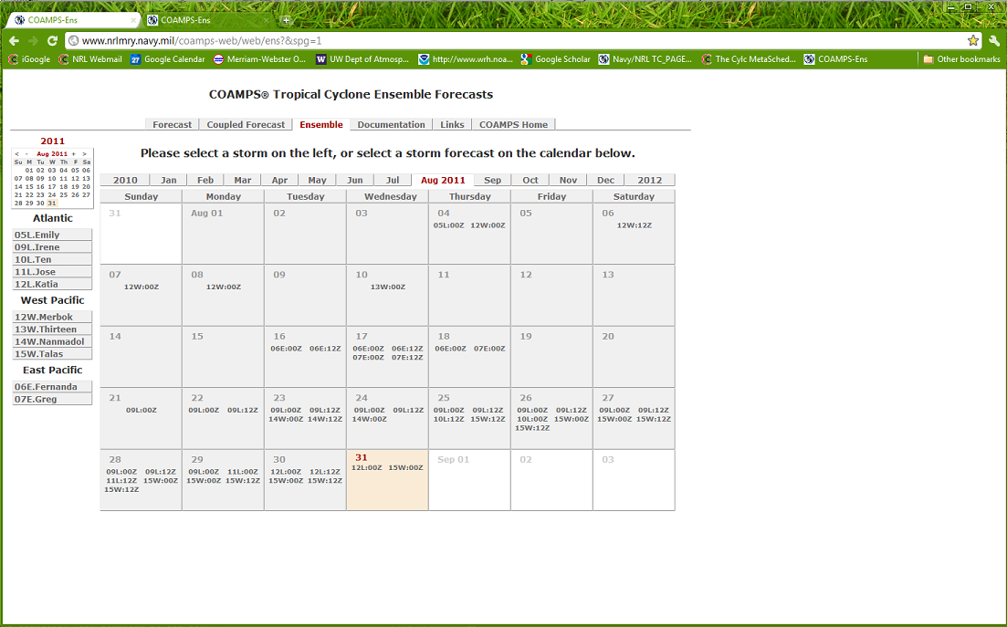
Web Page Interface
http://www.nrlmry.navy.mil/coamps-web/web/ens?&spg=1

Slide 5
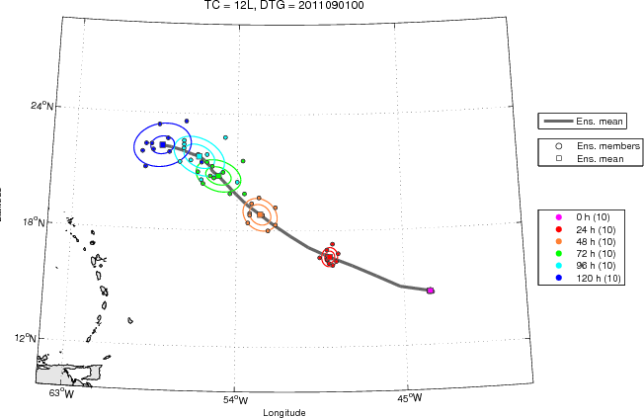
Real-time Katia Forecast

Slide 6
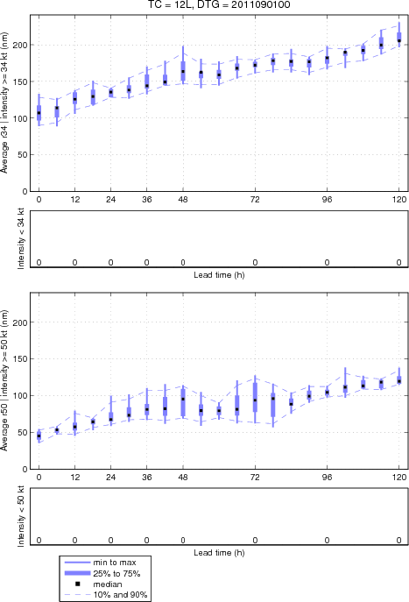
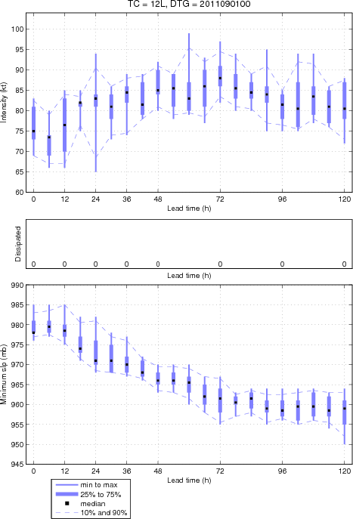
Storm radius
Storm intensity

