Slide 1
HFIP Regional Ensemble Call Audio = 800-857-6535 Passcode = 71511 Meeting ID: 492-533-786
24 September 2012 – Noon Mountain Time (1800 UTC)

Slide 2
HFIP Regional Ensemble Call
Agenda
Real-time Basin Scale Ensemble (Brian Etherton)
Ensemble based products (Andrea Schumacher)
Visualization of products (Paula McCaslin)

Slide 3
HFIP Ensemble Design Subgroup Update on Real-time Ensemble
Brian Etherton
September 24, 2012 Conference Call

Slide 4
Reservations on s-jet
Conversion of basin-scale scripts from t-jet/zeus to s-jet on going.
Big thanks to Sam Trahan
HWRF ran end-to-end this morning
Full ensemble test later today
Cycling of perturbations code worked on t-jet, need to port over to s-jet
Goal is fully functioning on October 1

Slide 5
HFIP Ensemble Product Subgroup Update on Prototype Products
Mark DeMaria and Andrea Schumacher
September 24, 2012 Conference Call

Slide 6
2 Prototype Ensemble Products Available on the HFIP Product Web since early August 2012
Genesis ensembles from global models
T. Marchok lead (GFDL)
Tracker run on multiple global model ensembles
Hybrid dynamical-statistical wind speed probabilities
A. Schumacher, M. DeMaria (co-leads)
Operational NHC wind speed probability model with statistical tracks replaced by global model ensemble tracks

Slide 7
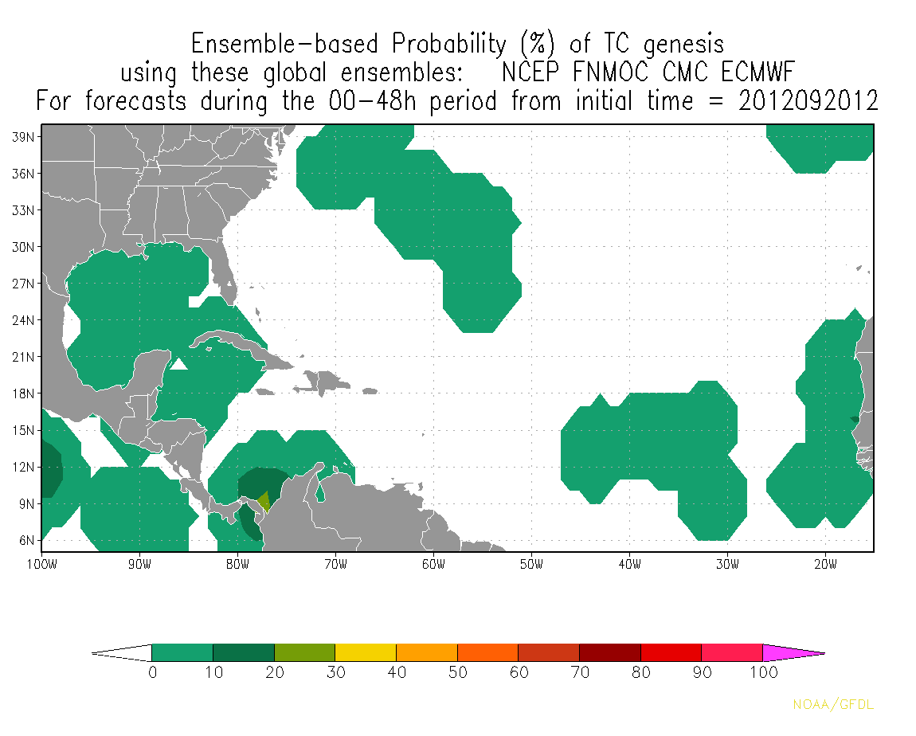
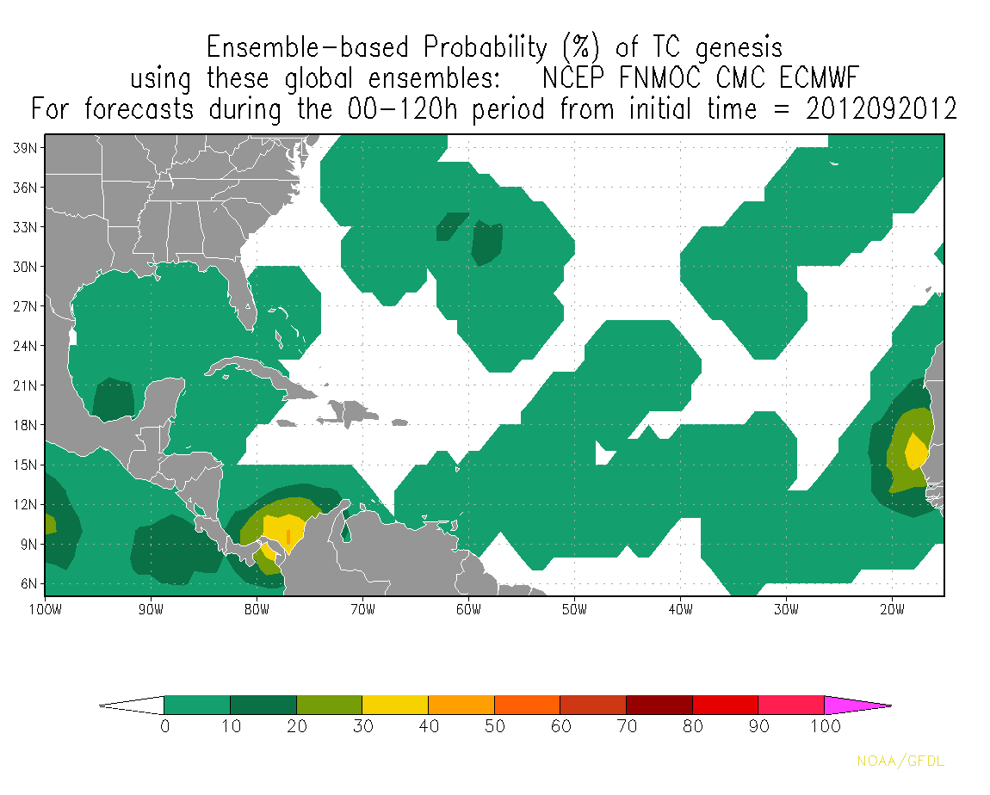
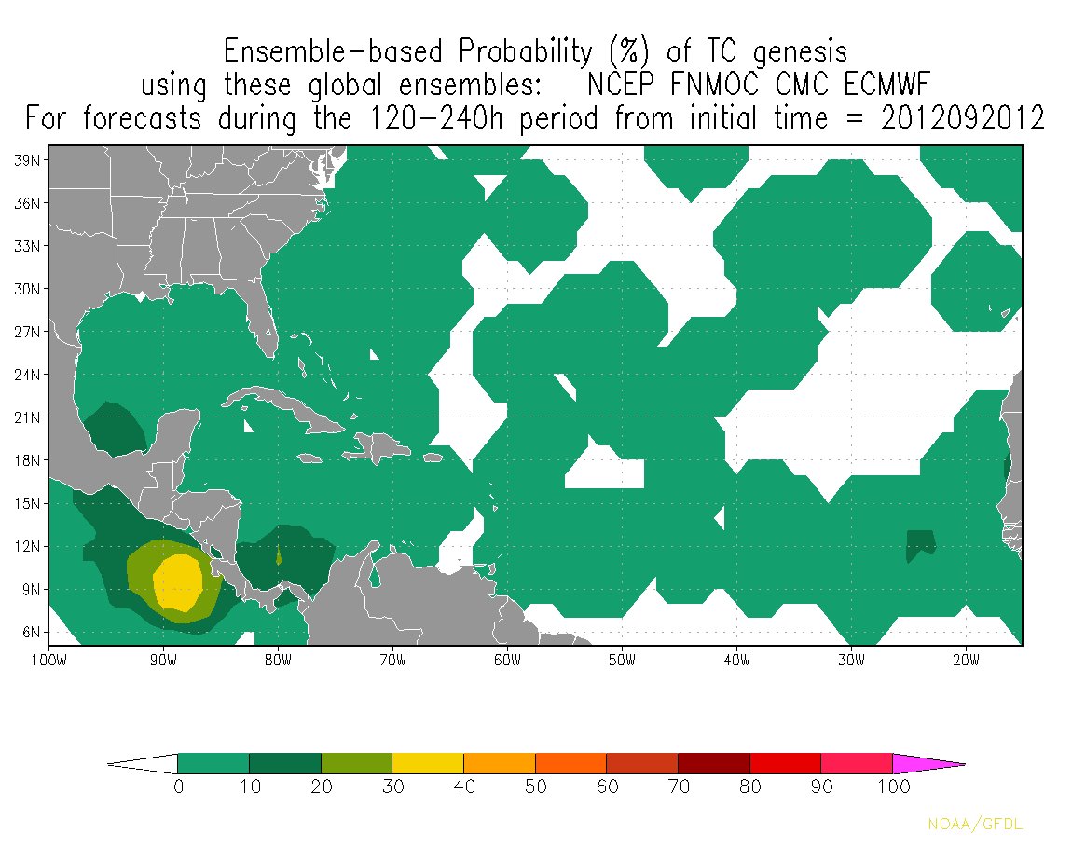

Slide 8
Hybrid statistical-dynamical wind speed probabilities
Overview
Replace statistical realization tracks with global model ensemble trakcs
133 tracks used: GFS (20), CMC (20), EMCWF (50), FNMOC (20), and UKMET (23)
Status
Available since 21 Aug 2012
Displayed in real-time on HFIP experimental products web page: http://www.hfip.org/products/
“Ensemble Model Probability” tab
Issue with latency / availability of global model ensemble tracks
Latency ~ 10 hours after synoptic time (0 and 12Z)
Finding UKMET often late (up to 2 days late)
Developing provisional product that will run with whatever ensemble tracks are available (should be running later this week)

Slide 9
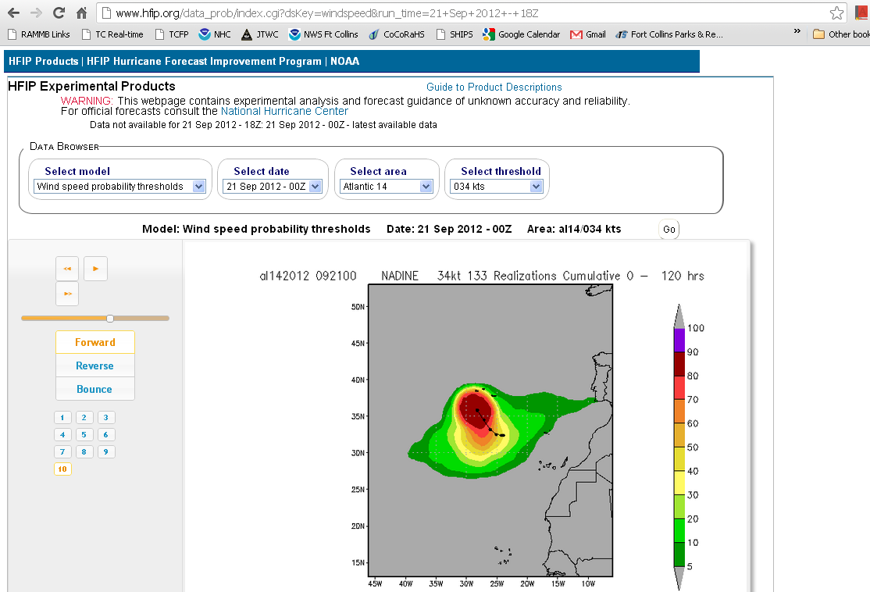
Screen shot on 21 Sep 2012 http://www.hfip.org/products/ “Ensemble Model Probability” Tab

Slide 10
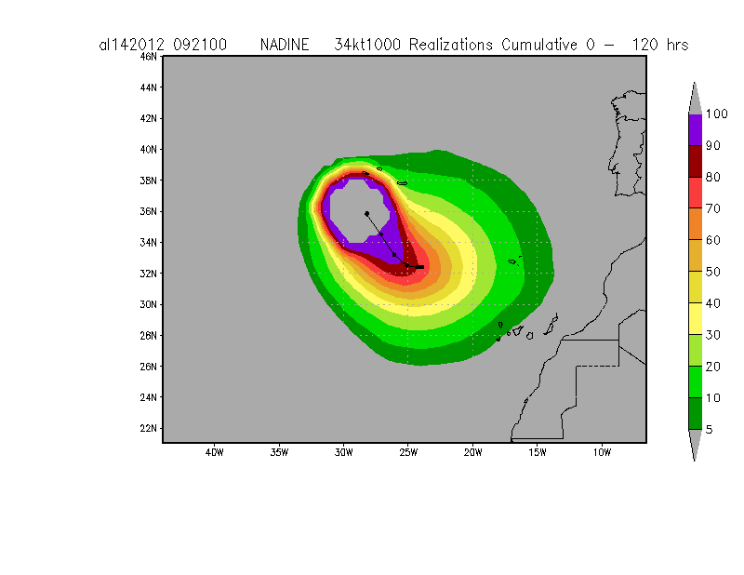
Screen shot on 21 Sep 2012 http://www.hfip.org/products/ “Ensemble Model Probability” Tab

Slide 11
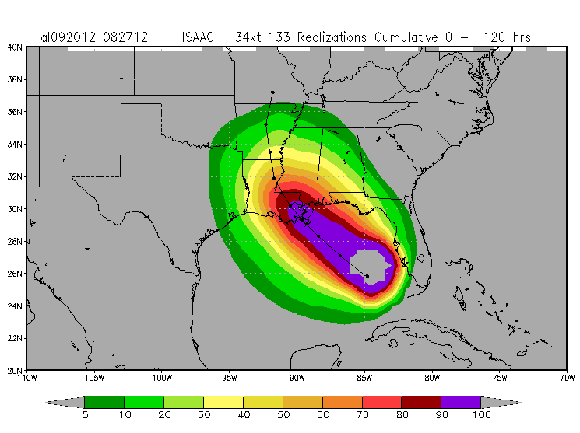
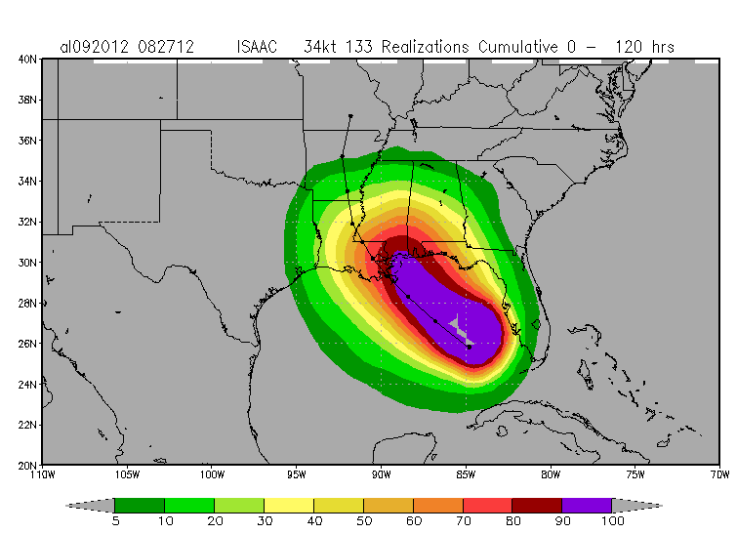
Example: 0-120h cumulative 34-kt wind speed probabilities Isaac, 8/27/12 12Z
Operational WSP
Hybrid WSP

Slide 12
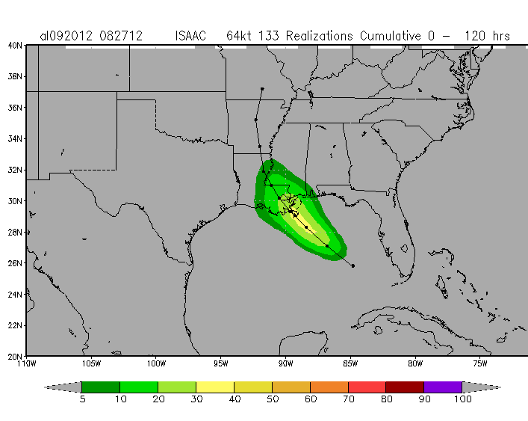
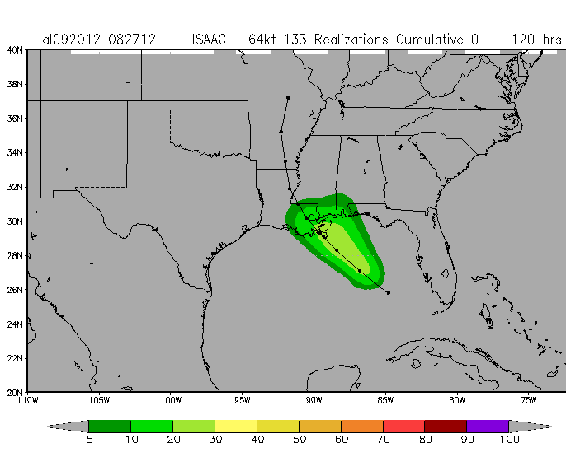
Example: 0-120h cumulative 64-kt wind speed probabilities Isaac, 8/27/12 12Z
Operational WSP
Hybrid WSP

Slide 13
HFIP Ensemble Design Subgroup Update on Visualization
Paula McCaslin
September 24, 2012 Conference Call

Slide 14
HFIP Regional Ensemble Call
Next Call
Tentatively scheduled for Monday, October 29th, at the same time.
Meeting summaries/presentations to be located here: http://rammb.cira.colostate.edu/research/tropical_cyclones/hfip/add_conference_call_summaries.asp
Other HFIP/hurricane calls this week:
HFIP All – Wednesday: Tim Marchok (GFDL) discussing the new Genesis product, Xuguang Wang (OU) describing her recent work with the hybrid DA.
AOML/DA – Thursday: Mingjing Tong (EMC) - results from EMC parallel test, Sim Aberson (AOML) - results from HEDAS

