Slide 1


2011 NHC Proving Ground Products Red-Green-Blue (RGB) Air Mass and Dust Products John Knaff

Slide 2
Red-Blue-Green (RGB) Products
Air Mass
Dust/Microphysics
MSG
Ch 5 (6.25µm), 6 (7.35µm), 8 (9.66µm), 9 (10.8µm)
R = WV6.25 - WV7.35 (-25 to 0 K)
G = IR9.66 - IR10.8 (-40 to +5 K)
B = WV6.25 (243 to 208 K)
Detect the position of jet streams and areas of dry descending stratospheric air with high PV (red areas)
Discriminate tropical air masses (i.e., rich-ozone tropical air mass vs. low-ozone polar air mass)
Discriminates subtropical air masses (dryer subtropics vs. moister tropics)
Detect typical WV features like cold lows, deformation zones and wave features
Clouds heights can also be inferred by brightness
MSG
Ch 7 (8.7µm), 8 (9.66µm), 9 (10.8µm), 10 (12.0µm)
R = IR10.8 – IR12.0 (-2 to 4 K)
G = IR10.8- IR8.7 (0 to +15 K, γ=2.5)
B = IR10.8 (261 to 289 K)
Dust appears as purple, pink or magenta
Generally thicker dust clouds appear as dark magenta or purple
Level, thickness, and phase (ice/water) can be inferred.
Animation helps to confirm moving features

Slide 3
RGB Airmass Product Interpretation of Colors
Thick, high-level clouds
Thick, mid-level clouds
Thick, low-level clouds
(warm airmass)
Thick, low-level clouds
(cold airmass)
Jet (high PV) Cold Airmass Warm Airmass Warm Airmass
Deeper Moisture Shallower Moisture
Copyright EUMETSAT

Slide 4
Dust Microphysics: Interpretation of Colors for High-level Clouds
Cold, thick, high-level clouds
Thin cirrus clouds / contrails
over vegetated land/ocean over sand desert
Ocean Warm Desert Cold Desert Warm Land Cold Land
Dust Microphysics:Interpretation of Colors for Low/Mid-level Clouds
Night
Thick, mid-level cloud
Thin, mid-level cloud
day
Day
Low-level cloud
(cold atmosphere, Europe)
Low-level cloud
(warm atmosphere, Africa)
Dust Storm
Ocean Warm Desert Cold Desert Warm Land Cold Land
Copyright EUMETSAT

Slide 5
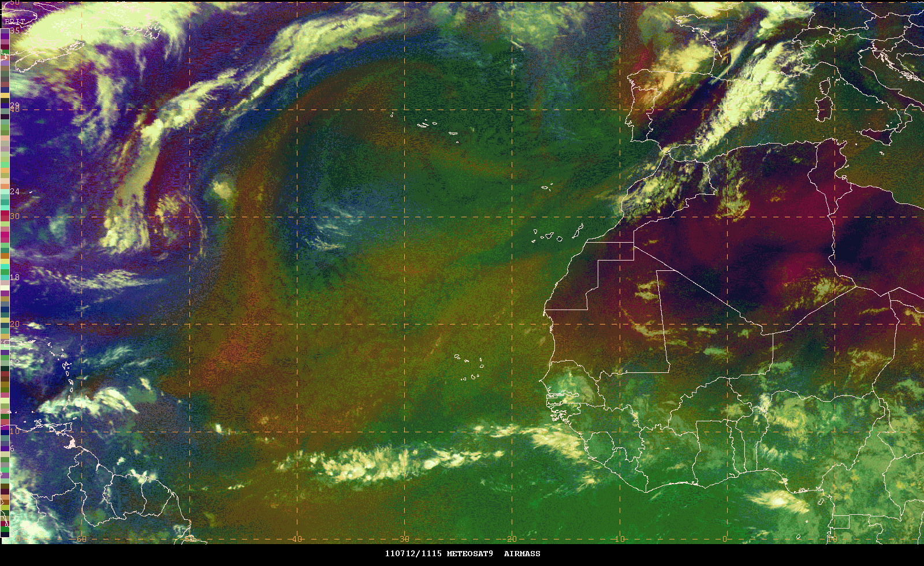
Cooler airmass
Limb effects
Hot Dry
Warm dryer
Warm moist

Slide 6
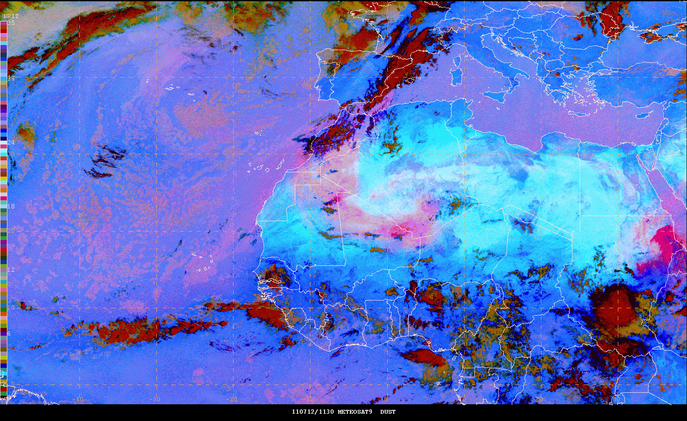
Low clouds
Over
ocean
DUST – hot background
High cloud
Mid-level clouds

