Slide 1


2011 NHC Proving Ground Products Super Rapid Scan Imagery John Knaff

Slide 2
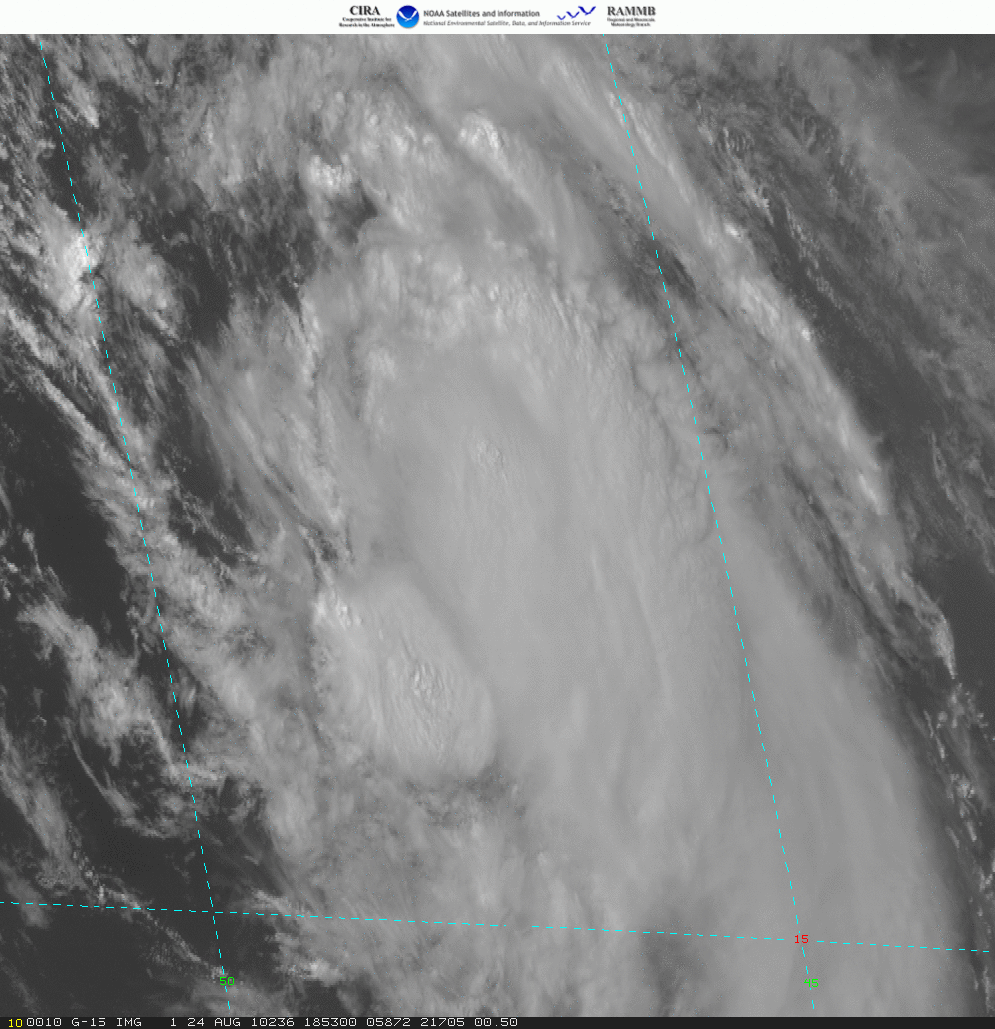
Super Rapid Scan Imagery GOES-15
Captures evolution of short lived convective features
Captures development of new convective features
Enables feature/cloud tracking near the eyewall
Current Capabilities:
Two 8 minute bursts an hour complementing the routine and Rapid Scan (~ 7 min) imagery.
Limitations:
Cannot be called if TS/H Watch/Warnings are up, or if there is a moderate severe wx threat in the U.S.
Plans:
Try to get a good rapid intensification case.
Try to get good landfalling TC case
Hurricane Danielle (2010) 24 August 18:53 to 19:55 UTC
POC: John Knaff, Mark DeMaria, Dan Lindsey

Slide 3
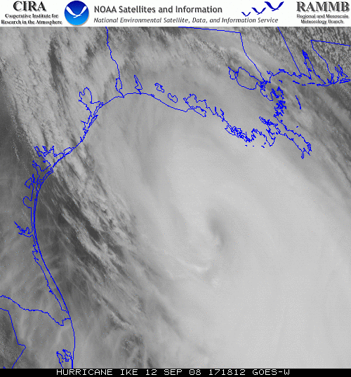
Super Rapid Scan Imagery GOES-W Hurricane Ike 12 September 2008 1718 UTC to 2250 UTC
For the Proving Ground
SRSO will be displayed in
NAWIPS
Web

Slide 4
Super Rapid Scan Imagery during 2010 Hurricane Season
2010 SRSO cases: Earl, Danielle, Igor and Karl
No SRSO at hurricane landfall in 2010
SRSO data availability valuable for testing operational systems
SRSO data were valuable for testing internet data pulls vs. local data pulls. NHC may not have a ground station in the future.

Slide 5
NHC Proving Ground Product Demonstrations
HIE → webpage at UW-CIMSS
TOT → webpage at UW-CIMSS
SAL → webpage at UW-CIMSS / GoogleEarth
Pseudo Natural Color → webpage at UW-CIMSS
GOES Natural Color → RAMMB TC real-time webpage
RGB Air Mass & Dust → NAWIPS / GoogleEarth
RII → RAMM ftp site
SRSO → NAWIPS / RAMMB webpage
UW-CIMSS :
http://cimss.ssec.wisc.edu/goes_r/proving-ground/SPC/SPC.html
RAMMB TC real-time webpage:
http://rammb.cira.colostate.edu/products/tc_realtime/
Note:
Additional
product
descriptions
on webpages

